Slide 1


How to use this PowerPoint (1)
This is the first of four lessons from Brian Conaghan on creative writing for young people. You can find the rest via the Scottish Book Trust website:
  Lesson 1: Developing your writing skills
  Lesson 2: Developing your writing style
  Lesson 3: How to write with empathy
  Lesson 4: Developing your editing skills
Each PowerPoint shares tips that can be used throughout a pupil’s writing experience, as well as activities you can do in your class or library. Where possible, we have highlighted how long an activity takes. Please do adapt this based upon the pupils you work with and/or if you would like to add in some time for reflection.
Feel free to use this entire PowerPoint as one lesson, or to dip in and out and use some of the tips and activities. For this specific lesson, we do recommend that pupils have a piece of writing with them that they can use for some of the activities. You can use Lessons 1 and 2 to create
these.
scottishbooktrust.com

Slide 2

How to use this PowerPoint (2)
Please note, slide 8 suggests some short stories your pupils can read to understand structure. As with all our resources, we suggest you read any texts before you use them with your class.
“Domestic Magic (Or Things My Wife and I Found Hidden In Our House)” by Kirsty Logan
“Story of Your Life” by Ted Chiang
“The Red Door” by Iain Crichton Smith
Uses the “Notes” function at the bottom of the screen to learn more about the texts.
scottishbooktrust.com
Notes:
“Domestic Magic (Or Things My Wife and I Found Hidden in Our House” by Kirsty Logan
Originally published in the collection Things We Say In the Dark, also available through Dark Magazine online.
This horror story is structured around objects that the narrator and her wife, Alice, find in a house they have inherited from Alice’s grandmother. As the story progress, the objects become more and more unusual. The items also reveal more about the grandmother who left the house to the couple. At the climax of the story, the main character and her wife to discover that Alice’s grandmother, who left them the house, was a kelpie.
This story is a great way to examine how a story can be structured around a list. Each heading is one of the items that the narrator and her wife find in the house (e.g. ‘1. A Ring’, ‘2. Paper’). This allows each item to provide a jumping off point for the next section of the story.
“The Story of Your Life” by Ted Chiang
Originally published in the collection Stories of Your Life and Others, also adapted into the film “Arrival” (2016).
This sci-fi short story is narrated by Louise, a linguist and addressed to her daughter (‘you’). The plot moves between her memories of her time working with aliens to understand their language and memories of her daughter. The story uses unusual tenses, for example: ‘I remember a conversation we’ll have when you’re in your junior year of high school.’
As Louise learns more of the alien language, she realises the aliens do not experience time as we do, but instead experience everything all at once. By learning the language, Louise is able to do the same. The memories of her daughter have not happened yet but are, instead, her able to see into her own future.
Though this short story is on the longer side (roughly 60 pages), its an excellent example of how a story can be structured using different times, tenses and parallel plotlines. You could also use the film (rated 12) to examine how this structuring is captured by the films use of flashbacks.
“The Red Door” by Iain Crichton Smith
Published in The Black and the Red and The Red Door: Complete English Stories, 1949-76
This short story is set in a small rural village in Scotland, and takes place the morning after Hallowe’en, when the protagonist Murdo notices that his door has been painted red during the night. This realisation causes him to reflect on his life in the conservative community and how his desire to fit in has caused him to lose his own identity. The village can be seen as a microcosm of society and how a society with strict rules can cause people to lose themselves of self.
This is a very short story, roughly 6 pages, but you can use it to look at the order of events. The story opens with Murdo seeing the door but his focus zooms out – the door comes to represent his village, society and the purpose of life more generally. By the end of the story, he has focused back on the door again. You could ask you pupils to note how each paragraph shifts focus and how the story progresses.

Slide 3
Curriculum for Excellence (1)
Activity 1: Structural edit
LIT 3-16a/4-16a, LIT 3-20a/4-20a, LIT 3-23a/4-23a,
LIT 3-24a/4-24a
Activity 2: Read to a partner
LIT 3-04a/4-04a, LIT 3-23a/4-23a
Activity 3: Edit for clarity
LIT 3-23a/4-23a, LIT 3-24a/4-24a
Activity 4: Highlighting edit
LIT 3-23a/4-23a, LIT 3-24a/4-24a
scottishbooktrust.com

Slide 4
Curriculum for Excellence (2)
Activity 5: Practice dialogue
LIT 3-04a/4-04a, LIT 3-07a/4-07a, LIT 3-23a/4-23a
Activity 6: Show the reader
LIT 3-04a/4-04a, LIT 3-07a/4-07a, LIT 3-16a/4-16a,
LIT 3-23a/4-23a
Activity 7: Showing edit
LIT 3-07a/4-07a, LIT 3-16a/4-16a, LIT 3-23a/4-23a
scottishbooktrust.com

Slide 5

Reading Schools
If you are taking part in Reading Schools, using this resource could help you deliver the following key areas of the framework:
2.2.2 Interdisciplinary book projects
2.3.4 Opportunities for learners to respond to what they’re reading
scottishbooktrust.com

Slide 6

Brian Conaghan’s creative writing lessons
Lesson 4: Developing your editing skills
scottishbooktrust.com

Slide 7
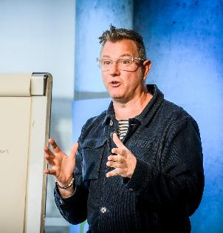
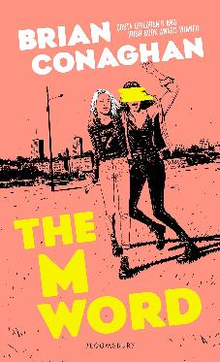
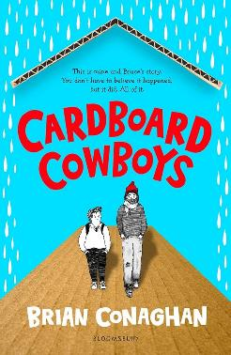
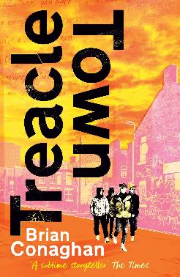
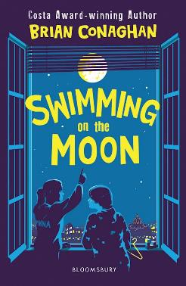
Introduction
Hello, I’m Brian Conaghan and, among other
things, I’m an author (you can see some of my
books below!) as well as a Reading Schools
ambassador.
These lessons gather some of my advice and ideas for
developing your creative writing. This time we’ll be looking at editing skills including structuring your work, showing instead of telling and improving your dialogue.
scottishbooktrust.com

Slide 8

Tip 1: Edit for structure first (1)
Your story’s structure is the order in which plot events are told to the audience.
As we’ll explore in this lesson, you want to edit your work in multiple rounds. But it’s important to edit for structure first.
Use the BBC Bitesize guide to find out more about story structure.
scottishbooktrust.com

Slide 9
Tip 1: Edit for structure first (2)
Good stories to look at for structure:
“Domestic Magic (Or Things My Wife and I Found Hidden In Our House)” by Kirsty Logan
Notice how the story is structured by each different object the narrator finds
“Story of Your Life” by Ted Chiang
Notice how the author uses different time periods to move through the plot
“The Red Door” by Iain Crichton Smith
Notice how the writer zooms in and out of the image of the door
scottishbooktrust.com

Slide 10


Activity 1: Structural edit
30+ minutes
Use these questions to edit a piece of your writing.
Does the story’s structure make sense? Is this story told in the right order?
Are there clear beginnings, middles and ends?
Does the plot progress logically?
Is there consistency in
pacing?
scottishbooktrust.com

Slide 11

Tip 2: Read out loud
Reading your work out loud can help you catch:
Awkward phrasing
Run-on sentences
Repetition
Unnatural dialogue
scottishbooktrust.com

Slide 12

Activity 2: Read to a partner
15 minutes
Read your work out loud. Even if you don’t have an audience, it’ll help you catch what’s not flowing!
Underline anything you think doesn’t sound right and revisit them later.
scottishbooktrust.com

Slide 13

Tip 3: Eliminate any unnecessary words (1)
The more concise your writing is, the more clear and powerful it is.
Extra words often weaken sentences.
scottishbooktrust.com

Slide 14
Tip 3: Eliminate any unnecessary words (2)
Original
The dog, which was brown and fluffy, with a tail that wagged quickly whenever someone would throw the ball, ran excitedly to catch the toy.
Edit 1
The dog was brown and fluffy and it ran excitedly to catch the ball.
Edit 2
The brown fluffy dog raced towards the ball, its tail wagging in excitement.
Which edit do you prefer. Why?
scottishbooktrust.com

Slide 15
Tip 3: Eliminate any unnecessary words (3)
Edit 1
The dog was brown and fluffy and it ran excitedly to catch the ball.
This is bad editing. You can see that whilst the sentence is technically correct, it lacks flow and vividness. It simplifies the sentence without enhancing clarity or detail.
Edit 2
The brown fluffy dog raced towards the ball, its tail wagging in excitement.
This is good editing. It’s concise yet descriptive, it removes unnecessary words, improves flow and keeps the image clear.
scottishbooktrust.com

Slide 16

Activity 3: Edit for clarity (1)
15 minutes
Example 1:
She sat down on the floor. She really felt very tired. Her body was as heavy as a large and grey stone.
Edit this paragraph to make it shorter and more
concise.
scottishbooktrust.com

Slide 17
Activity 3: Edit for clarity (2)
15 minutes
Example 2:
The box was completely full of books. When he looked up, there was a great number of moths flying around the room.
Edit this paragraph to make it shorter and more
concise.
scottishbooktrust.com

Slide 18
Activity 3: Edit for clarity (3)
15 minutes
Example 3:
Quickly, she ran down the road. There was something chasing her, she thought. It was completely terrifying, too small for her to see without turning her head. She didn’t want to look at it.
Edit this paragraph to make it shorter and more
concise.
scottishbooktrust.com

Slide 19

Tip 4: Edit your work in multiple rounds
Each round of editing sharpens your work – plus trying to do it all in one go can be a bit overwhelming!
Edit your work in the following passes:
Structure
Character
Dialogue
Syntax and language
Grammar
scottishbooktrust.com

Slide 20

Activity 4: Highlighting edit
15 minutes
Use a highlighter to go through your piece of writing, highlighting any words you notice that you use often. Then, as you read back, you can decide if they’re essential or can be removed.
scottishbooktrust.com

Slide 21
Tip 5: Dialogue flow (1)
Original
"I don't think that's a good idea," she said, her voice uncertain, as she looked down at the ground, shuffling her feet, not sure what to do.
Edit 1
"I don’t think that's a good idea," she murmured, glancing at the ground.
Edit 2
"I don't think that's a good idea," she said, looking down and shuffling her feet.
Which edit do you prefer. Why?
scottishbooktrust.com

Slide 22
Tip 5: Dialogue flow (2)
Edit 1
"I don’t think that's a good idea," she murmured, glancing at the ground.
This is good editing. This version trims the excess, while keeping the essential mood of the scene. It uses “murmured” instead of “said” to imply uncertainty without additional description.
Edit 2
"I don't think that's a good idea," she said, looking down and shuffling her feet.
This is bad editing. This reduces some of the original sentence but doesn’t improve clarity or focus. The action is still overly detailed for what’s needed.
scottishbooktrust.com

Slide 23
Activity 5: Practice dialogue (1)
15 minutes
“I do not care anyway. I do not see what the big deal is.” she said, tapping her foot impatiently as she looked at him.
“Do not talk to me like that.” he shouted.
Edit this dialogue to make it clearer, more concise and feel more natural.
scottishbooktrust.com

Slide 24
Activity 5: Practice dialogue (2)
15 minutes
“Are you ready to order?”
“Yes, I would like the soup to start and the salad for a main.”
“And I would like the roast beef.”
“Rare or medium?”
“Well done.”
“Can I have the chicken? No potatoes, please.”
Edit this dialogue to make it clearer, more concise and feel more natural.
scottishbooktrust.com

Slide 25
Activity 5: Practice dialogue (3)
15 minutes
“How are you, Sarah?” asked Aunty Ruth.
“I’m great, Aunty Ruth. How are you?” asked Sarah.
“Great,” said Aunty Ruth. “Who is this?”
“This is my friend Julia, she is staying at my house. She wanted to ask you a question about working at the museum. Is that okay?” Sarah smiled.
Edit this dialogue to make it clearer, more concise and feel more natural.
scottishbooktrust.com

Slide 26

Tip 6: Word choice (1)
Choosing the right words can make your writing more concise and clearer.
Be aware of using intensifiers too much (“very”, “completely”, “really”). Sometimes one word can do more.
scottishbooktrust.com

Slide 27
Tip 6: Word choice (2)
Original
She was really, really mad about the situation.
Edit 1
She was very mad about the situation.
Edit 2
She was furious about the situation.
Which edit do you prefer. Why?
scottishbooktrust.com

Slide 28
Tip 6: Word choice (3)
Edit 1
She was very mad about the situation.
This is bad editing. This doesn’t improve the impact of the sentence, and "very mad" is still weak.
Edit 2
She was furious about the situation.
This is good editing. "Furious" is a stronger, more precise word than "very mad." It condenses the emotion into a single powerful word.
scottishbooktrust.com

Slide 29

Tip 7: Show don’t tell (1)
“Show don’t tell” means that your writing should show your readers what you mean instead of telling them.
This makes your prose more engaging as the reader has to do a little bit more work, rather than passively be told what’s happening.
The phrase is attributed to Anton Chekov who said: ‘Don’t tell me the moon is shining; show me the glint of the light on the broken
glass.’
scottishbooktrust.com

Slide 30
Tip 7: Show don’t tell (2)
Original
He was nervous as he stood in front of the class.
Edit 1
His hands trembled as he stood in front of the class, his heart pounding in his chest.
Edit 2
He felt nervous standing in front of the class.
Which edit is showing? Which edit is telling?
scottishbooktrust.com

Slide 31
Tip 7: Show don’t tell (3)
Edit 1
His hands trembled as he stood in front of the class, his heart pounding in his chest.
This is good editing. This version “shows” the characters nervousness by describing physical reactions, making the scene more immersive and vivid.
Edit 2
He felt nervous standing in front of the class.
This is bad editing. This is still “telling” instead of showing. It doesn’t give the reader a vivid sense of his anxiety.
scottishbooktrust.com

Slide 32

Activity 6: Show the reader (1)
15 minutes
Come up with some sentences or paragraphs which show and don’t tell something.
If you need some prompts, see the next slide.
scottishbooktrust.com

Slide 33
Activity 6: Show the reader (2)
15 minutes
Show the following:
A character is angry
The characters in the story haven’t seen each other in a long time
Two characters are trying something new; one is nervous and one is excited
A character didn’t like the gift they were given, but has to be polite
scottishbooktrust.com

Slide 34

Activity 7: Showing edit
15 minutes
Use a highlighter to go through your piece of writing, highlighting any times you notice you may have told instead of shown something to your reader.
scottishbooktrust.com

Slide 35

Recap
Editing is a crucial part of writing
Always edit your work in rounds to make sure you’ve improved each element of your story (including its structure, character, dialogue, etc.)
Check your word choices to make sure your work is concise, clear and doesn’t overuse any words
Reading your work aloud can help you spot any awkward phrasing
Always make sure your writing shows and doesn’t tell the
reader
scottishbooktrust.com

Slide 36
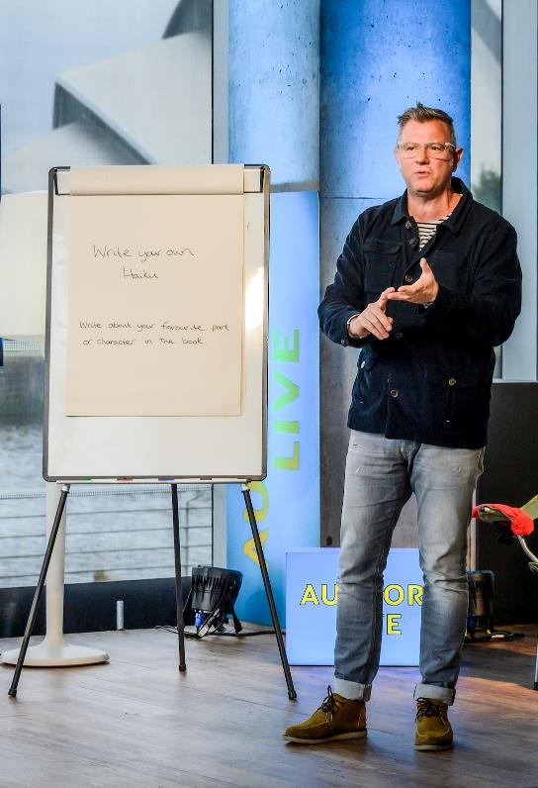
Next steps
Watch Brian Conaghan’s Authors Live
See our other Creative writing resources
Use the Young Writers section of the website for more advice, plus articles and top tips from other authors
scottishbooktrust.com

Slide 37

Thank you
scottishbooktrust.com
Scottish Book Trust is a national charity changing lives through reading and writing. Registered company SC184248 | Scottish charity SC027669

