Slide 1

Book Discovery Guide
Issue 6: February 2024
scottishbooktrust.com

Slide 2



How to use this PowerPoint
This PowerPoint version of the Book Discovery Guide (Issue 6) allows you to share the guide with your colleagues.
Each slide will contain the covers and, where applicable, age ratings of the books.
Click “Notes” at the bottom of your window to read the blurbs of each book.
scottishbooktrust.com

Slide 3
What is Book Discovery Guide?
Book Discovery Guide is our guide to help you find high-quality contemporary books for pupils of all ages and reading levels.
Each issue contains our top picks across themes, staff picks, guest recommendations and responses to frequently asked questions.
scottishbooktrust.com
Notes:
This Book Discovery Guide is here to help you find new books for pupils of all ages and reading levels.
We’ve given guidelines of which year groups might enjoy each book, but these are only guidelines and each reader will have their own reading level.

Slide 4
The importance of using contemporary books in your classroom:
More representative, which allows pupils to see themselves on page
Read about a wide range of experiences relevant to today (for example, climate change, refugee crisis, technology and the Internet)
Language is up-to-date, making it easier to follow
scottishbooktrust.com
Notes:
Using contemporary books in the classroom allows the children to see themselves on the page and read about a wide variety of experiences, and research from the Open University has shown how important teacher knowledge of contemporary books is to help pupils enjoy reading.

Slide 5
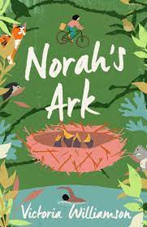
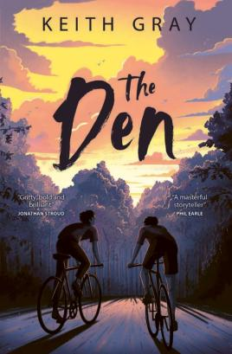
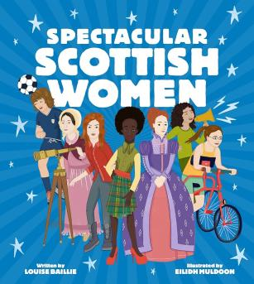
New from Scottish publishers and authors
P4+
See Spectacular Scottish Women on Browns Books
P5+
See Norah’s Ark on Browns Books
S1+
See The Den
on Browns
Books
scottishbooktrust.com
Notes:
New from Scottish publishers and authors
Spectacular Scottish Women by Louise Baillie and Eilidh Murdoch (Floris Books)
Meet 30 of Scotland’s many spectacular women from across history! Iconic figures are brought to life with vibrant illustrations and detailed fact files full to the brim with information about some of the world’s finest actors, athletes, scientists, musicians, campaigners, queens, and more. A fascinating, uplifting, and very inspiring read!
Norah’s Ark by Victoria Williamson (Neem Tree Press)
Norah and her dad live in temporary accommodation and rely on foodbanks to get by. Adam lives in a huge, beautiful house that conceals the realities of his slow recovery from leukaemia. When they stumble across a nest of motherless baby birds, their worlds collide. Norah’s Ark addresses tricky topics with hope and realism.
The Den by Keith Gray (Barrington Stoke)
Marshall and Rory are elated to uncover an abandoned underground bunker. However, when Rory spreads the news of their discovery, Marshall feels betrayed. For Rory, the den was a cool discovery. For Marshall, a safe space away from his volatile dad. As the rivalry unfurls, friendships and family relationships are tested. A gripping read from a masterful storyteller.

Slide 6
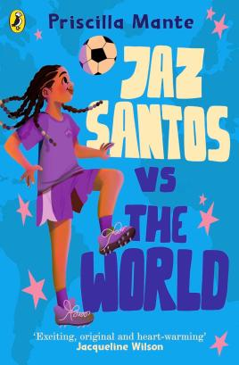
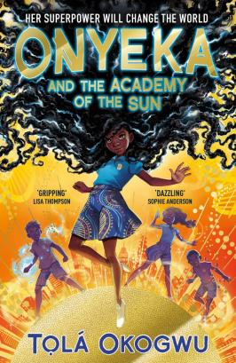
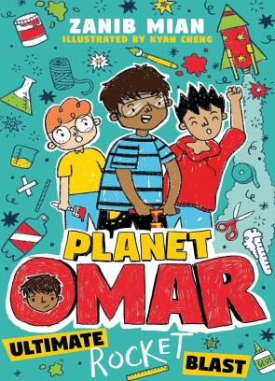
Our favourite BPOC protagonists in children’s and young adult books (1)
P5+
See Jaz Santos vs. the World on Browns books
P5+
See Onyeka and the Academy of the Sun on Browns books
P6+
See Planet Omar on
Browns books
scottishbooktrust.com
Notes:
Our favourite BPOC protagonists in children’s and young adult books
The Dream Team: Jaz Santos vs. the World by Priscilla Mante (Puffin)
Jaz has formed the Bramrock Stars, a football team destined for success. Now all she needs to do is help them work together – there's a lot of different personalities on one team! Jaz's story is heart-warming, with nuanced perspectives on fear of rejection and the blockades girls and women face in sport.
Onyeka and the Academy of the Sun by Tolá Okogwu (Simon & Schuster)
Onyeka’s hair is the subject of stares from strangers and whispers from the other kids at school. One day, when Onyeka's hair proves it has a life of its own she discovers she's a Solari, a group of mutants from Nigeria. This superhero story is full of themes of freedom, sacrifice and fighting for the greater good!
Planet Omar: Ultimate Rocket Blast by Zanib Mian (Hodder)
Hilarious playground antics starring a Muslim boy with a huge imagination. Omar is back and with the help of his friends is taking part in a national rocket building competition! Combining Omar's signature perspective with funny cartoon illustrations, this series is both heart-warming and laugh out loud.

Slide 7
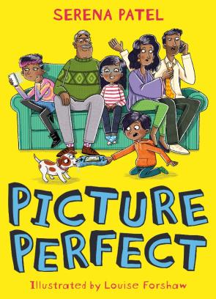
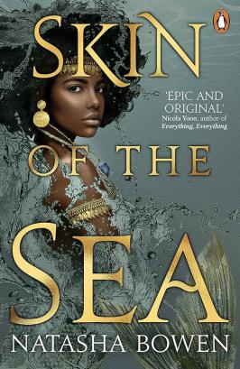
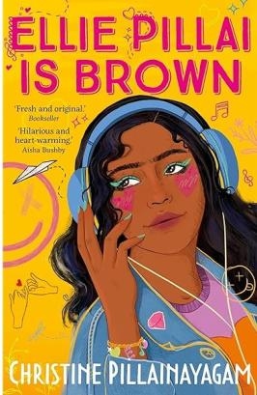
Our favourite BPOC protagonists in children’s and young adult books (2)
P6+
See Picture Perfect on Browns books
S1+
See Skin of the Sea on Browns books
S2+
See Ellie Pillai
is Brown on Browns books
scottishbooktrust.com
Notes:
Our favourite BPOC protagonists in children’s and young adult books
Picture Perfect by Serena Patel and Louise Forshaw (Barrington Stoke)
Sonal needs to take a photo of her family for a school project. When everyone is too busy doing their own thing to sit and take a picture together, she hatches a plan – a digital detox camping trip! This funny madcap adventure reminds the reader that no family is perfect.
Skin of the Sea by Natasha Bowen (Penguin Books)
Inspired by West African mythology, this story combines fantasy and romance. Simi is a Mami Wata, a mermaid who is responsible for collecting the souls of those lost at sea. When she saves the life of a boy thrown overboard, she threatens the Mami Wata rules, and puts them all in danger.
Ellie Pillai is Brown by Christine Pillainayagam (Faber & Faber)
Ellie always feels like she stands out – her life is soundtracked by her favourite songs and old movies. She's a hopeless romantic who's fallen head over heels for Ash, the new boy at school. She's also the only brown girl at her school, and faces pressure from her first-generation immigrant parents. Ellie is a wonderful example that being yourself is the best person to be.

Slide 8
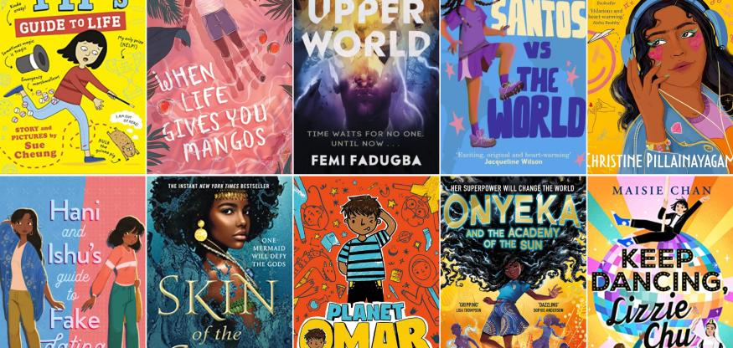
See the full book list on our website: Our favourite BPOC protagonists in children's and young adult books
scottishbooktrust.com
Notes:
To see our full list of our favourite BPOC protagonists in children and young adult books, see the book list on our website: scottishbooktrust.com/book-lists/our-favourite-bpoc-protagonists-in-childrens-and-young-adult-books

Slide 9
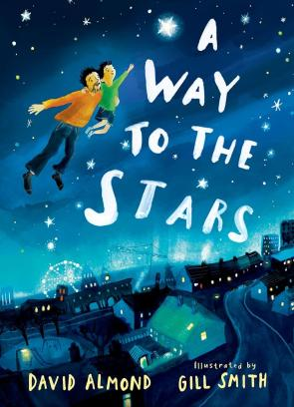
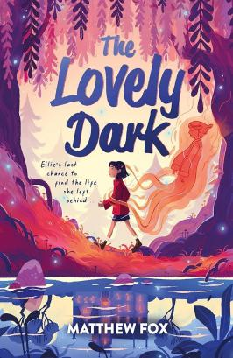
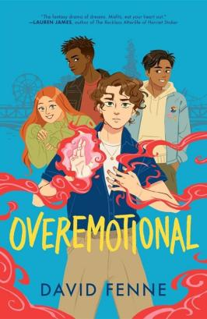
Staff picks: Jasmine Ewens
EY+
See A Way to the Stars on Browns books
P6+
See The Lovely Dark on Browns books
S3+
See
Overemotional
on Browns
books
scottishbooktrust.com
Notes:
Scottish Book Trust Staff Picks: Jasmine Ewens
A Way to the Stars by David Almond and Gill Smith (Walker Books)
A father and son duo work together to reach the stars, testing different methods. This is a beautifully illustrated, gentle book.
The Lovely Dark by Matthew Dark (Hachette)
12-year-old Ellie journeys through a fractured underworld, seeking a way back to the living after an accidental death. Poignant and captivating.
Overemotional by David Fenne (Ink Road)
A fun, fantastical LGBTQ+ coming-of-age story complete with untameable magic powers, monsters, spies, perilous adventure, and questionable first kisses.

Slide 10
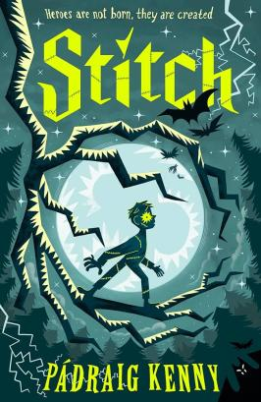
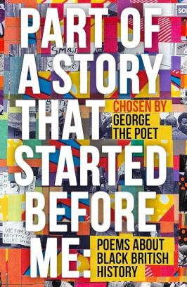
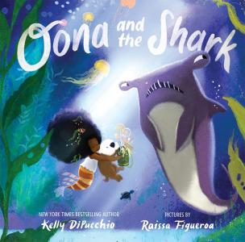
Staff picks: Maggie Still
EY+
See Oona and the Shark on Browns books
P6+
See Stitch on Browns books
S2+
See Part of a Story
that Started Before
Me on Browns
books
scottishbooktrust.com
Notes:
Scottish Book Trust Staff Picks: Maggie Still
Oona and the Shark by Kelly DiPucchio and Raissa Figueroa (HarperCollins)
This is a delightful story of a determined little mermaid and her inventions who never gives up on friendship.
Stitch by Padraig Kenny (Walker Books)
This magnificent gothic adventure will have children hooked as they read the story touching the worst and best of humanity.
Part of a Story That Started Before Me: Poems about Black British History by various, edited by George the Poet (Penguin Books)
George the poet’s exciting selection of poems about Black British history will engage, enthral, appal and delight all readers.

Slide 11
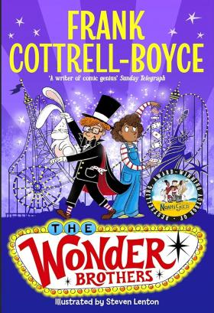
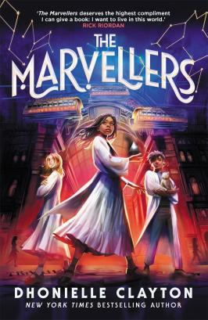
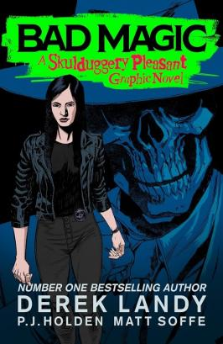
Staff picks: Liam McCallum
P4+
See The Wonder Brothers on Browns books
P6+
See The Marvellers on Browns books
S3+
See Bad
Magic on
Browns books
scottishbooktrust.com
Notes:
Scottish Book Trust Staff Picks: Liam McCallum
The Wonder Brothers by Frank Cottrell Boyce (Macmillan Children’s Books)
A hilarious magical mystery from the masterful Frank Cottrell Boyce! Budding young magicians try to un-vanish Blackpool Tower… what could go wrong?
The Marvellers by Dhonielle Clayton (Piccadilly Press)
A refreshing, new take on magical institutes and gifted children overcoming dark adversaries. A wonderfully diverse edge-of-your-seat fantasy adventure.
Bad Magic by Derek Landy (Walker Books)
Skullduggery Pleasant gets an illustrated makeover in this fantastic standalone graphic novel. Dark and mischievous, would you expect anything less?

Slide 12
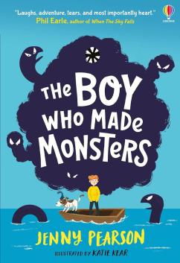
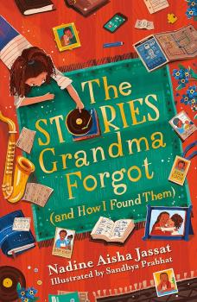
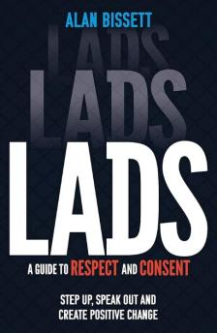
Top picks from Authors Live
P4+
See The Boy Who Made Monsters on Browns books
Watch Authors Live broadcast on the Scottish Book Trust website
P5+
See The Stories Grandma Forgot (and How I Found Them) on Browns books
Watch Authors Live broadcast on the Scottish Book Trust website
S3+
See Lads on Browns
books
Watch Authors
Live broadcast
on Scottish
Book Trust website
scottishbooktrust.com
Notes:
Top picks from Authors Live
Authors Live is a series of world class children’s author and illustrator events brought directly to your classroom, library or home for free, live on the web. We’ve complied some of the latest releases from recent guest authors all guaranteed to excite and engage your readers.
The Boy Who Made Monsters by Jenny Pearson (Usbourne Publishing)
When their parents go missing, Benji and Stanley move in with their uncle next to Loch Lochy. Benji believes if he tries hard enough, he can prove two impossible things: the Loch Lochy monster exists, and his parents will come home. A tender read that will make you laugh and cry all at once.
The Stories Grandma Forgot (And How I Found Them) by Nadine Aisha Jassat (Orion Children’s Books)
Nyla understands that grandma’s memory is changing due to Alzheimer's. But when her grandma swears that she’s seen Nyla’s dad, Nyla knows she must investigate – because, according to everyone else, her dad is dead. This gorgeous verse novel explores grief, identity, family, community, and joy as Nyla works to unravel the family mystery.
Lads: A Guide to Respect and Consent by Alan Bissett (Wren & Rook)
This straight-talking guide acts as a toolkit for boys navigating their teenage years. Alan Bissett discusses ‘locker room talk’, calling out unacceptable behaviour among friends, treating people with respect and becoming your best self. A relevant, honest, and unpatronizing look at a culture of misogyny and how to be part of the solution.

Slide 13
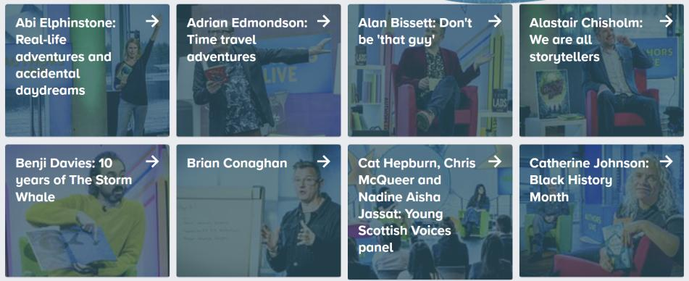
Visit the Authors Live on Demand library to catch up on author and illustrator broadcasts
scottishbooktrust.com
Notes:
For more on demand broadcasts with world class illustrators and authors, see the Authors Live on Demand library on the Scottish Book Trust website: scottishbooktrust.com/authors-live-on-demand

Slide 14
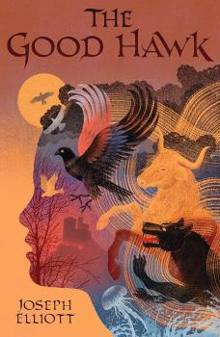
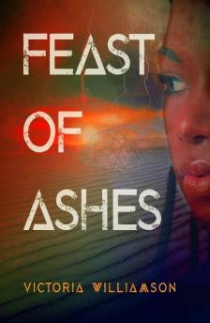
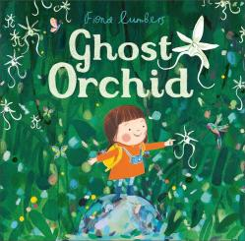
Top picks from Scottish Friendly’s Children Book Tour
EY+
See Ghost Orchid on Browns books
P7+
See The Good Hawk on Browns books
S1+
See Feast of Ashes on Browns books
Discover our upcoming school events, opportunities and tours on the Scottish Book Trust website
scottishbooktrust.com
Notes:
Top picks from Scottish Friendly Children’s Book Tour
The Scottish Friendly Children's Book Tour brings authors, illustrators and a variety of other creative practitioners to schools, libraries and public venues. We’ve complied some of the latest releases from recent guest authors all guaranteed to excite and engage your readers.
Ghost Orchid by Fiona Lumbers (Andersen Press)
‘Hurry, Ava, hurry!’ is the rallying cry of Ava’s parents as they rush through the wilderness to find a rare ghost orchid. With all that hurrying, though, they miss the beautiful things that Ava notices along the way. This thoughtfully illustrated book encourages readers to appreciate the journey as much as the destination.
The Good Hawk by Joseph Elliott (Walker Books)
In a mythical ancient Scotland, unlikely heroes Agatha and Jaime must travel over land and sea to rescue members of their clan who have been kidnapped.
The Good Hawk kicks off an exciting trilogy with endearing, believable characters, a rich and fantastical setting, and plenty of captivating action.
Feast of Ashes by Victoria Williamson (Neem Tree Press)
It’s the year 2123 and Adina has accidentally incinerated the eco-bubble that housed her whole community. As Adina treks across the barren wasteland to find safety, she comes to realises that the outside world isn’t quite as deserted as she was led to believe…
One for fans of spine-tingling dystopian fiction.

Slide 15
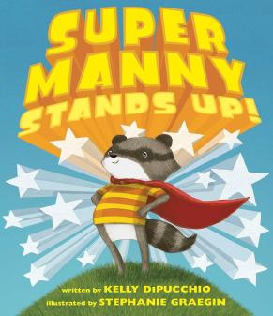
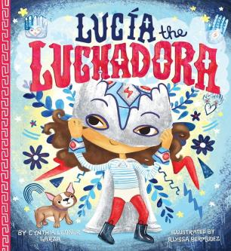
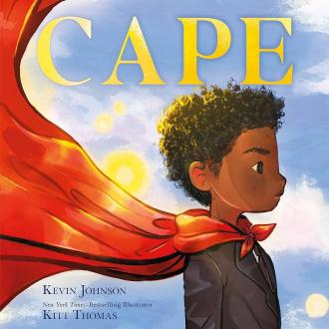
What to read if they like… superheroes! (1)
P1-3
See Super Manny Stands Up! on Browns books
P1-4
See Lucia the Luchadora on Browns books
P2-5
See Cape on Browns
books
scottishbooktrust.com
Notes:
What to read if they like… superheroes!
Super Manny Stands Up! by Kelly DiPucchio and Stephanie Graegin (Atheneum Books for Young Readers)
This beautifully illustrated picture book follows Manny, a young racoon who loves superheroes. When he encounters a bully at school, he learns what being a hero really means.
Lucia the Luchadora by Cynthia Leonor Garza and Alyssa Bermudez (POW!)
The boys at Lucia’s school tell her she can’t be she’s a superhero because she’s a girl. Lucia’s abuelo tells her she’s from a family of luchadoras – but with that title, comes the job of fighting for what is right.
Cape by Kevin Johnson and Kitt Thomas (Roaring Brook Press)
When faced with an overwhelming loss, a young boy uses his superhero cape to help him feel brave.
A beautiful book about grief – reminding us that sadness doesn’t negate our strength.

Slide 16
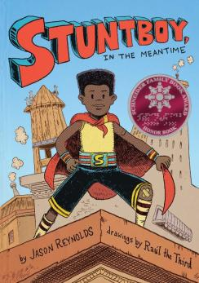
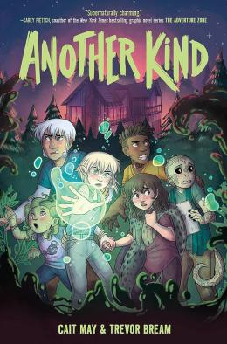
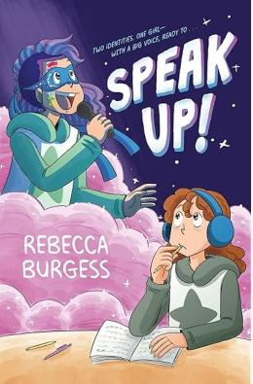
What to read if they like… superheroes! (2)
P5-7
See Stuntboy, in the Meantime on Browns books
Explore our resource on this title via our Read Woke learning resources
P6-S2
See Another Kind on Browns books
P5-S2
See Speak Up!
on Browns
books
scottishbooktrust.com
Notes:
What to read if they like… superheroes!
Stuntboy, In the Meantime by Jason Reynolds and Raúl the Third (Knights Of Media)
Stuntboy solve mysteries in his high-rise, helps friends and keeps people safe, but behind the mask is a young boy: Portico, who’s struggling to cope with his parent’s constant arguing. A comic yet heartfelt exploration of anxiety and relationships.
Another Kind by Cait May and Trevor Bream (HarperAlley)
In a secret facility live six superhuman children live happily: until a security breach forces them out into the world and into danger! A captivating, page-turning graphic novel with a delightful cast of characters.
Speak Up! by Rebecca Burgess (Quill Tree Books)
At school, autistic Mia is bullied for being different. At home, she absorbs the online persona of superhero music star Elle-Q! An accessible and heart-warming graphic novel about fitting in, music and finding your voice.

Slide 17
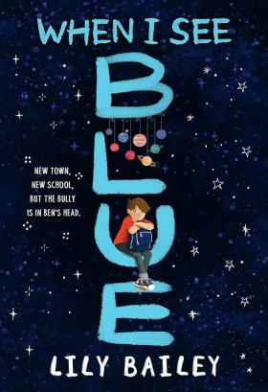
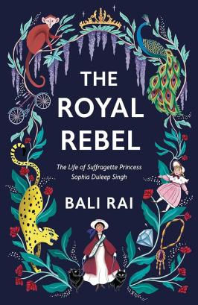
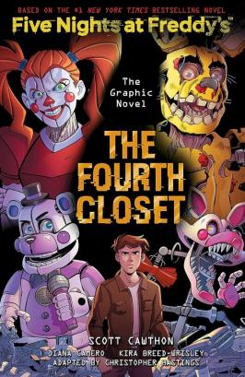
Recommendations from schools (1)
P6+
See When I See Blue on Browns books
P7+
See The Royal Rebel on Browns books
S1+
See The Fourth
Close on Browns books
scottishbooktrust.com
Notes:
Recommendations from schools
In this issue, we celebrate the new pupil-led book recommendation project pioneered by St Andrew’s and St Bride’s High School, Calderglen High School, Duncanrig Secondary School and Strathaven Academy. Each month, pupils from each of the four Reading Schools write a recommendation for a book they have recently loved, which is then displayed in Waterstones, East Kilbride.
When I See Blue by Lily Bailey (Orion Children’s Books)
‘When I See Blue is a beautiful story of self acceptance. It is wonderful for educating children about OCD as a disorder and felt so freeing to read. You fall in love with the characters and really root for the happy ending.’
Chosen by Louise Ann (S3) at St. Andrew’s and St. Bride’s High School
The Royal Rebel: The Life of a Sufragette Princess Sophia Duleep Singh by Bali Rai (Barrington Stoke)
'This book is about a family who are part of the Sikh dynasty but now live in Britain. It's a fiction book but feels very real especially in the way it talks about women's rights. I recommend it for people who like books that are easy to read but help you make opinions about injustice.’
Chosen by Carrie (S1) at Strathaven Academy
The Fourth Closet by Scott Cawthorn and Kira Breed-Wrisley (Scholastic US)
‘The last graphic novel in the Five Nights series has plot changes and switches in who is telling the story and where the characters are. It builds up to an ending most Freddy fans will enjoy. And readers will find out what happened to Charlie along the way.’
Chosen by Ellie (S1) at St. Andrew’s and St. Bride’s High School

Slide 18
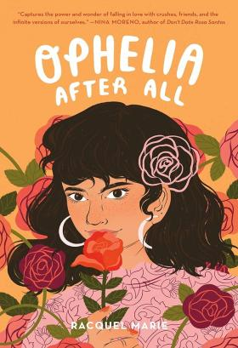
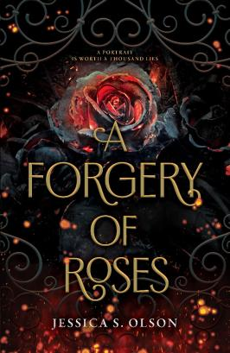
Recommendations from schools (2)
S3+
See Ophelia After All on Browns books
S3+
See A Forgery of Roses on Browns books
scottishbooktrust.com
Notes:
Recommendations from schools
In this issue, we celebrate the new pupil-led book recommendation project pioneered by St Andrew’s and St Bride’s High School, Calderglen High School, Duncanrig Secondary School and Strathaven Academy. Each month, pupils from each of the four Reading Schools write a recommendation for a book they have recently loved, which is then displayed in Waterstones, East Kilbride.
Ophelia After All by Racquel Marie (St. Martin’s Press)
'Ophelia After All is a book about romance, friendship and discovery. Follow Ophelia Rojas as she navigates her final year at high school. Prom is just around the corner and Ophelia has always wanted a cute boy to take her. When she can’t stop thinking about the pretty girl in her government class, Ophelia must ask herself some questions…'
Chosen by Orla (S2) at St. Andrew’s and St. Bride’s High School
A Forgery of Roses by Jessica S. Oslo (Harper Fire)
'A Forgery of Roses is an amazing book that will keep you on the edge of your set. It’s full of sisterhood, friendship and surprises. Jessica S. Olson has crafted a masterpiece and this is, coincidentally, my new favourite book!'
Chosen by Olivia (S4) at St. Andrew’s and St. Bride’s High School

Slide 19
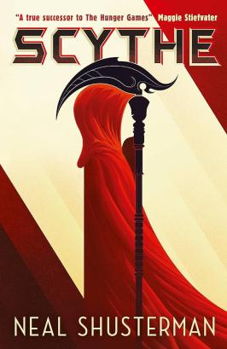
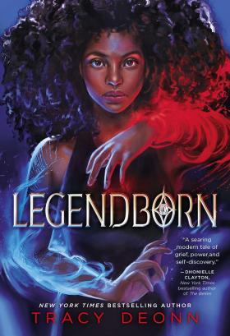
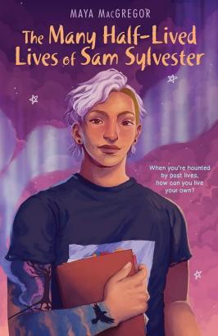
Ask a librarian
Something like The Hunger Games
Something with magic
A mystery
S4+
See The Many Half-Lived Lives of Sam Sylvester on Browns books
S1+
See Scythe on Browns books
S4+
See Legendborn on Browns books
scottishbooktrust.com
Notes:
Ask a librarian
This issue's recommendations for frequently asked questions comes from Sarah Keirs, School Librarian for Belmont Academy, Girvan Academy and Queen Margaret Academy.
Legendborn by Tracy Deonn (Margaret K. McElderry Books)
After the death of her Mum, Bree thinks starting at a new school will be a fresh start, but on her first night, she witnesses an attack by a demon. Bree is whisked into a world of magic by a group of students claiming to be the descendants of the Knights of the Round Table.
Scythe by Neal Shusterman (Walker Books)
Set in a dystopian future where medicine has advanced so far that no one dies of natural causes anymore, this book follows two apprentice Scythes, who take on the role of death to control population levels.
The Many Half-Lived Lives of Sam Sylvester by Maya MacGregor (Astra Young Readers)
Sam’s special interest is the cases of teenagers who died before they turned nineteen. When they move to a new town with their Dad, they know they’re going to have to navigate a new school, but they don’t expect to be thrown into a mystery they’ve studied for years.

Slide 20
For more recommendations
Download our free Bookzilla app to find book recommendations, challenges and dares
Browse the Book lists on our website, which you can filter by age, topic and genre
Enter our Bookzilla Book of the Month competition to win a copy of our monthly pick
Learn more about our upcoming CLPL sessions, including our Book Discovery Sessions, where we share some of our favourite texts on a specific topic
scottishbooktrust.com

Slide 21

Thank you
scottishbooktrust.com
Scottish Book Trust is a national charity changing lives through reading and writing. Registered company SC184248 | Scottish charity SC027669

