Slide 1

Book Discovery Guide
Issue 4: May 2022
scottishbooktrust.com

Slide 2


How to use this PowerPoint
This PowerPoint version of the Book Discovery Guide (Issue 4, May 2022) allows you to share the guide with your colleagues.
Each slide will contain the covers and, where applicable, age ratings of the books.
Click “Notes” at the bottom of your window to find the blurbs for each book.
scottishbooktrust.com

Slide 3
The importance of contemporary books in your classroom:
More representative, which allows pupils to see themselves on page
Read about a wide range of experiences relevant to today (for example, climate change, refugee crisis, technology and the Internet)
Language is up-to-date, making it easier to follow
scottishbooktrust.com
Notes:
For more information on the importance of using contemporary books in your classroom, you may find the following useful:
“Why using ‘classic’ children’s books can be problematic” from TES: https://www.tes.com/magazine/teaching-learning/general/why-using-classic-childrens-books-can-be-problematic
“Exploring teachers’ knowledge of contemporary literature” from The Open University: http://oro.open.ac.uk/12527/

Slide 4
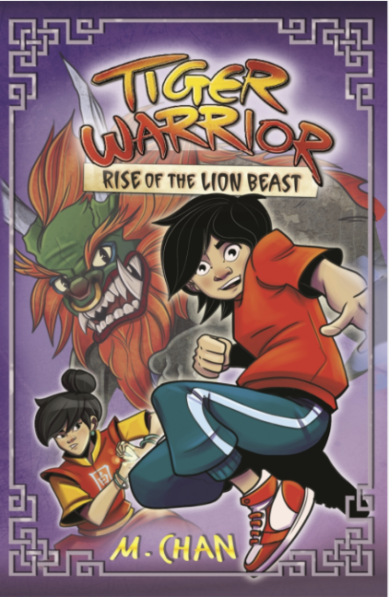
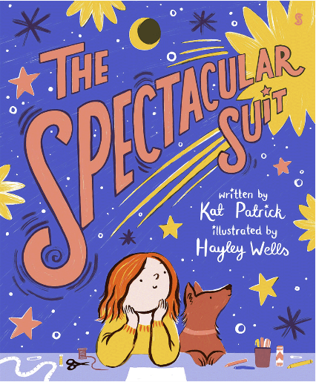
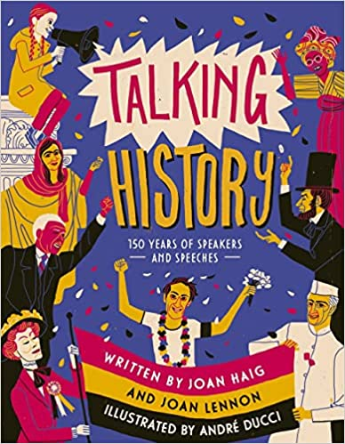
New from Scottish writers and illustrators
P1-P3
P3-P5
P5-S3
scottishbooktrust.com
Notes:
The Spectacular Suit, Kat Patrick and Hayley Wells (Scribe Publications)
Frankie’s birthday party is just around the corner . . . but what is she going to wear? Her family come together to make her the spectacular suit of her dreams! Bright digital illustrations bring Frankie’s dazzling suit to life in this uplifting picture book, which celebrates being who you want to be.
Tiger Warrior: Rise of the Lion Beast, Maisie Chan (Orchard Books)
A thrilling read that follows Jack as he battles his worst fear, the Nian lion beast, at Lunar New Year. Can he defeat it and save the Jade Kingdom? Look out for other titles in the superb Tiger Warrior series, ideal for readers on a quest for action-packed fantasy.
Talking History: 150 Years of Speakers and Speeches, Joan Haig, Joan Lennon and André Ducci (Templar Publishing)
From Abraham Lincoln to Nelson Mandela and Greta Thunberg, Talking History charts important days in history when words made a difference, covering subjects including war, civil rights and the environment. Beautiful, graphic illustrations help readers experience the power of speeches in this inspiring and immersive book.

Slide 5
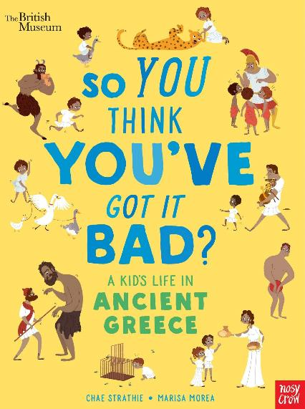
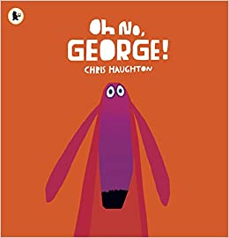
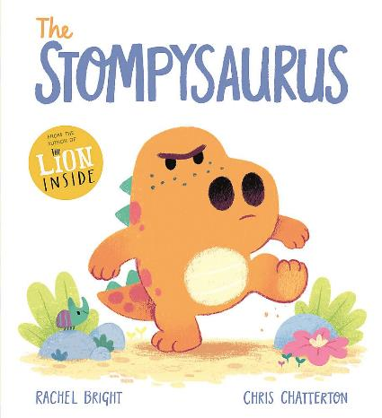
First Minister’s Reading Challenge Celebration Festival 2022 (Part 1)
P1-P3
P1-P3
P4-7
scottishbooktrust.com
Notes:
Oh No, George!, Chris Haughton (Walker Books)
Celebrating its 10th anniversary this year, Oh No, George! is a bold and funny picture book about George the dog, who is trying very hard to be good while his owner is out for the day. However, things don’t go to plan when George is faced with the temptations of a chocolate cake and a cat to chase! A beautiful book sure to make you laugh out loud and be charmed by George.
The Stompysaurus, Rachel Bright and Chris Chatterton (Orchard Books)
A bad-tempered Stompysaurus learns to take control of his anger and frustration in the latest edition to the DinoFeelings series. This picture book will help children to face their feelings of anger and annoyance when nothing seems to be going right, and find a new way to look at things.
So You Think You’ve Got it Bad? A Kid’s Life in Ancient Greece, Chae Strathie and Marisa Morea (Nosy Crow)
So you think you’ve got it bad? Imagine living on a diet of blood soup whilst wearing nothing but a cloak, or having to learn a poem that was over 15,000 lines long! A kid’s life in ancient Greece might sound fun, but you’d be wrong. Full of funny facts and beautifully illustrated, this book will tease out your inner historian and bring Ancient Greece to life.

Slide 6
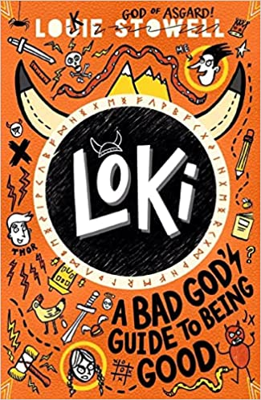
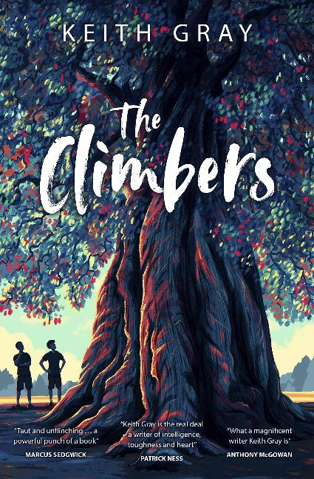
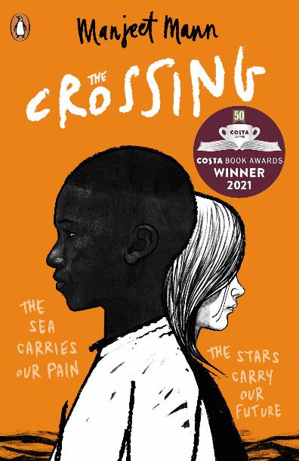
First Minister’s Reading Challenge Celebration Festival 2022 (Part 2)
P4-P7
S1-S4
S3+
scottishbooktrust.com
Notes:
Loki: A Bad God’s Guide to Being Good, Louie Stowell (Walker Books)
You’ve probably heard of the trickster god Loki, but have you seen him navigate life on Earth without his powers, in the body of an eleven yearold boy? After one trick too many, Loki is banished on Earth to live as a ‘normal’ school boy and must show moral improvement to return to his true form. This is a very funny diary-style story full of doodles and comic strips – perfect for Diary of a Wimpy Kid fans!
The Climbers, Keith Gray (Barrington Stoke)
When Sully, the best tree-climber in his village meets his rival, a contest ensues that leads to a turning point in both their lives. Both boys must race to climb the last unnamed tree and whoever makes it to the top will become a legend. This compelling and moving story of teenage rivalries, friendship and identity will pull you in and captivate you until its final pages.
The Crossing, Manjeet Mann (Andersen Press)
When two teenagers find themselves brought together through a twist of fate in a broken world, they both feel hope for the new lives they yearn for. An essential and sadly all too relevant story, The Crossing is a powerful verse-novel of hope, grief and the very real tragedies faced by refugees. The book beautifully explores the experience of simply being human, and the lottery of where we are born.

Slide 7
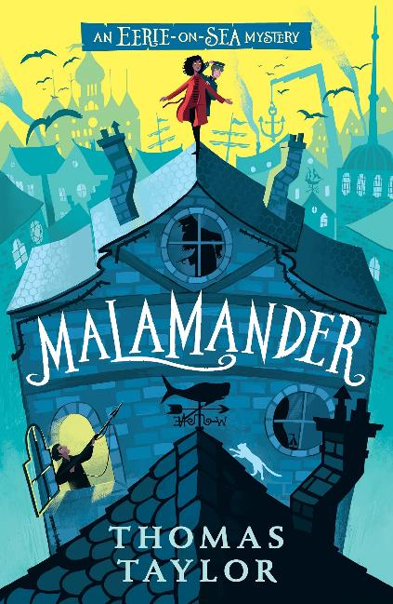
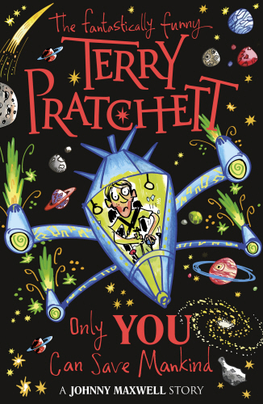
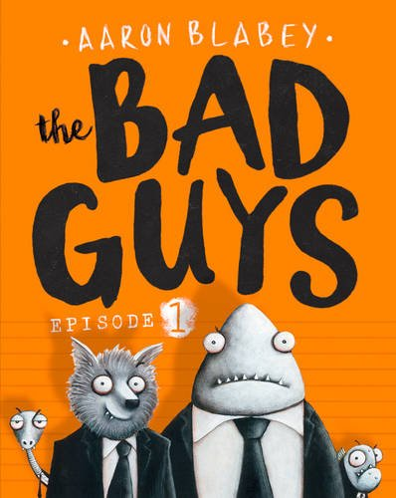
Staff picks: Liam McCallum
P4-P7
P4-P7
S1+
scottishbooktrust.com
Notes:
Malamander, Thomas Taylor (Walker Books)
This Scooby Doo-like mystery adventure has it all – colourful characters, creepy mythical creatures and a loveable, if a little incompetent, hero.
Bad Guys, Aaron Blabey (Scholastic)
What happens when bad guys go good? This hilarious, highly illustrated series is an absolute, laugh-a-minute hoot!
Only You Can Save Mankind, Terry Pratchett (Corgi Childrens)
Gaming fans will love this ‘What if it’s actually real?’ story of Johnny Maxwell and his quest to save mankind, sort of.

Slide 8
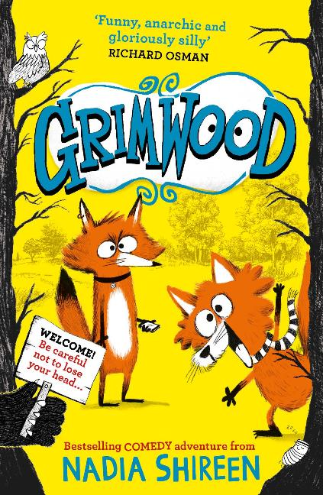
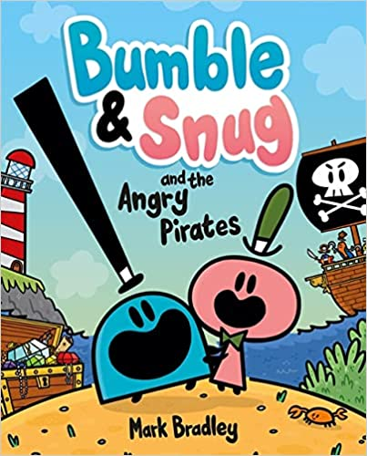
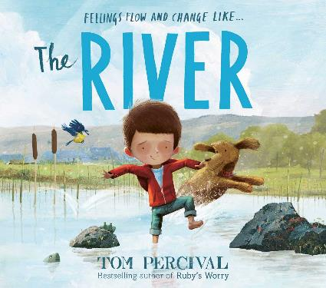
Staff picks: Heather Collins
P3-P7
P1-P4
P1-P5
scottishbooktrust.com
Notes:
Grimwood, Nadia Shireen (Simon & Schuster Children’s UK)
A brilliantly bonkers, completely original and heartwarming story of sibling love and adventure. A very enjoyable read.
The River, Tom Percival (Simon & Schuster Children’s UK)
A moving story of how connecting with nature can help us overcome grief and channel our emotions. Gentle, moving, beautifully done.
Bumble and Snug and the Angry Pirates (Hodder Children’s Books)
This comic is a perfect package of wacky adventure, drawing tips and thoughtful ways to discuss mental wellbeing with young children.

Slide 9
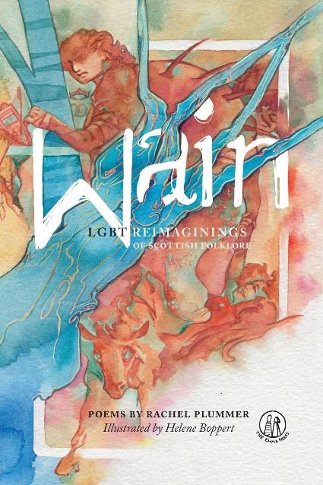
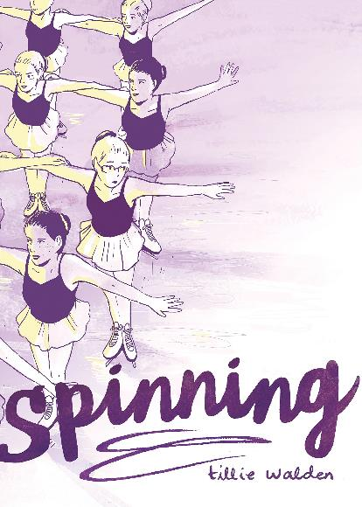
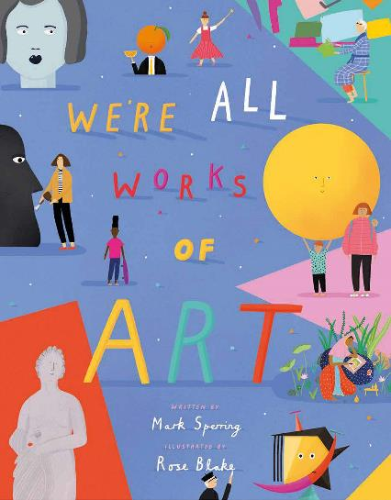
Staff picks: Catherine Wilson Garry
P1-P3
S1+
S5+
scottishbooktrust.com
Notes:
We’re All Works of Art, Mark Sperring and Rose Blake (Pavilion Children’s)
Told through different forms of artwork, this beautiful picture book introduces the idea that it’s okay – great even! – that we all look and feel different in the bodies we’re given.
Wain, Rachel Plummer (The Emma Press)
LGBT+ reimaginings of Scottish folklore told through poems. Find selkies and kelpies, but also the often overlooked cat síth, stoor worms and seven big women of Jura!
Spinning, Tillie Walden (SelfMadeHero)
A graphic novel about growing up and figuring out who you are – all told through Walden’s experience as a competitive figure skater and how it shaped her life both on, and off, the ice-rink.

Slide 10
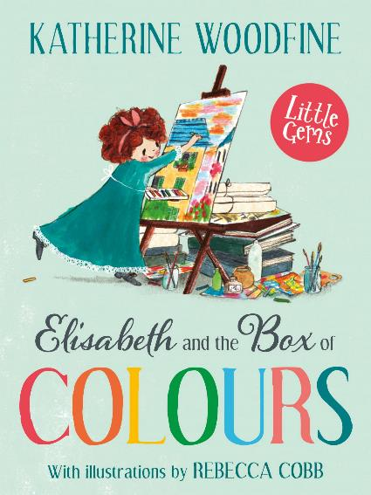
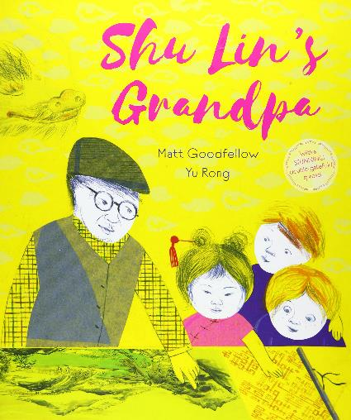
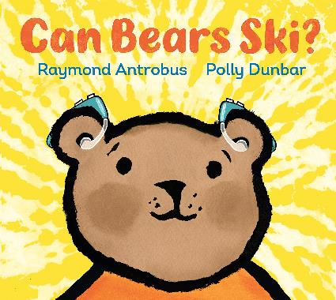
Books to promote empathy
(Part 1)
P1+
P1+
P2-P4
scottishbooktrust.com
Notes:
There’s always room for more empathy. These books will help children to understand experiences that might be outside of their own, and are a great starting point for conversations about empathy.
Can Bears Ski?, Raymond Antrobus and Polly Dunbar (Walker Books)
Can Bears Ski? follows Bear as he begins to realise he can’t hear like others, and his journey to receiving assistive technology. This book is ideal for sharing across the school, for starting discussions about hearing loss and disability, and how we can support others.
Shu Lin’s Grandpa, Matt Goodfellow and Yu Rong (Otter-Barry Books)
Shu Lin has started a new school, and finds it hard to be accepted. When her grandfather comes into class to show his beautiful paintings, things begin to change. This is a book about how we judge others, and the power of art to build connection and cultural understanding.
Elizabeth and the Box of Colours, Katherine Woodfire and Rebecca Cobb (Barrington Stoke)
The latest in the Little Gem series, this historical f iction story explores grief and loss and is perfect for exploring how isolating and alone we can feel, even when surrounded by others. This is a heart-warming story of friendship, and discovering what brings you joy.

Slide 11
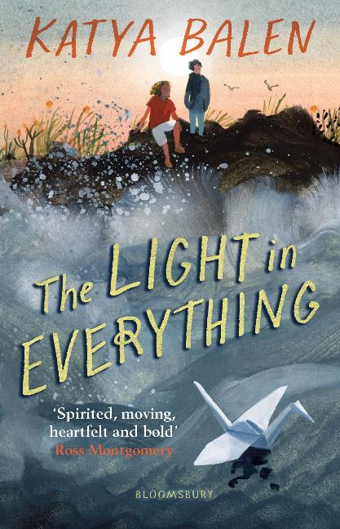
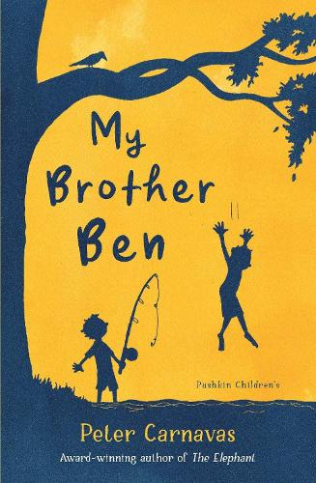
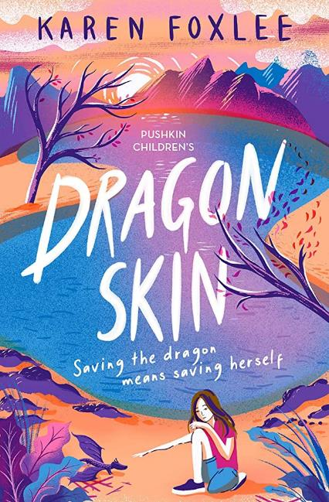
Books to promote empathy (Part 2)
P4-P7
P5+
P7+
scottishbooktrust.com
Notes:
The Light in Everything, Katya Balen (Bloomsbury Children’s Books)
Exploring the challenges of two families coming together, Tom and Zofia struggle with the change when their parents decide to move in together – Zofia is angry, and Tom finds it hard to trust. Told in dual narrative, this is ideal for reading aloud and allows for discussion around emotional literacy and the importance of communication.
My Brother Ben, Peter Carnavas (Pushkin’s Children’s Books)
My Brother Ben is perfect for sharing with pupils preparing to transition to a new class or new school. Luke’s brother has just moved to secondary school, and we follow the impact this has on their relationship and Luke’s struggle with the change. With gentle messages of resilience and mindfulness, this is ideal for sharing in school.
Dragon Skin, Karen Foxlee (Pushkin’s Children’s Books)
A powerful story of living in a household with emotional abuse, this is an emotional but important read. Pip never wants to be home and seeks refuge by nursing a baby dragon. This story poignantly mixes reality and fantasy, exploring family and manipulative relationships in a considered and sensitive way.

Slide 12
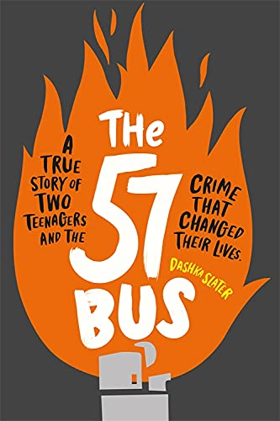
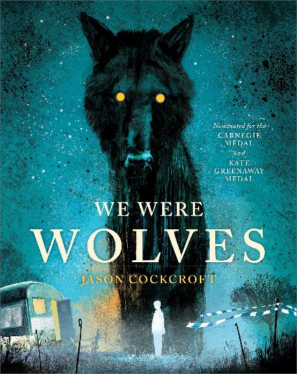
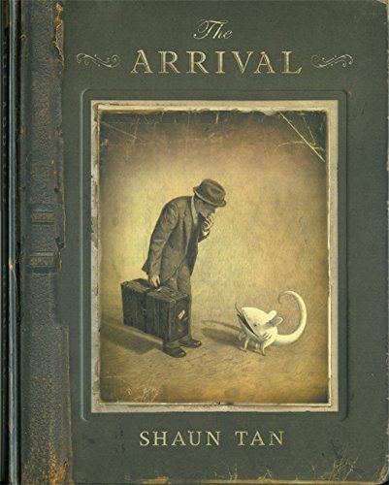
Guest picks: Julie Sutherland
P4-P7
P4+
S1+
scottishbooktrust.com
Notes:
Julie Sutherland is the librarian at Forrester High School in Edinburgh and winner of the Scottish Book Trust Learning Professional Award 2022. Her impressive knowledge of the children’s and YA literature market has inspired hundreds of pupils to become readers and writers, and her colleagues describe her as the beating heart of the school.
We Were Wolves, Jason Cockcroft (Andersen Press)
We Were Wolves has the most incredible illustrations, and a story that will make you sing, ponder and break your heart. Boy avoids school, learning off the land with his dad who has PTSD. Boy is consumed by guilt when a decision to get help has terrible consequences.
The Arrival, Shaun Tan (Hodder Children’s Books)
A wholly immersive wordless picture book of the immigrant experience. You arrive in a land that you don’t recognise, with an alien language, strange food and rules you don’t understand, experiencing this together with the protagonist. The book can make you feel heart-broken, confused, frustrated, and helped.
The 57 Bus, Dashka Slater (Wren & Rook)
A Black teen messes about with a lighter on a bus, egged on by his friends and setting alight the skirt of a white agender teen, who is horribly burnt. This incredibly powerful true story recounts the event from before the incident, the trial and beyond, to forgiveness and redemption.

Slide 13
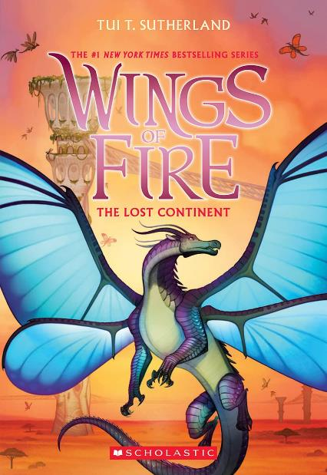
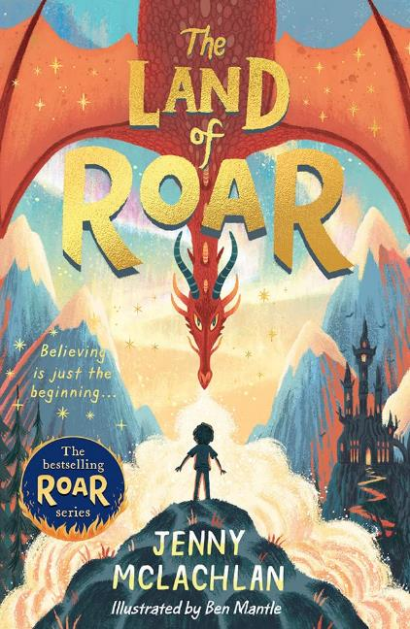
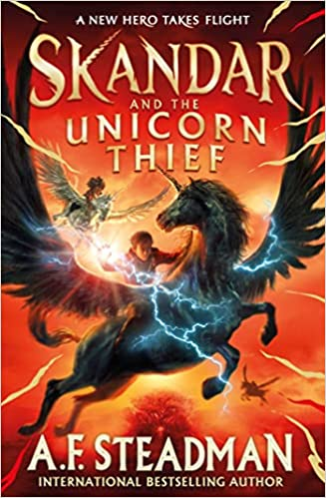
FAQs: What to read after Cressida Cowell
P4+
P4+
P4+
scottishbooktrust.com
Notes:
Wings of Fire, Tui T Sutherland and Mike Holmes (Scholastic)
First in the exhilarating The Dragonet Prophecy series, follow the dragonets as they try to end the war between the dragon kingdom.
The Land of Roar, Jenny McLachlan and Ben Mantle (Egmont)
A laugh-out-loud adventure filled with ninja-magicians, living scarecrows, mermaids and, of course, dragons. Perfect for fans of Hiccup’s humour!
Skandar and the Unicorn Thief, A.F. Steadman (Simon & Schuster’s Children’s)
The first in a new series, perfect for those who loved Hiccup and Toothless’ bond. Follow ferocious unicorns and their riders as they learn to control their powers.

Slide 14
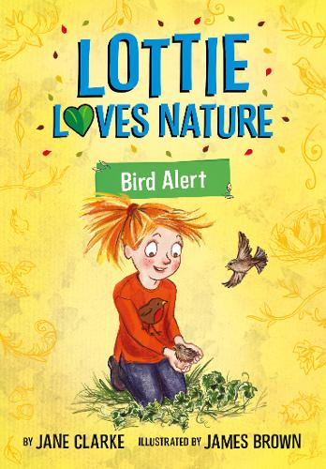
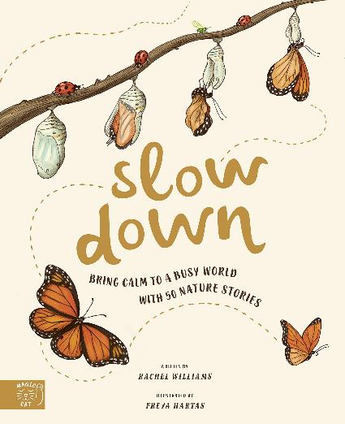
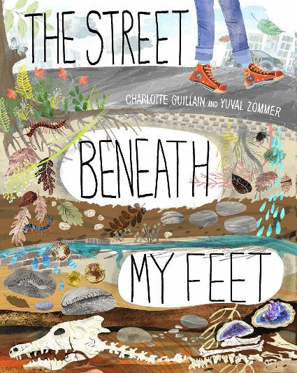
FAQs: Books to support outdoor learning
P3-P5
P4-P7
P2-P5
scottishbooktrust.com
Notes:
Slow Down, Rachel Williams and Freya Hartas (Magic Cat)
50 illustrated nature stories encouraging children to slow down and discover amazing facts about the world around them.
The Street Beneath My Feet, Charlotte Guillan and Yuval Zommer (Words and Pictures)
This books gives children the opportunity to journey deep underground, discovering what might lie below both urban and rural landscapes.
Lottie Loves Nature series, Jane Clarke and James Brown (Five Quills)
A fiction series that will let younger readers discover tips and facts about nature on their doorstep while following Lottie’s hilarious outdoor adventures.

Slide 15
Find out more:
Learn about our schools programmes and learning resources
Register for our upcoming CLPL sessions
Find more book recommendations with our book lists or our Bookzilla app
scottishbooktrust.com

Slide 16

Thank you
scottishbooktrust.com
Scottish Book Trust is a national charity changing lives through reading and writing. Registered company SC184248 | Scottish charity SC027669

