Slide 1

Book Discovery Guide
Issue 3: November 2021
scottishbooktrust.com

Slide 2


How to use this PowerPoint
This PowerPoint version of the Book Discovery Guide (Issue 3, November 2021) allows you to share the guide with your colleagues.
Each slide will contain the covers and, where applicable, age ratings of the books.
Click “Notes” at the bottom of your window to find the blurbs for each book.
scottishbooktrust.com

Slide 3
The importance of contemporary books in your classroom:
More representative, which allows pupils to see themselves on page
Read about a wide range of experiences relevant to today (for example, climate change, refugee crisis, technology and the Internet)
Language is up-to-date, making it easier to follow
scottishbooktrust.com
Notes:
For more information on the importance of using contemporary books in your classroom, you may find the following useful:
“Why using ‘classic’ children’s books can be problematic” from TES: https://www.tes.com/magazine/teaching-learning/general/why-using-classic-childrens-books-can-be-problematic
“Exploring teachers’ knowledge of contemporary literature” from The Open University: http://oro.open.ac.uk/12527/

Slide 4
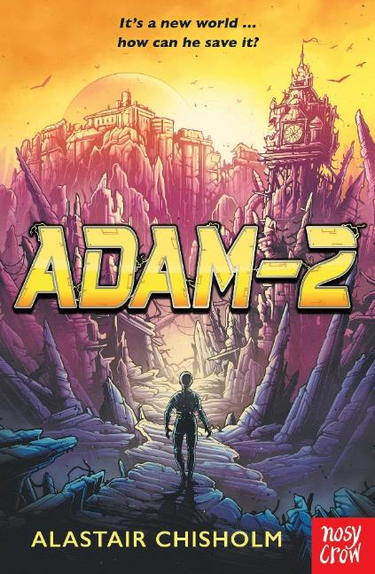
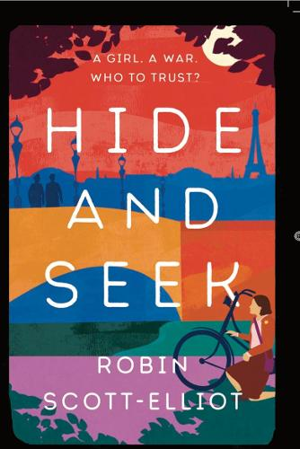
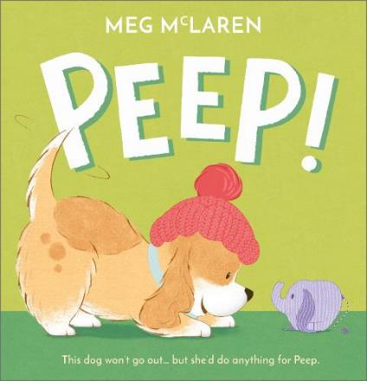
New from Scottish authors
P1-P3
P4-P7
S1+
scottishbooktrust.com
Notes:
Peep!, Meg McLaren (Andersen Press)
Peep! is a beautifully illustrated story about facing your fears by The Bookbug Picture Book Prize winner Meg McLaren. Adorable puppy Dot is afraid of going outside until her favourite toy Peep goes missing and Dot has to venture out on a rescue mission. Maybe the world won’t be as scary as she thought?
Adam-2, Alaistair Chisholm (Nosy Crow)
Full of twists and turns, Adam–2 is a sci-fi novel set in a futuristic, post-apocalyptic Edinburgh. Linden and Runa discover a robot called Adam, who has been trapped in a basement for years. Both exciting and thought provoking, this fantastic adventure asks fascinating questions about human nature and the future of AI.
Hide and Seek, Robin Scott-Elliot (Everything with Words)
Robin Scott-Elliot returns with another brilliant historical fiction novel. Set in Paris in 1942, Amelie Dreyfus joins the French resistance after her parents are taken by Nazis. Thrumming with tension and suspense, Hide and Seek is a thrilling story about survival and trust inspired by real-life resistance fighters.

Slide 5
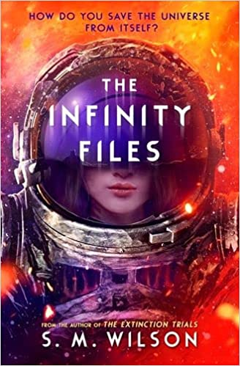
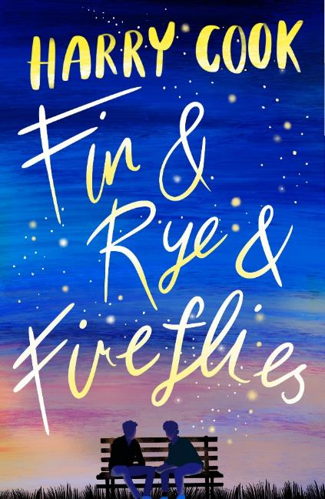
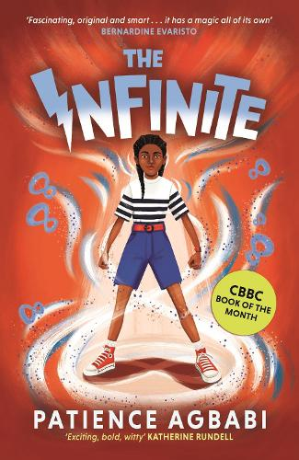
The Scottish Teenage Book Prize 2022
scottishbooktrust.com
Notes:
Please note: as of 2023, Scottish Book Trust are no longer running the Scottish Teenage Book Prize.
The Infinity Files, S. M. Wilson (Usborne)
Ash Yang dreamed of being a starfighter pilot. But when she crashes out of her final test – literally – she somehow lands the most powerful job in the universe. She must secretly planethop across the galaxies, stealing or returning treasures that have the power to stop wars – or start them. But when her home planet is the one at war, can she use her new skills to save it?
Fin & Rye & Fireflies, Harry Cook (Ink Road)
After Fin is cruelly outed, his parents move him across the country in search of a ‘fresh start’. A fresh start won’t change who Fin is, but it does introduce him to the best squad in town – including the super cute Rye. When Fin’s parents send him to conversion therapy, an outrageous plan is needed to give Fin and Rye a chance at the happy-ever-after their story deserves.
The Infinite, Patience Agbabi (Canongate Books)
Leaplings, born on 29 February, are very rare. Rarer still are Leaplings with The Gift – the ability to leap through time. Elle Bíbi-Imbelé Ifíè has The Gift, but she’s never used it. Until now. Elle has received a mysterious warning from the future and Leaplings are disappearing in time. Soon Elle’s adventure becomes more than a race through time. It’s a race against time.

Slide 6
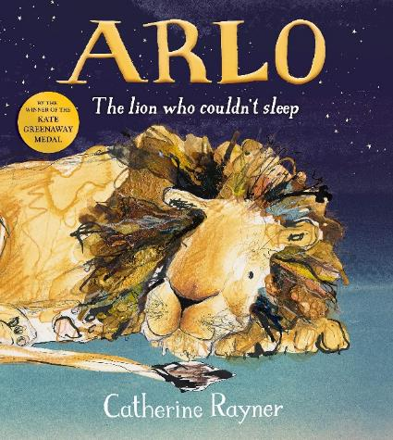
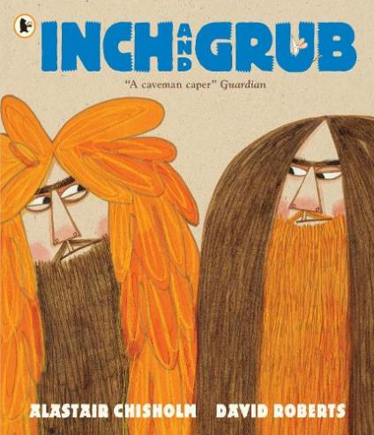
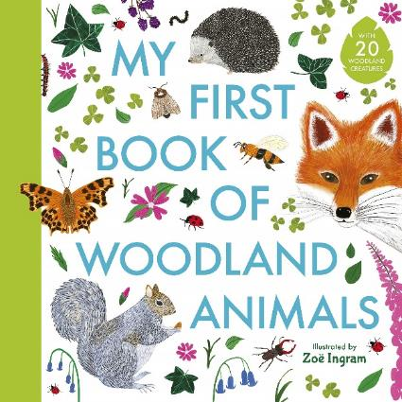
The Bookbug Picture Book Prize 2022
scottishbooktrust.com
Notes:
Please note: as of 2023, Scottish Book Trust are no longer running the Bookbug Picture Book Prize.
Arlo: The Lion Who Couldn’t Sleep, Catherine Rayner (Macmillan Children’s Books)
Arlo is exhausted. He just can’t get to sleep, however hard he tries. But then he meets Owl, who might have helpful tricks for him. A beautifully illustrated story with a gentle mindfulness message, perfect for wee ones who have trouble getting to sleep.
Inch and Grub, Alastair Chisholm and David Roberts (Walker Books)
Inch and Grub are cavemen, and they’re both determined to have the best cave! The contest spirals and spirals, until they each have a HUGE wobbling pile of stuff. But what happens when the piles collapse? A funny story about being competitive and what really matters in life.
My First Book of Woodland Animals, illustrated by Zoë Ingram (Walker Books)
The perfect book for any young animal lover, this beautiful spotter guide is an ideal introduction to wild woodland animals. Illustrated in a bright, contemporary style, the book is full of information, fun facts and tips to help you spot the animals in the natural world.

Slide 7
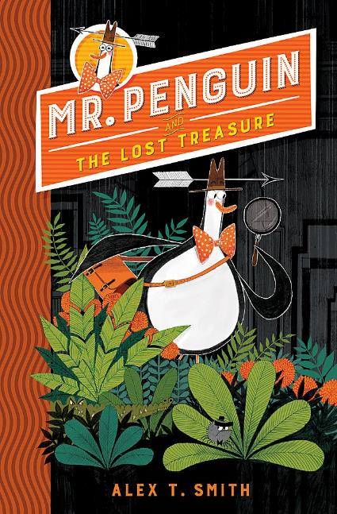
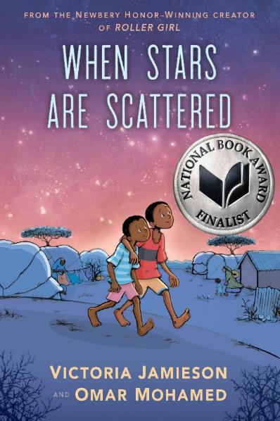
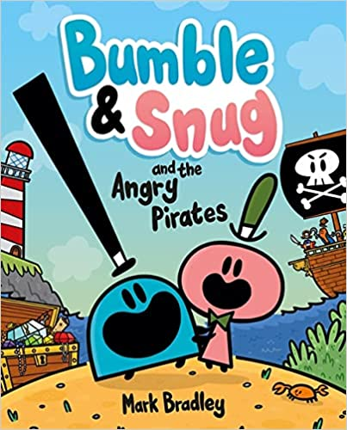
Staff picks: Marianne Doherty
P3-P6
P3-P6
P6-S2
scottishbooktrust.com
Notes:
Bumble & Snug and the Angry Pirates, Mark Bradley (Hodder Children’s Books)
Bumble, Snug and their Bugbop friends are a fantastic introduction to graphic novels for emerging readers and tremendous fun for all comic fans.
Mr Penguin and the Lost Treasure, Alex T Smith (Hodder Children’s Books)
Mr Penguin and his sidekick begin a new career as professional adventurers. Hilarious antics, terrifying dangers and the odd fish finger sandwich lie ahead!
When Stars are Scattered, Victoria Jamieson and Omar Mohamed (Faber & Faber)
Heart-breaking and heart-warming in equal measure, this stunning depiction of life in a refugee camp brings an incredible story to life.

Slide 8
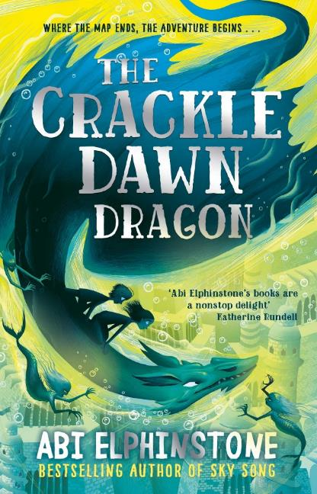
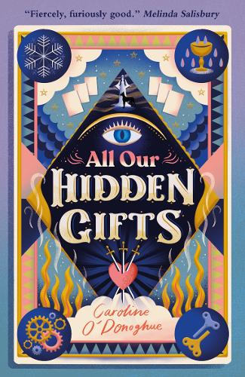
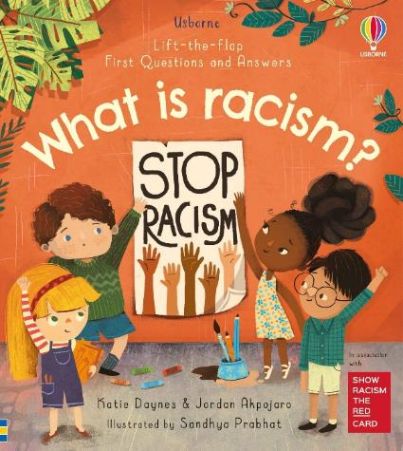
Staff picks: Megan Graham
P1-P3
P4-P7
S2-S5
scottishbooktrust.com
Notes:
What is Racism?, Katie Danes, Jordan Akpojaro and Sandhya Prabhat (Usborne)
Usborne has a reputation for excellent non-fiction books, and this book is no different. It gently explains what racism is, how it happens and why it is never acceptable.
The Crackledawn Dragons, Abi Elphinstone (Simon & Schuster Children’s UK)
This magical adventure includes fire krakens, underwater palaces and a talking chameleon. Don’t miss Abi’s fantastic Authors Live event, now available on demand.
All Our Hidden Gifts, Caroline O’Donoghue (Walker Books)
When Maeve discovers a talent for tarot reading, she doesn’t expect her gift to lead to the disappearance of her ex-best friend. A wonderfully witchy YA adventure for autumn.

Slide 9
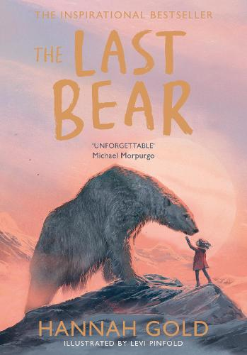
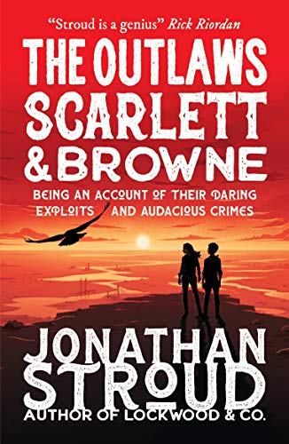
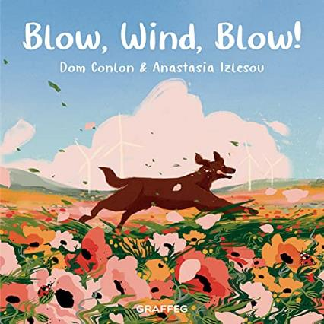
Staff picks: Christian Ritchie
P3-P5
P4-P7
S1-S4
scottishbooktrust.com
Notes:
Blow, Wind, Blow, Dom Conlon and Anastasia Islesov (Graffeg)
A beautifully illustrated book, which poetically describes the journey of the wind as it travels across the Earth in its many natural forms.
The Last Bear, Hannah Gold (HarperCollins)
A moving adventure of the unusual bond between April, a determined young girl, and a lonely, forgotten polar bear battling against climate change in the Arctic.
The Outlaws Scarlett & Browne, Jonathan Stroud (Walker Books)
Set in a lawless, futuristic England, an encounter between two contrasting characters who are both being pursued leads to an audacious adventure of survival against all odds.

Slide 10
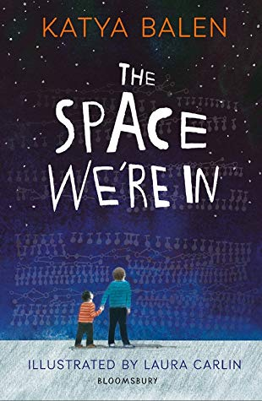
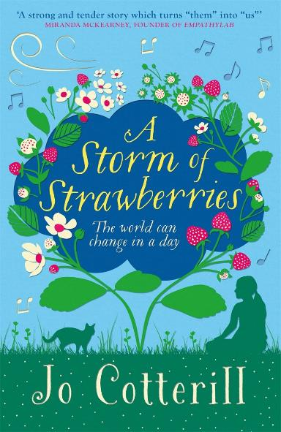

Books about disability and neurodiversity (Primary)
P4-P7
P4-P7
P4-P7
scottishbooktrust.com
Notes:
The Space We’re In, Katya Balen (Bloomsbury)
Frank knows his brother Max is different. He only eats quavers, he doesn’t talk, and he can have big meltdowns. Sometimes Frank wishes mum could do all the things she did before Max was born. But when tragedy strikes, Frank begins to understand Max more. A story of empathy and understanding, this book will break your heart and put it back together.
I Am Not a Label, Cerrie Burnell and Lauren Mark Baldo (Wide Eyed Editions)
Meet 34 disabled artists, activists, athletes, thinkers and individuals who changed the world. Find out how these people overcame obstacles, owned their differences and paved the way for others. Perfect for dipping in and out of, this is a non-fiction title you will return to again and again.
A Storm of Strawberries, Jo Cotterill (Piccadilly Press)
The yearly chocolate egg hunt is one of Darby’s favourite things. But when her big sister Kaydee brings an unkind friend home and a tornado hits the family farm, this weekend might not turn out as planned. This warm, empathetic and thoughtful story about a young person with Down’s Syndrome is a must-read.

Slide 11
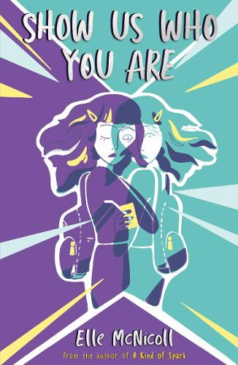
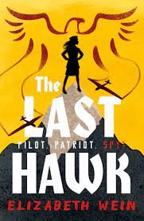
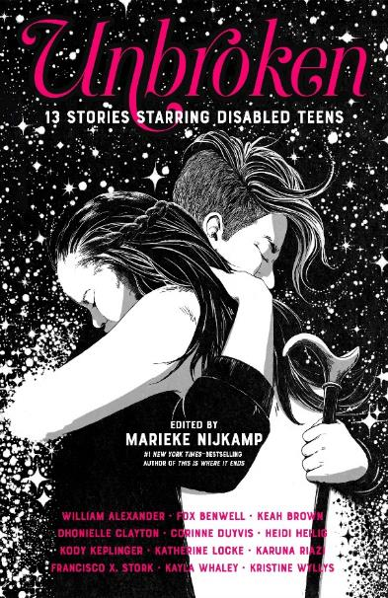
Books about disability and neurodiversity (Secondary)
P7+
S1+
S1+
scottishbooktrust.com
Notes:
Show Us Who You Are, Elle McNicoll (Knights Of)
12-year-old Cora is invited to help develop interactive holograms that will allow people to visit their loved ones after they die. Cora is autistic, and there aren’t many holograms like her just yet. But Cora is about to f ind out that dangerous secrets lie at the heart of the project. A gripping science-fiction story about being true to yourself and not letting others define your worth.
The Last Hawk, Elizabeth Wein (Barrington Stoke)
Nazi Germany is a dangerous place for a girl with a stammer. Ingrid knows this. But when she glides through the air, she feels free. When Ingrid joins a propaganda tour, it’s her last chance to prove her dedication to her homeland. Will it be her escape or her undoing? A thrilling read, this is a complex and gripping story by Elizabeth Wein.
Unbroken, edited by Marieke Nijkamp (Farrar, Straus & Giroux)
This collection of short stories by disabled writers puts young disabled protagonists front and centre. From love stories to sci-fi, fantasy, horror and adventure, there is sure to be a story in this collection to suit every reader.

Slide 12
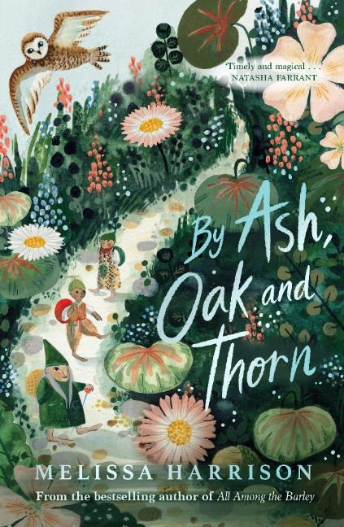
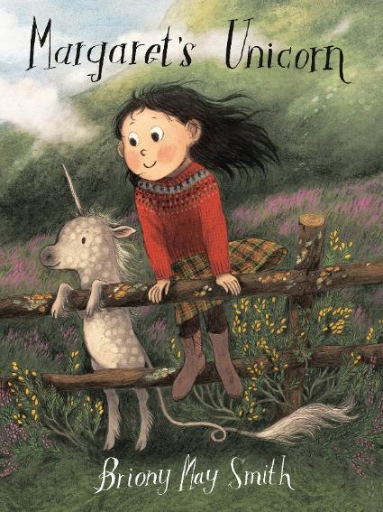
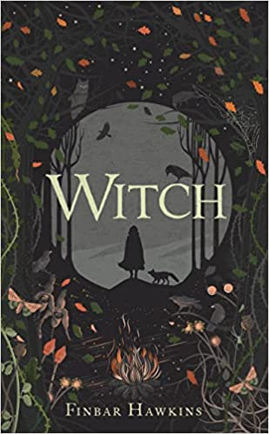
Guest picks: Angie Crawford
P1-P3
P4-P7
S3-S6
scottishbooktrust.com
Notes:
We asked Angie Crawford, Waterstones’ Scottish and non-fiction buyer, to tell us about some of the best children’s books she’s read this year.
Margaret’s Unicorn, Briony May Smith (Walker Books)
This is a gorgeously illustrated book that’s perfect for reading out loud or indeed for developing readers. Margaret’s mum and dad have decided to move to a new home by the sea so that they can be closer to her Gran. One evening she finds a baby unicorn who needs looking after. It’s such a lovely story of caring and friendship – lots to talk about!
By Ash, Oak and Thorn, Melissa Harrison (Chicken House)
Inspired by the classic The Little Grey Men, this is a beautifully written story that feels both nostalgic and whimsical. It weaves together the story of three ancient beings of the Hidden Folk who secretly look after the natural world. It brims full of folklore and nature and is a really lovely starting point for garnering more interest in the world around us.
Witch, Finbar Hawkins (Head of Zeus)
This is quite a dark novel for older readers rooted in myth and folklore and set during the 17th century witch trials. It tells the story of Evey and her sister Dill who witness the brutal murder of their mother and embark on a perilous journey to avenge her. It’s very atmospheric, explores sibling rivalry to a certain degree but overall is a really compulsive read especially in these autumnal evenings.

Slide 13
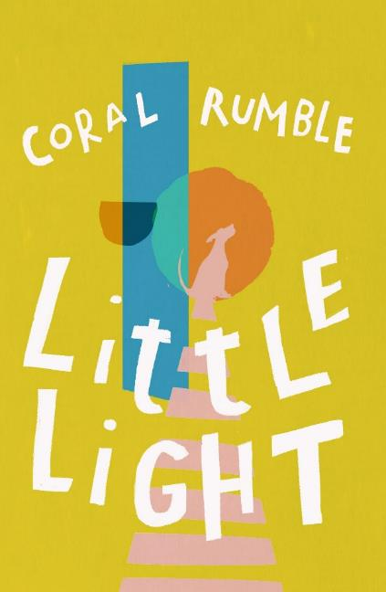
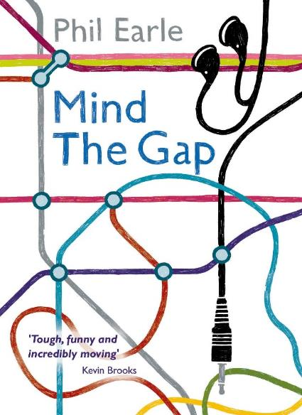
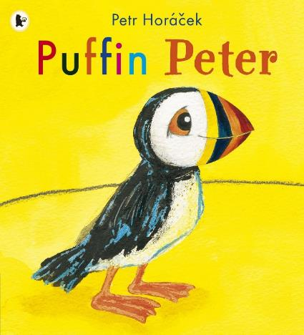
FAQs: Recommendations for whole class reads
P1-P3
P5-P7
S1-S4
scottishbooktrust.com
Notes:
Puffin Peter, Petr Horáček (Walker Books)
A kind whale helps Peter look for his lost best friend Paul. They f ind lots of funny and noisy birds, but are any of them Paul?
Little Light, Coral Rumble (Troika Books)
Ava’s life is darkened by bullies and everything seems lost when they end up homeless. This poetic narrative shines light on a young girl’s misfortunes.
Mind the Gap, Phil Earle (Barrington Stoke)
This heart-warming story deals beautifully with male friendship, boys’ relationships with dads and loss in a believable and honest world.

Slide 14
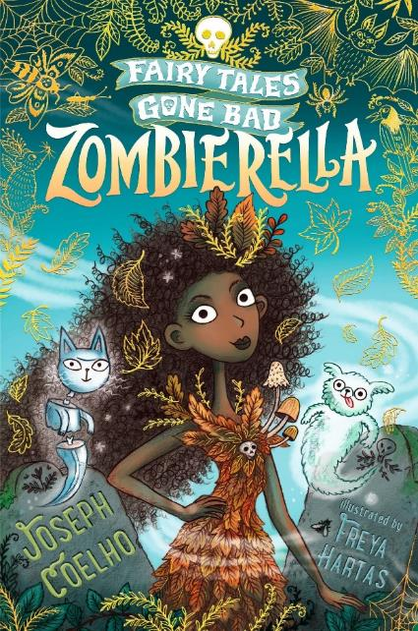
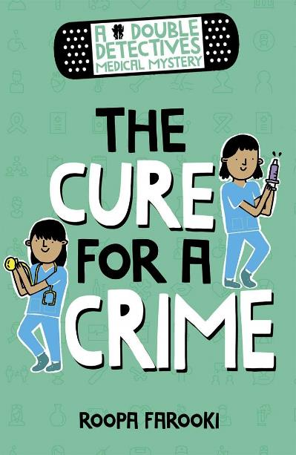
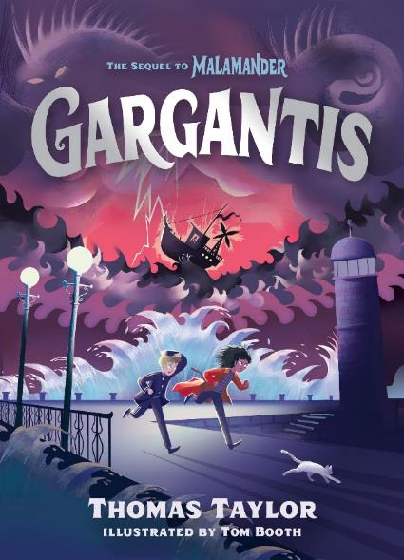
FAQs: What to read after Roald Dahl
P4-P7
P4-P7
P4-P7
scottishbooktrust.com
Notes:
Zombierella: Fairy Tales Gone By, Joseph Coelho (Walker Books)
This twisted version of a classic tale has hardship, magic, dark humour and all the suspense needed to keep you rooting for the heroine.
Gargantis, Thomas Taylor (Walker Books)
Herbie Lemon and Violet Parma must act fast to save Eerie-on-Sea from total destruction with just an ancient bottle to help them. A thrilling tale!
The Cure for a Crime, Roopa Farooki (Oxford University Press)
Detective work is electrifying fun for the twins and their mysterious nan in her flash wheelchair; especially as the prime suspect is a brain surgeon.

Slide 15
Find out more
Learn about our schools programmes and learning resources
Register for our upcoming CLPL sessions
Find more book recommendations with our book lists or our Bookzilla app
scottishbooktrust.com

Slide 16

Thank you
scottishbooktrust.com
Scottish Book Trust is a national charity changing lives through reading and writing. Registered company SC184248 | Scottish charity SC027669

