Slide 1


About this resource
This PowerPoint contains four lessons that can be used alongside An Illustrated Treasury of Scottish Mythical Creatures by Theresa Breslin, illustrated by Kate Leiper. The lessons are as follows:
What are myths and legends?
How do myths and legends travel?
Myths, meanings and morals
Myths and language
This PowerPoint is designed to be used alongside our accompanying Word/PDF resource which you can find on the Myths and legends learning activities webpage.
Make sure you click Notes at the bottom of the screen to see our instructions for each slide.
scottishbooktrust.com

Slide 2
Further ideas
Use our Misinformation and fake news resource to look at reliable sources of information
Use our Storytelling activities to explore drama, stories and reading aloud
Explore Folklore Scotland’s map to find local stories from your area
scottishbooktrust.com

Slide 3

Scottish myths and legends
Scottish Book Trust
scottishbooktrust.com

Slide 4
Lesson 1: What are myths and legends?
scottishbooktrust.com
Notes:
Lesson 1: What are myths and legends?
Estimate time to complete: 30-45 minutes (if using accompanying Word/PDF resource) or 25 minutes if just using PowerPoint
Materials needed: Pens, paper

Slide 5
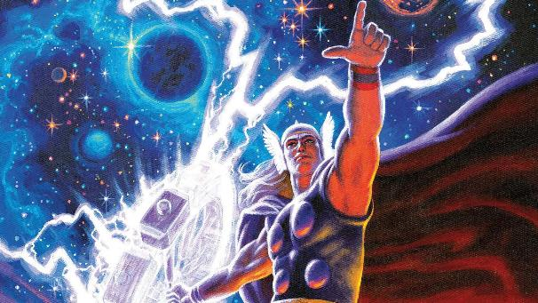
What is a myth?
A myth is a traditional story that usually involves supernatural beings or events. Myths are sometimes used to explain something people don’t understand.
For example, in Norse mythology, Thor is the God of thunder and lightning. So people used the story of Thor to explain storms.
scottishbooktrust.com
Notes:
Read through the slide with your class. Ask if they can think of any myths.

Slide 6
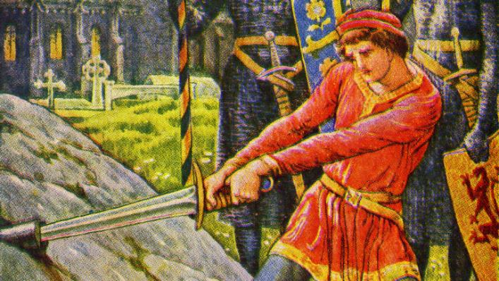
What is a legend?
A legend is another form of story that usually mentions real people or historical events.
For example, King Arthur may have been based on a real person and is based in a specific time period.
scottishbooktrust.com
Notes:
Read through the slide with your class. Ask if they can think of any legends.

Slide 7
How to tell if a story is myth or legend:
Myth:
Look for magical or supernatural animals, creatures or beings
Often not set in a specific time period
Legend:
Look for stories about a real person or specific event
Often set in a specific time period
scottishbooktrust.com
Notes:
Go through this slide together, and then read the story “The Mermen of Bell Rock” aloud together.

Slide 8
Sort the following as either myths or legends
scottishbooktrust.com
Notes:
The following slides will show images of famous stories. Ask your pupils to guess if they are myths or legends. You can either ask them to write this down or vote.

Slide 9
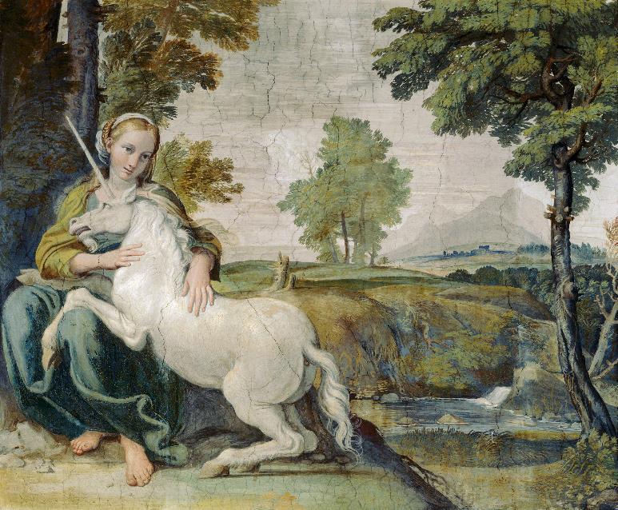
Unicorns
A unicorn is a horse with a single horn on their head.
scottishbooktrust.com

Slide 10
Unicorns are… myth!
A unicorn is a myth.
scottishbooktrust.com

Slide 11
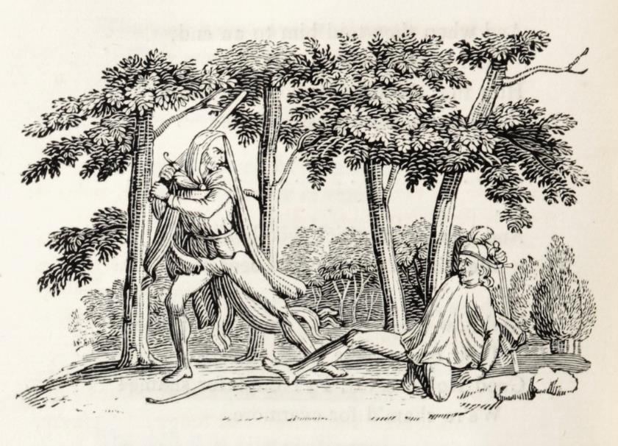
Robin Hood
Robin Hood is the story of a man who steals from the rich to give to the poor.
scottishbooktrust.com

Slide 12
Robin Hood is… legend!
Robin Hood is a legend, as the story is inspired by a real person and time period.
scottishbooktrust.com

Slide 13
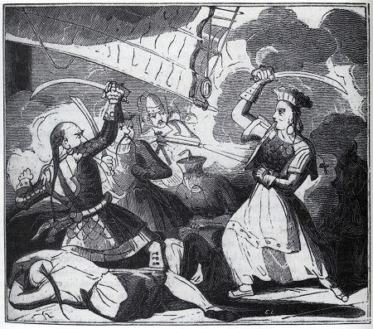
Zheng Yi Sao
Zheng Yi Sao was a pirate leader from China who commanded over 60,000 pirates. She was one of the most successful pirates in history.
scottishbooktrust.com

Slide 14
Zheng Yi Sao is… legend!
Zheng Yi Sao is a legend because, whilst her story is exaggerated she was a real person (and a real pirate!)
scottishbooktrust.com

Slide 15
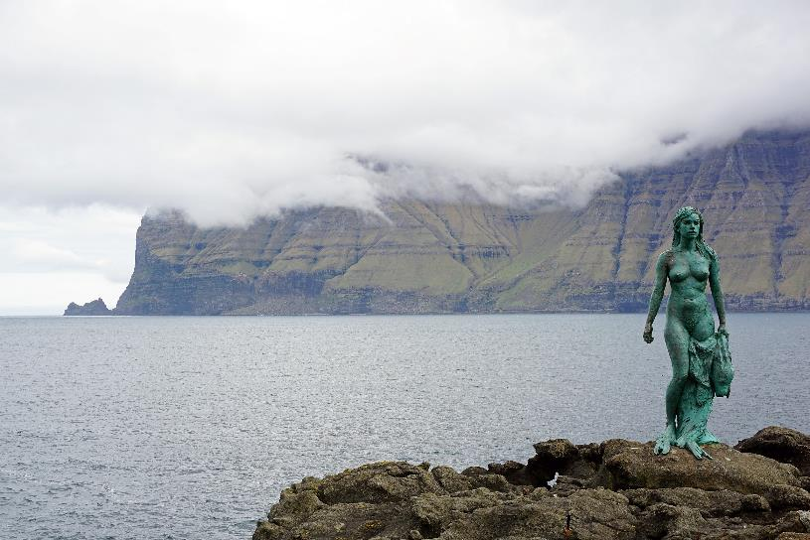
Selkies
Selkies are seals who can turn into people by removing their sealskin.
scottishbooktrust.com

Slide 16
Selkies are… myth!
Selkies are myth because they are not based on a true story.
scottishbooktrust.com

Slide 17
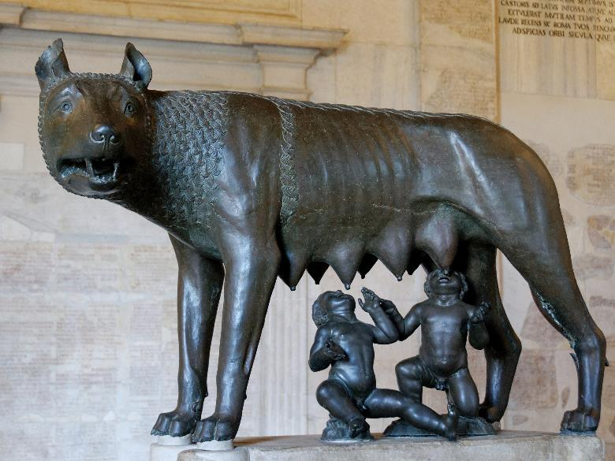
Romulus and Remus
Romulus and Remus were twin brothers who founded the city of Rome. The story claims they were raised by a female wolf.
scottishbooktrust.com

Slide 18
Romulus and Remus are… legend!
Romulus and Remus are legend because they are based on a real person and city.
scottishbooktrust.com

Slide 19
Lesson 2: How do myths and legends travel?
scottishbooktrust.com
Notes:
Lesson 2: How do myths and legends travel?
Estimate time to complete: 30-45 minutes (if using accompanying Word/PDF resource) or 25 minutes if just using PowerPoint
Materials needed: Pens, paper

Slide 20
How myths and legends travel
Some myths and legends are specific to some countries, whereas others can travel.
Most myths and legends were stories that people would tell one another. So, when people from different cultures meet and share stories, a myth or legend can spread to another area – whether that’s a new town, area or country.
scottishbooktrust.com
Notes:
Read through the slide together. Ask the children if they’ve heard of a story travelling. Have they heard a story from a family member? Or heard of urban legends spreading through different schools?

Slide 21
Dragons!
Dragons are a great example of a common myth. Many cultures across the world have a story about a dragon, but each of them are a bit different.
scottishbooktrust.com
Notes:
Ask the children to try and describe a dragon to you. If you have longer time, set a timer for five minutes and ask them to draw a dragon from memory. What are the main things they think are important?

Slide 22
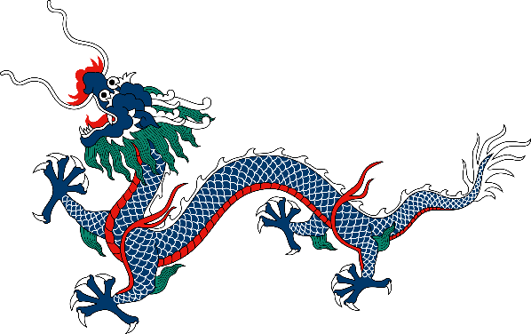
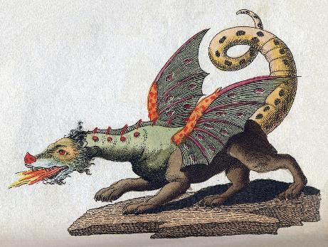
Types of dragon
European:
Can fly
Breathe fire
Have horns
Often don’t talk
Chinese:
No wings
Can’t breathe fire
No horns
Incredibly intelligent
scottishbooktrust.com
Notes:
Discuss with the children – if they described or drew a dragon, was it closer to a European or a Chinese dragon? What influenced how they see dragons in their head – e.g. a book, film, story.

Slide 23
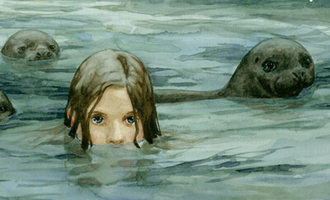
Selkies 1
A famous myth from Scotland is a selkie – a seal who can turn into a person by removing their sealskin. The story often follows a selkie who has their skin stolen, and so can’t return to the sea.
scottishbooktrust.com
Notes:
Read through the slide together. Has anyone heard of the selkie story? What do they know about them?
Read the story “Gillon and the Selkie” together.

Slide 24
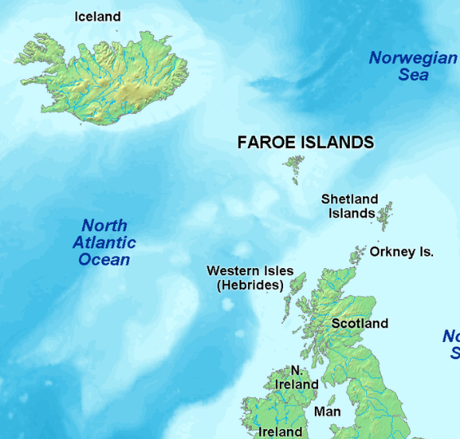
Selkies 2
The selkie story is from the Northern Islands of Scotland (Orkney and Shetland).
But the selkie story has also been found in Iceland, the Faroe Islands and Ireland.
By looking at a map we can see how this story has travelled.
scottishbooktrust.com
Notes:
Read through the slide together. Can children think of why this story would travel specifically to these areas?

Slide 25
Lesson 3: Myths, meanings and morals
scottishbooktrust.com
Notes:
Lesson 3: Myths, meanings and morals
Estimate time to complete: 45-60 minutes (if using accompanying Word/PDF resource) or 30-45 minutes if just using PowerPoint
Materials needed: Pens, paper

Slide 26
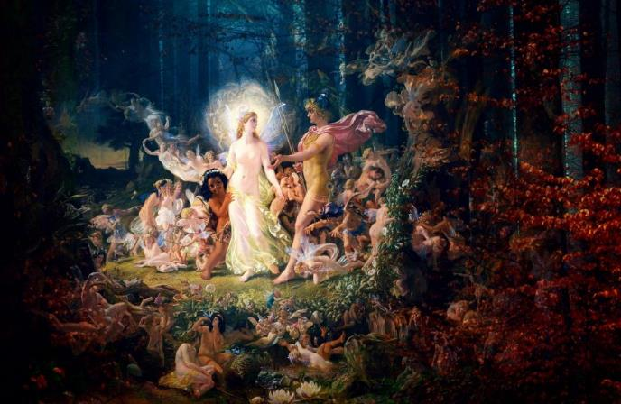
The meanings behind stories
Myths and legends often have a moral. This means that there is a lesson we can take away from them that can apply to other situations.
One example of this is The Wee Folk of Merlin Craig.
scottishbooktrust.com
Notes:
Read through the slide together. Does anyone in the class know of any stories with meanings or morals behind them? Read “The Wee Folk of Merlin Craig” together.

Slide 27
What’s the moral of the Wee Folk?
What do you think the moral of the story is?
We can often figure out what a myth or legend is trying to tell us by looking at:
how the characters behave
what words are used to describe the characters
who is celebrated versus who is punished
scottishbooktrust.com
Notes:
Put the children into groups and ask them to discuss what they think the moral of the story is. The next couple of slides contain a recap if they need it.

Slide 28
The Wee Folk of Merlin Craig 1
This story follows Dougal who cuts peat from the land his master owns. His boss will then sell the peat to people who will burn it to heat their homes.
Dougal doesn’t want to cut the peat where the Wee Folk live as this will destroy their homes.
Dougal’s master forces him to cut the peat by threatening that he will fire him if he doesn’t.
scottishbooktrust.com
Notes:
If needed you can use these slides to recap the story.

Slide 29
The Wee Folk of Merlin Craig 2
When Dougal’s master forces him to cut the peat, the Wee Folk’s house is destroyed. The Wee Folk get revenge on the master by forcing him to dance all day for twenty days.
When the master returns home, he realises because the Wee Folk are magical and he wasn’t away for twenty days – he was away for twenty years!
scottishbooktrust.com
Notes:
If needed you can use these slides to recap the story.

Slide 30
Dougal versus The Master
Dougal:
Doesn’t want to harm the Wee Folk
Tries to explain to his Master why he shouldn’t cut the peat
Wants to look after his family (and so tries to keep his job)
Ends the story with a family and a big house
The Master:
Puts the money he’ll make before the Wee Folk’s homes
Forces Dougal to harm the Wee Folk by threatening him
Is punished by the Wee Folk for harming them
Ends the story
without a house
scottishbooktrust.com
Notes:
Read through the slide together. If we compare Dougal and The Master we can see how one is seen by the story as more moral than the other.

Slide 31
Adjectives: Dougal and the Master 1
What words would you use to describe Dougal versus the Master?
scottishbooktrust.com
Notes:
Put the children back in their groups and ask them to come up with some adjectives to describe each of the characters. If you have a smart board you can write them under the question.

Slide 32
Dougal versus The Master 2
Dougal:
Hardworking
Caring
Loving
Patient
The Master:
Selfish
Cruel
Exploitative (takes advantage of Dougal’s work)
scottishbooktrust.com
Notes:
Do the children agree with these adjectives? Did they use different ones?

Slide 33
The moral of the Wee Folk 1
The Wee Folk of Merlin Craig is…
scottishbooktrust.com
Notes:
Ask the children to write three sentences explaining the moral of the story.

Slide 34
The moral of the Wee Folk 2
The Wee Folk of Merlin Craig is telling us we should look after other people and that we shouldn’t be selfish and put ourselves before others.
We could also understand this through The Golden Rule which says we should treat others how we would like to be treated.
scottishbooktrust.com
Notes:
Look at examples of The Golden Rule together online.
How would the following characters have behaved if they followed the Golden Rule:
Dougal
The Wee Folk
The Master

Slide 35
Lesson 4: Myths and language
scottishbooktrust.com
Notes:
Lesson 3: Myths and language
Estimate time to complete: 45-60 minutes (if using accompanying Word/PDF resource) or 30-45 minutes if just using PowerPoint
Materials needed: Pens, paper

Slide 36
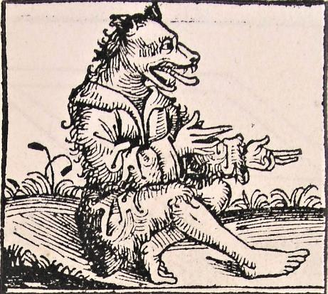
Wulvers and werewolves
Who has heard of a wulver before?
Have you heard of a werewolf?
How are they similar? How are they different?
scottishbooktrust.com
Notes:
Ask the children if they’ve ever heard of a wulver and, if so, do they know how they’re different or similar to a werewolf. Read “The Wulver” together.

Slide 37
Compare wulvers and werewolves 1
Wulvers | Both | Werewolves
scottishbooktrust.com
Notes:
Read through Kids Britannica webpage on Werewolves and compare werewolves with wulvers by creating a chart of their similarities. If you’re short on time and have a smart board, you can also ask children to answer verbally and write directly on this slide.

Slide 38
Compare wulvers and werewolves 2
Wulvers | Both | Werewolves
Like fishing | Are half man, half wolf | Hunt humans and other animals
Live in caves | Mythical creatures | Change during full moon, are humans the rest of the time
Are wulvers all the time and don’t transform | Explore the wilderness | Can turn other humans into werewolves by biting them
Wear clothes and can talk |  | Don’t wear clothes or act like people when they’re in werewolf form
Are kind and generous |  | Are aggressive and angry
scottishbooktrust.com

Slide 39
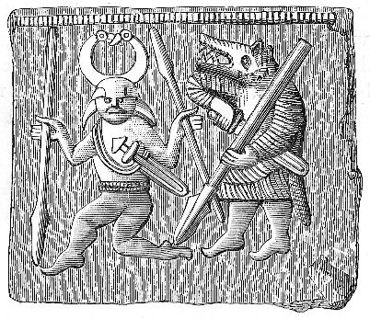
Word: Werewolf
We can learn more about a myth when we look at where the words we use come from.
For example, the word werewolf comes from the Old English wolf man.
So we know that long ago people were
talking about a creature that was both
man and wolf.
Seems obvious, right?
scottishbooktrust.com
Notes:
Read through the slide together.

Slide 40
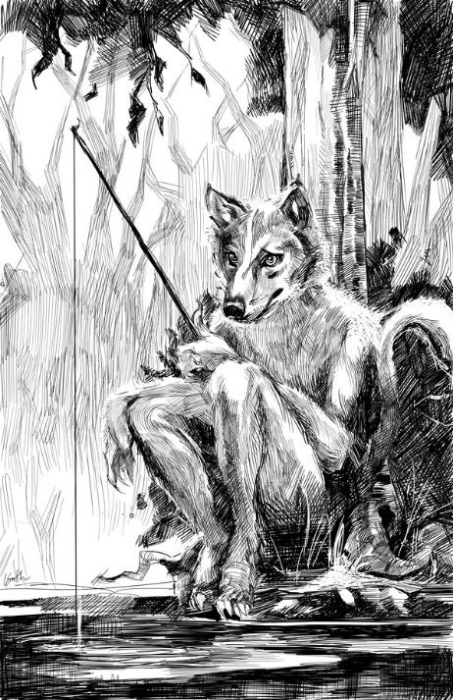
Word: Wulver
Where do you think the word wulver comes from?
What do you think it means?
The answer might surprise you!
scottishbooktrust.com
Notes:
Read through the slide together. Can anyone guess where the word wulver comes from?

Slide 41
Origin of “wulver” 1
The word wulver actually means fairy! Here’s how it came to name a mythical creature.
In 1890s, Jakob Jakobsen, a scholar from the Faroe Islands, was creating a list of the names of places in Shetland and came across Wolvershull.
Shetland has a lot of Old Norse place names because of how close it is to Norway as well as how many Vikings lived in Shetland.
scottishbooktrust.com
Notes:
Read through the slide together. You can look up more about Jakob Jakobsen and Jessie Saxby on the Shetland Museum Archive website.

Slide 42
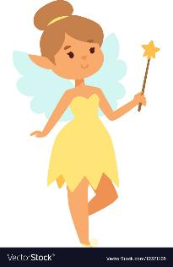
Origin of “wulver” 2
Jakob Jakobsen pointed out that Wolvershull came from the Old Norse and meant fairy hill.
Wolver = Fairy
Hull = hill
In the 1930s, over 40 years after Jakob Jakobsen’s study, a folklorist called Jessie Saxby was struck by how much the word “wolver” or “wulver” sounded like the word “wolf”. So she wrote a story about a half man, half wolf called a wulver.
scottishbooktrust.com
Notes:
Read through the slide together. You can look up more about Jakob Jakobsen and Jessie Saxby on the Shetland Museum Archive website.

Slide 43
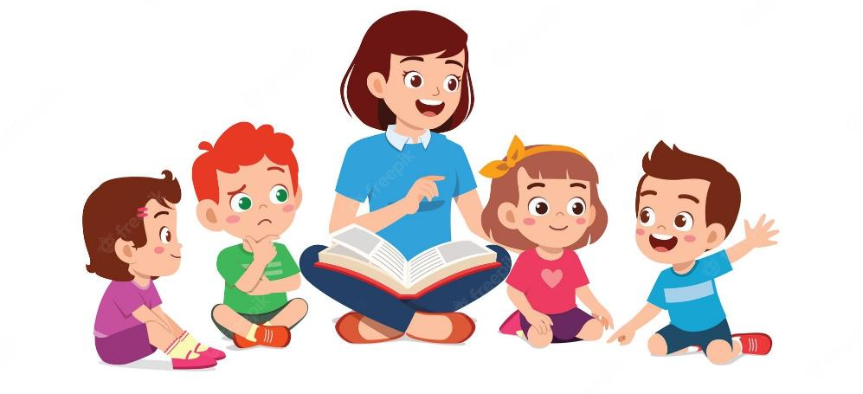
Language
So by looking at myths, we can learn more about language including what languages people spoke in the past and how those languages have changed over time.
scottishbooktrust.com
Notes:
Read through the slide together. Does anyone know any words that are new (e.g. emoji)?

Slide 44


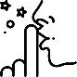

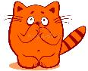



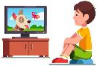


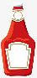




Which words do you recognise?
lemon | ninja | wheest | wee
namby-pamby | lamp | sushi | café
cartoon | gloaming | dog | ketchup
penguin | sock | kitchen | tumshie
scottishbooktrust.com
Notes:
Go through each word and ask who recognises each one. If you need a definition for any of them, see below (but don’t reveal what country they’re from!)
Ninja means “spy” in Japanse
Wheest is used to tell people to be quiet (shhh!) in Scots
Wee means “small” in Scots
Namby-pamby is a Scots adjective used to describe someone timid, indecisive or lacking in character
Sushi is a Japanese dish of rice, seaweed and fish or vegetables
Gloaming is the time of day just before sunset, e.g. twilight or dusk
Tumshie means turnip, but is also used as an insult!

Slide 45
Where do you think these words come from?
lemon | ninja | wheest | wee
namby-pamby | lamp | sushi | café
cartoon | gloaming | dog | ketchup
penguin | sock | kitchen | tumshie
scottishbooktrust.com
Notes:
Ask the children to guess where the words are from. They can either make a list by themselves or in pairs. Or, if you have a smart board you can write answers directly under each word.

Slide 46
How many did you get right?
lemon Arabic | ninja Japanese | wheest Scots | wee Scots
namby-pamby English | lamp English | sushi Japanese | café French
cartoon Italian | gloaming Scots | dog English | ketchup Chinese
penguin Welsh | sock English | kitchen English | tumshie Scots
scottishbooktrust.com
Notes:
Go through each word together. How many did they get right? Here’s some information about the words:
“Lemon” comes from the Arabic, and would have originally covered all citrus fruits
“Ninja” comes from Japanese, meaning “spy” and would be someone skilled at the martial art ninjitsu
“Wheest” is the Scots version of Shhh! Try saying it aloud – it’s an onomatopoeia!
“Namby-pamby” is an English adjective used to describe someone timid, indecisive or lacking in character. It comes from a poem written by a poet called Henry Carey, where he was trying to criticise Ambrose Phillips (another poet!)
“Lamp” came originally from Greek for “torch”
“Sushi” comes from the Japanese “sour rice”, as the dish is often uses vinegar
“Café” comes from the French for “coffee”
“Cartoon” is an Italian word for “drawing”
“Gloaming” is a Scots word coming from “gloom”
“Dog” is an English word, with uncertain origin – dogs have obviously been around for centuries!
“Ketchup” is a Chinese word. It at one point has meant “soy sauce” and “fish sauce”. No one is sure how it came to mean tomato sauce, but there’s a lot of theories about different people travelling for trade!
“Penguin” comes from the Welsh language, and was originally used to describe the great auk (another bird). It means “white head”
Sock is an English word with a Germanic origin. It was originally used to refer to the low-heeled slippers that actors would wear on stage.
“Kitchen” comes from both Germanic and Latin origins, meaning “to cook”
“Tumshie” means “turnip” (it’s also used an insult!”) but its origins are unclear

Slide 47
How words travel
Our language is always changing and new words are created and shared all the time.
One way that languages are changed is when we tell stories. Stories often travel between different areas or countries, and mean we swap words.
Wulver was a story originally from Shetland, but is now known across Scotland – and beyond!
scottishbooktrust.com
Notes:
Read through the slide together.

Slide 48
Time to be a storyteller!
Imagine you’re telling a story to someone.
Pick one of the words from the list and write down how you’d explain it to someone who didn’t recognise it.
lemon | ninja | wheest | wee
namby-pamby | lamp | sushi | café
cartoon | gloaming | dog | ketchup
penguin | sock | kitchen | tumshie
scottishbooktrust.com
Notes:
Split the children into pairs. Ask them to pick one of the words and write down how they would explain the word to someone who didn’t recognise it.

Slide 49
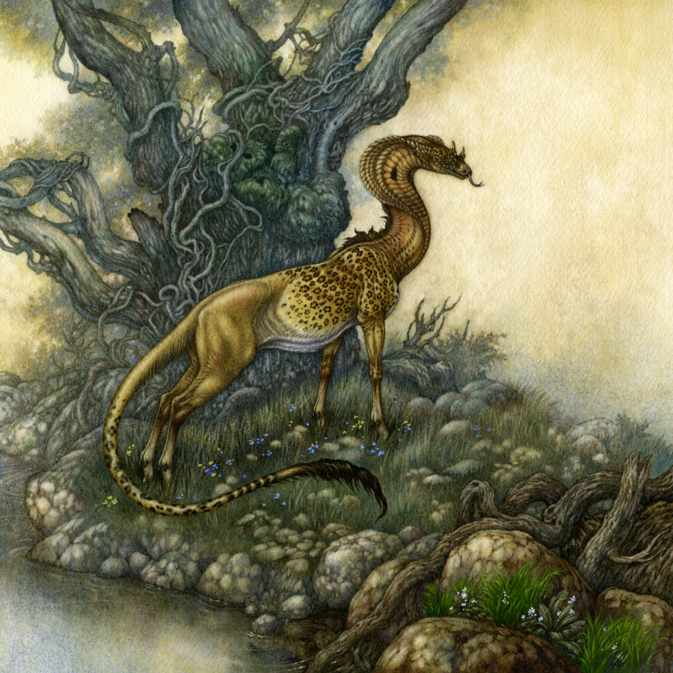
When stories don’t always make it…
scottishbooktrust.com
Notes:
Play a game of telephone together. The person who goes first has to whisper a word or phrase into the person next to them, and so on and so on. Did the same phrase come out the end?
Stories are the same! Often, when stories or language travel, there’s a lot of change along the way.
The art is a Questing Beast and appears in lots of texts from the medieval period. It has:
The neck of a snake
The body of a leapord
The upper legs of a lion
The feet of a dear
The tail of a lion
Can anyone guess what the questing beast might have been? Click to reavel on the next slide!

Slide 50
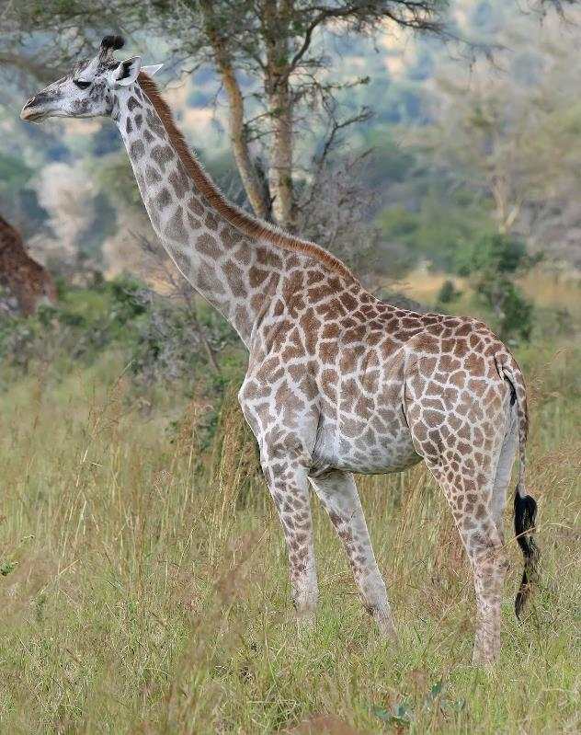
What is a Questing Beast?
scottishbooktrust.com
Notes:
Some historians think a questing beast was actually just people trying to describe a giraffe to someone who hadn’t seen one!
A long neck become like a snake
The pattern on it becomes like a leopard
The tail is like a lion’s
The feet are hoofs like a deer
So, just like Jessie Saxby deciding wulver could link to wolves – sometimes words get reinvented, and new stories are made!

Slide 51

Thank you
scottishbooktrust.com
Scottish Book Trust is a national charity changing lives through reading and writing. Registered company SC184248 | Scottish charity SC027669

