Slide 1

National Parks
The Cairngorms, Scotland
Yosemite, USA
scottishbooktrust.com

Slide 2

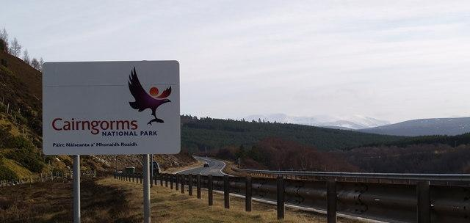

Cairngorms National Park
scottishbooktrust.com
Notes:
Cairngorm National Park This is taken on the A9 Inverness to Perth road near the Slochd Summit looking South-east towards the snow capped Cairngorm mountains.
This image was taken from the Geograph project collection. See this photograph's page on the Geograph website for the photographer's contact details. The copyright on this image is owned by Thelma Smart and is licensed for reuse under the Creative Commons Attribution-ShareAlike 2.0 license.

Slide 3
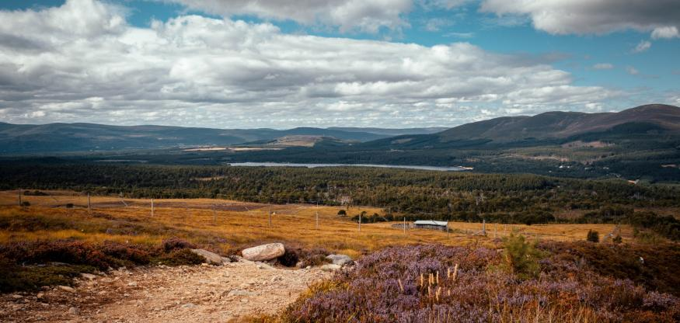
Loch Morlich and the Northern Corries
scottishbooktrust.com
Notes:
Overlooking Loch Morlich and the Northern Corries.
Photo by Jack Skinner on Unsplash.

Slide 4
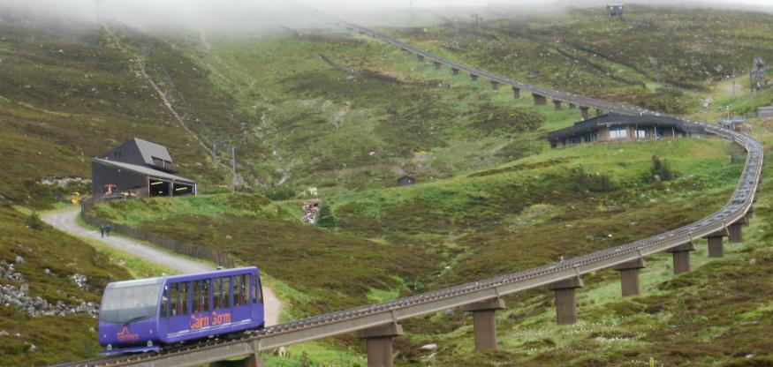
Funicular railway
scottishbooktrust.com
Notes:
Funicular railway in Cairngorm National Park.
This image was taken from the Geograph project collection. See this photograph's page on the Geograph website for the photographer's contact details. The copyright on this image is owned by Peter S and is licensed for reuse under the Creative Commons Attribution-ShareAlike 2.0 license.

Slide 5
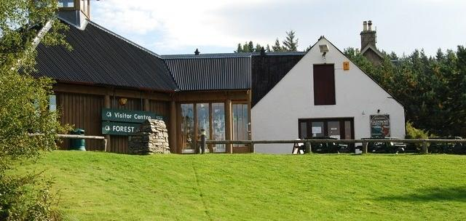
Glenmore Visitor Centre
scottishbooktrust.com
Notes:
Glenmore Visitor Centre, situated opposite the Glenmore Campsite, next door to the Reindeer Centre.
This image was taken from the Geograph project collection. See this photograph's page on the Geograph website for the photographer's contact details. The copyright on this image is owned by jeff collins and is licensed for reuse under the Creative Commons Attribution-ShareAlike 2.0 license.

Slide 6
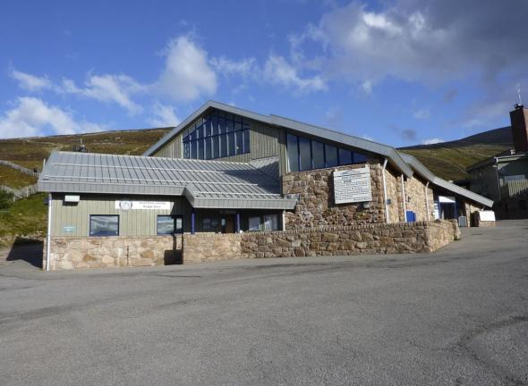
Cairngorm Ranger Base
scottishbooktrust.com
Notes:
Rangers base in Cairngorm National Park.

Slide 7
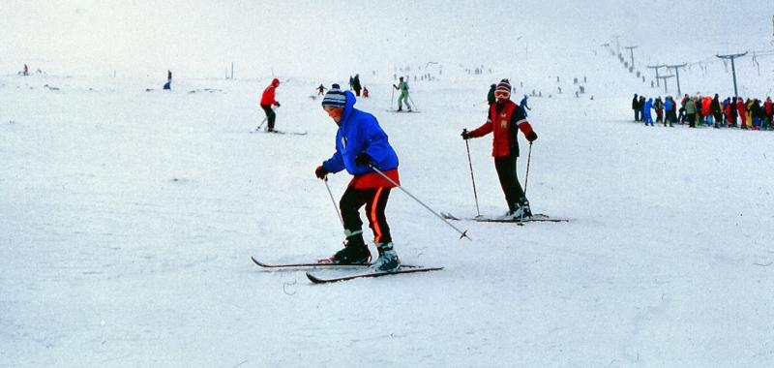
Cairngorm ski slopes
scottishbooktrust.com
Notes:
Cairngorm ski slopes
This image was taken from the Geograph project collection. See this photograph's page on the Geograph website for the photographer's contact details. The copyright on this image is owned by David Dixon and is licensed for reuse under the Creative Commons Attribution-ShareAlike 2.0 license.

Slide 8
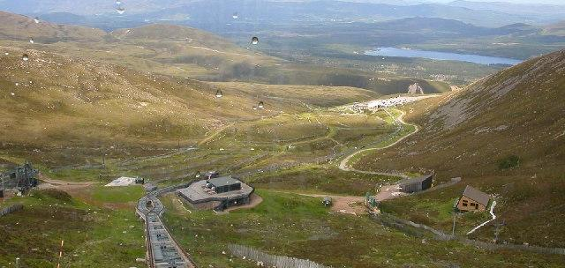
Loch Morlich from Cairngorm
scottishbooktrust.com
Notes:
Cairgorm Funicular Railway. Railway nearing the Ptarmigan centre and restaurant with the mid station, bottom ski centre and car park and finally Loch Morlich below.
This image was taken from the Geograph project collection. See this photograph's page on the Geograph website for the photographer's contact details. The copyright on this image is owned by Johnny Durnan and is licensed for reuse under the Creative Commons Attribution-ShareAlike 2.0 license.

Slide 9
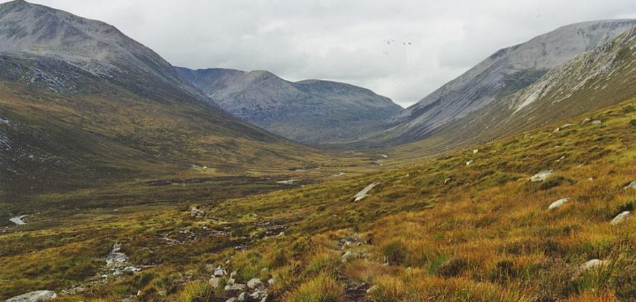
Lairig Ghru
scottishbooktrust.com
Notes:
Path into the Lairig Ghru. As the path begins a slight descent to the floor of Glen Dee, views of the Lairig Ghru open up. Cairn Toul is on the left with Braeriach behind, and Ben Macdui on the right. The tiny dot of Corrour Bothy can be seen left of centre.
This image was taken from the Geograph project collection. See this photograph's page on the Geograph website for the photographer's contact details. The copyright on this image is owned by Nigel Brown and is licensed for reuse under the Creative Commons Attribution-ShareAlike 2.0 license.

Slide 10
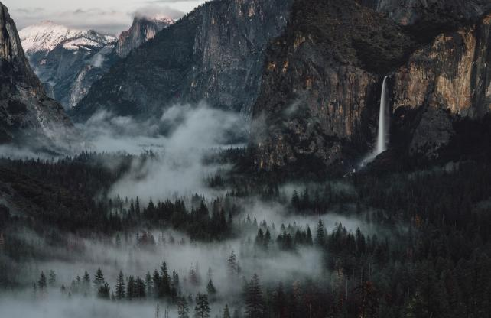
Bridalveil Falls, Yosemite
scottishbooktrust.com
Notes:
Fog in the valley at Yosemite National Park. To the right of the image is Bridalveil Falls
Photo by Thom Milkovic on Unsplash

Slide 11
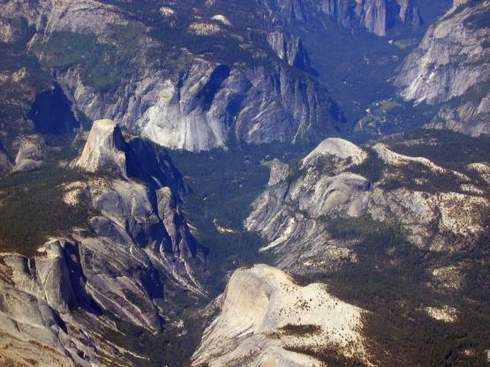
Looking down on Yosemite
scottishbooktrust.com
Notes:
An aerial view of Yosemite Valley from the east looking west. Half Dome rises majestically on the left.
This file is licensed under the Creative Commons Attribution 2.0 Generic license.

Slide 12
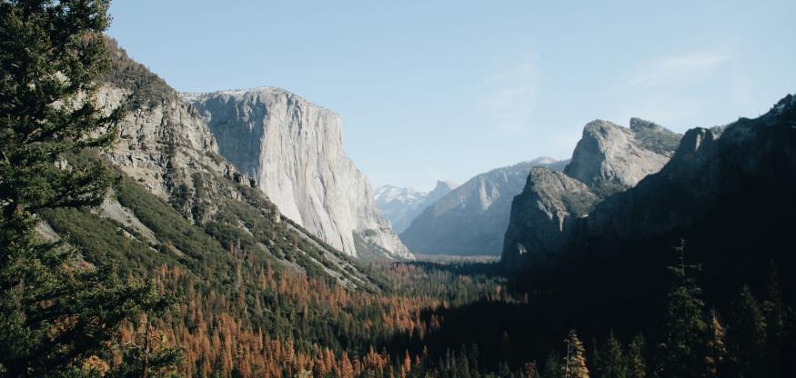
Tunnel view
scottishbooktrust.com
Notes:
Tunnel view, Yosemite. Looking back up Yosemite valley.
Photo by Juliana Malta on Unsplash

Slide 13
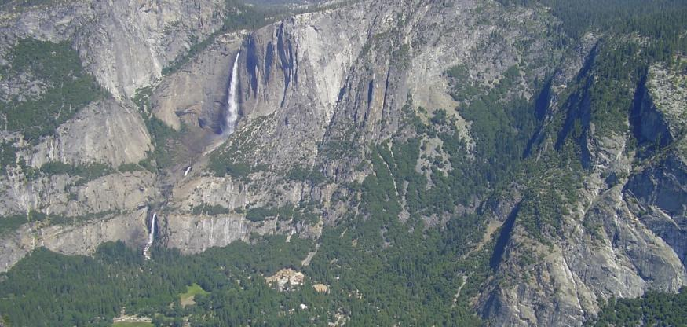
Falls in Yosemite
scottishbooktrust.com
Notes:
Aerial view of falls in Yosemite National Park.
Permission is granted to copy, distribute and/or modify this document under the terms of the GNU Free Documentation License, Version 1.2 or any later version published by the Free Software Foundation; with no Invariant Sections, no Front-Cover Texts, and no Back-Cover Texts. A copy of the license is included in the section entitled GNU Free Documentation License. The copyright holder of this file, Anke Meskens, allows anyone to use it for any purpose, provided that the copyright holder is properly attributed. Redistribution, derivative work, commercial use, and all other use is permitted. Attribution: Foto Anke Meskens

Slide 14
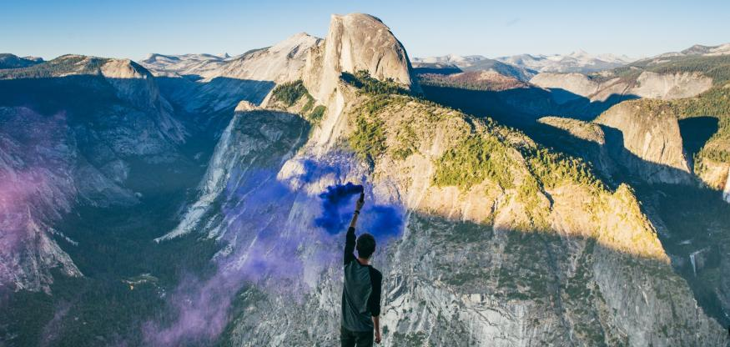
Half Dome from Glacier Point
scottishbooktrust.com
Notes:
Looking towards Half Dome along Glacier Point.
Photo by Austin Neill on Unsplash

Slide 15
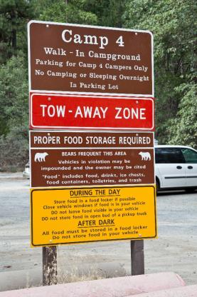
Camp 4 Yosemite Valley
scottishbooktrust.com
Notes:
Sign of a campground favoured by rock climbers near Yosemite Falls in Yosemite Valley, California..
This file is licensed under the Creative Commons Attribution-Share Alike 3.0 Unported license.

Slide 16
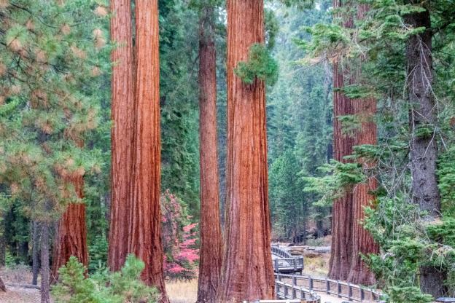
Mariposa grove
scottishbooktrust.com
Notes:
Mariposa grove in Yosemite National Park
Photo by KC Welch on Unsplash

Slide 17
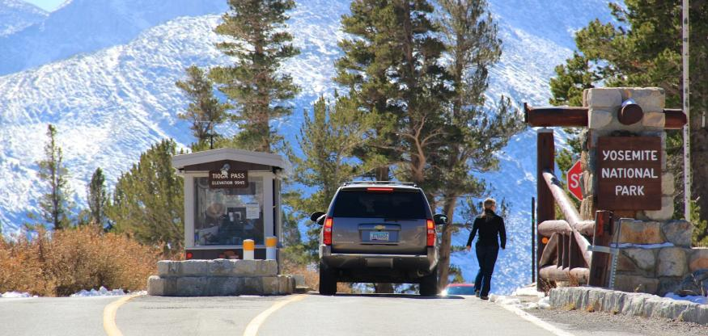
Yosemite Park entrance
scottishbooktrust.com
Notes:
Tioga Pass entrance to Yosemite National Park.
This image was originally posted to Flickr by daveynin at https://www.flickr.com/photos/44124370018@N01/10887160235. It was reviewed on 17 November 2013 by FlickreviewR and was confirmed to be licensed under the terms of the cc-by-2.0.

Slide 18
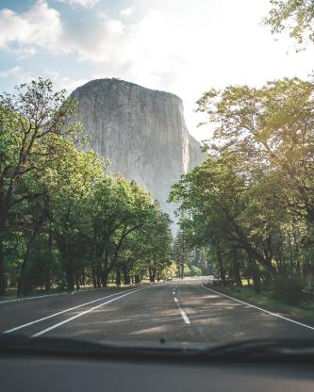
El Capitan
scottishbooktrust.com
Notes:
El Capitan from Southside Drive, Yosemite National Park. El Capitan is part of the Sierra Nevada mountain range. They are also called Pamidu Toiyabe by the native Paiute or Nüümü people. It means Western Mountains. They were renamed by Padre Pedro Font, a Spanish Coliniser.
Photo by Cam DiCecca on Unsplash

Slide 19
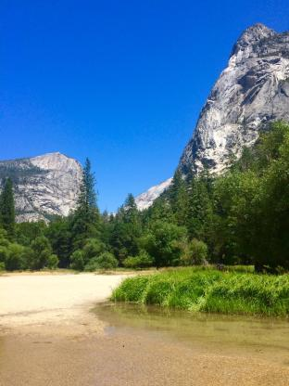
Dry Mirror Lake
scottishbooktrust.com
Notes:
Bottom of Mirror Lake beginning to dry, taken from Mirror Lake Trail, Yosemite.
Photo by Francis Bouffard on Unsplash

Slide 20

Thank you
scottishbooktrust.com
Scottish Book Trust is a national charity changing lives through reading and writing. Registered company SC184248 | Scottish charity SC027669

