Slide 1

Landscapes
Glaciation
scottishbooktrust.com

Slide 2

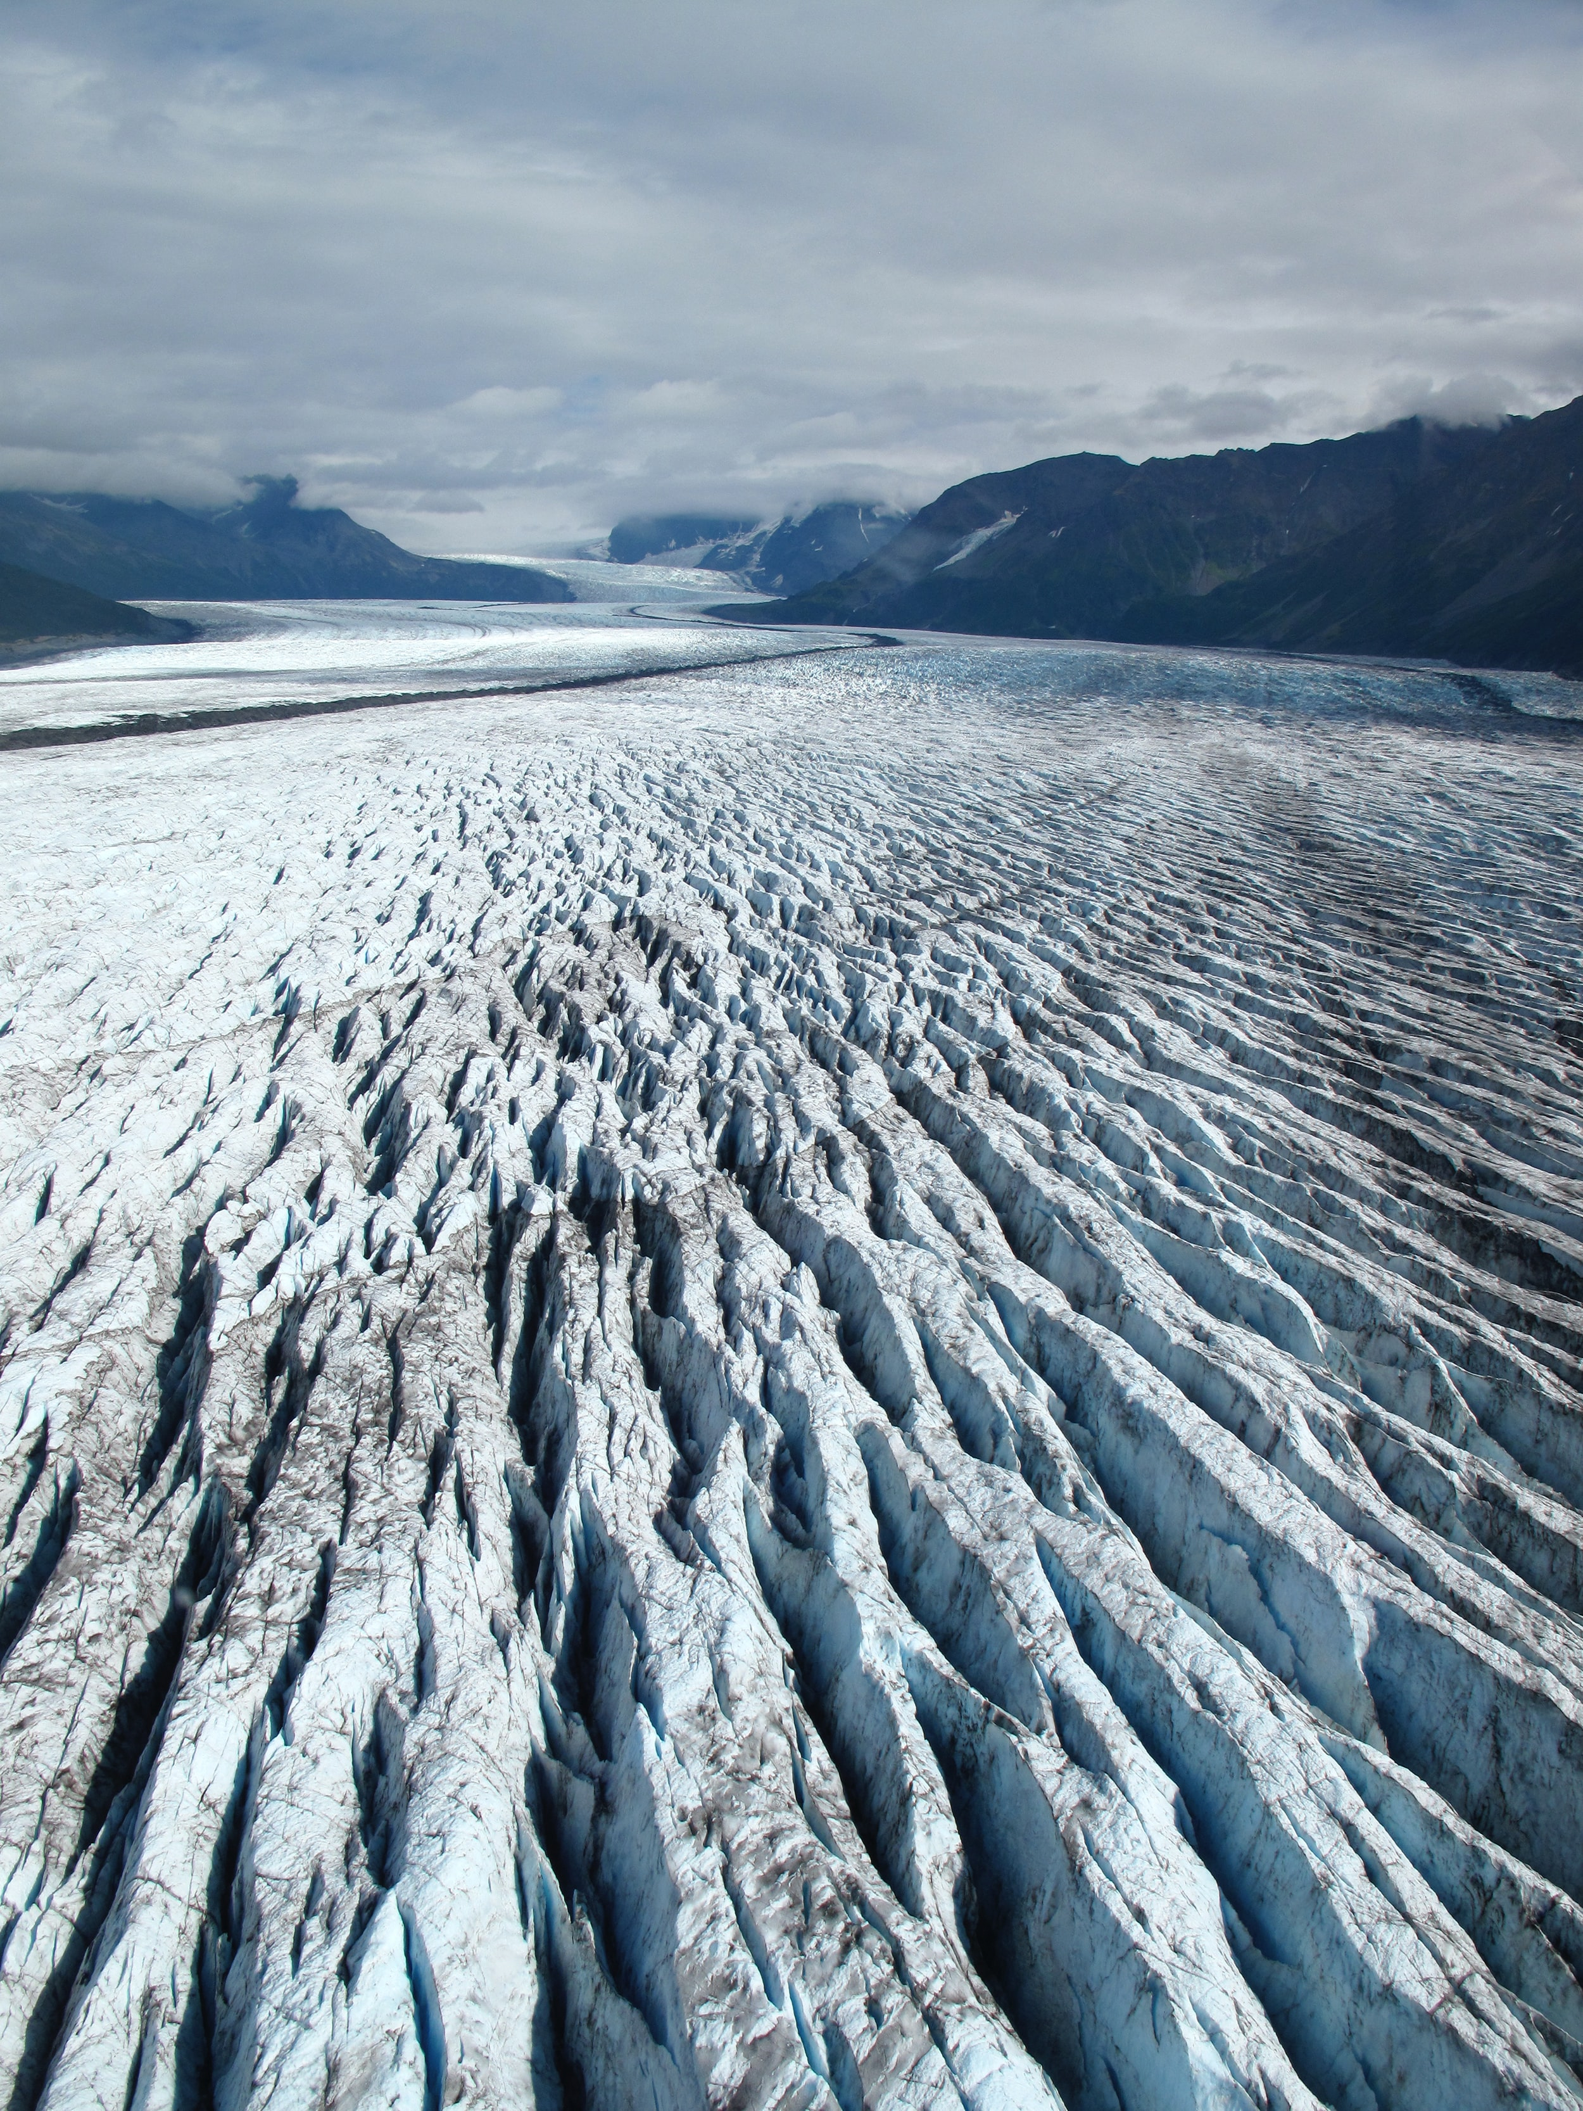

Glacial feature
scottishbooktrust.com
Notes:
Photo by NOAA on Unsplash. Aerial view of a heavily crevassed glacier.

Slide 3
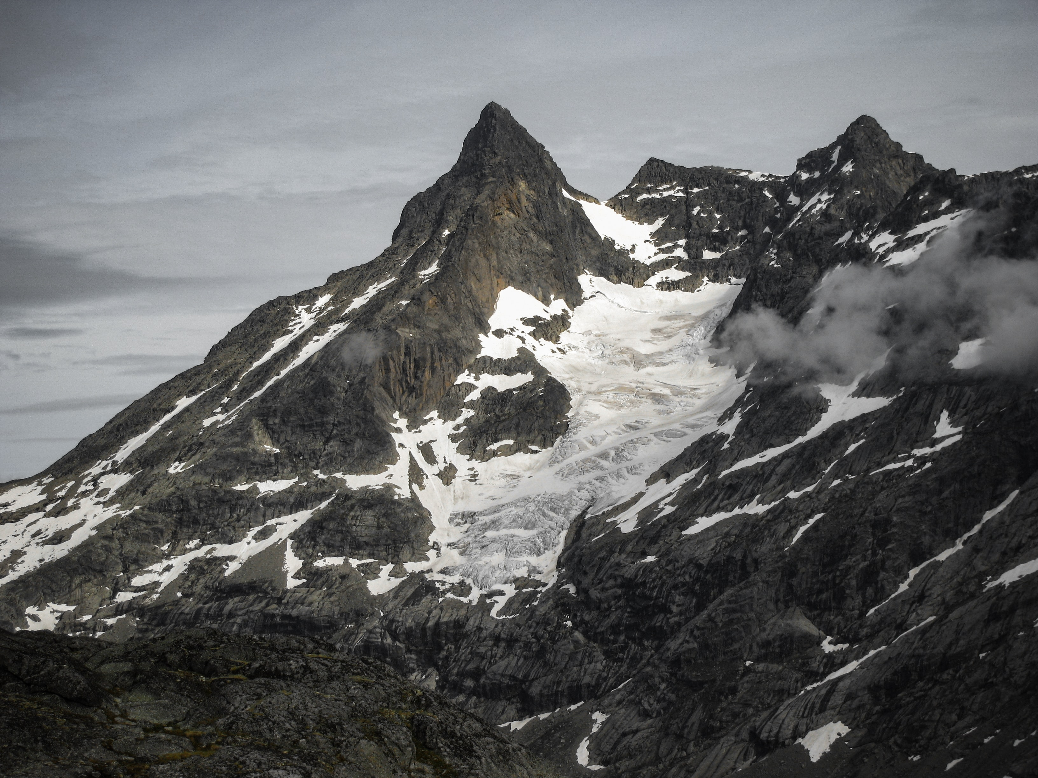
A glacier
scottishbooktrust.com
Notes:
Photo by Matej Drha on Unsplash. Glacier at Storen, Jotunheimen, Norway.

Slide 4
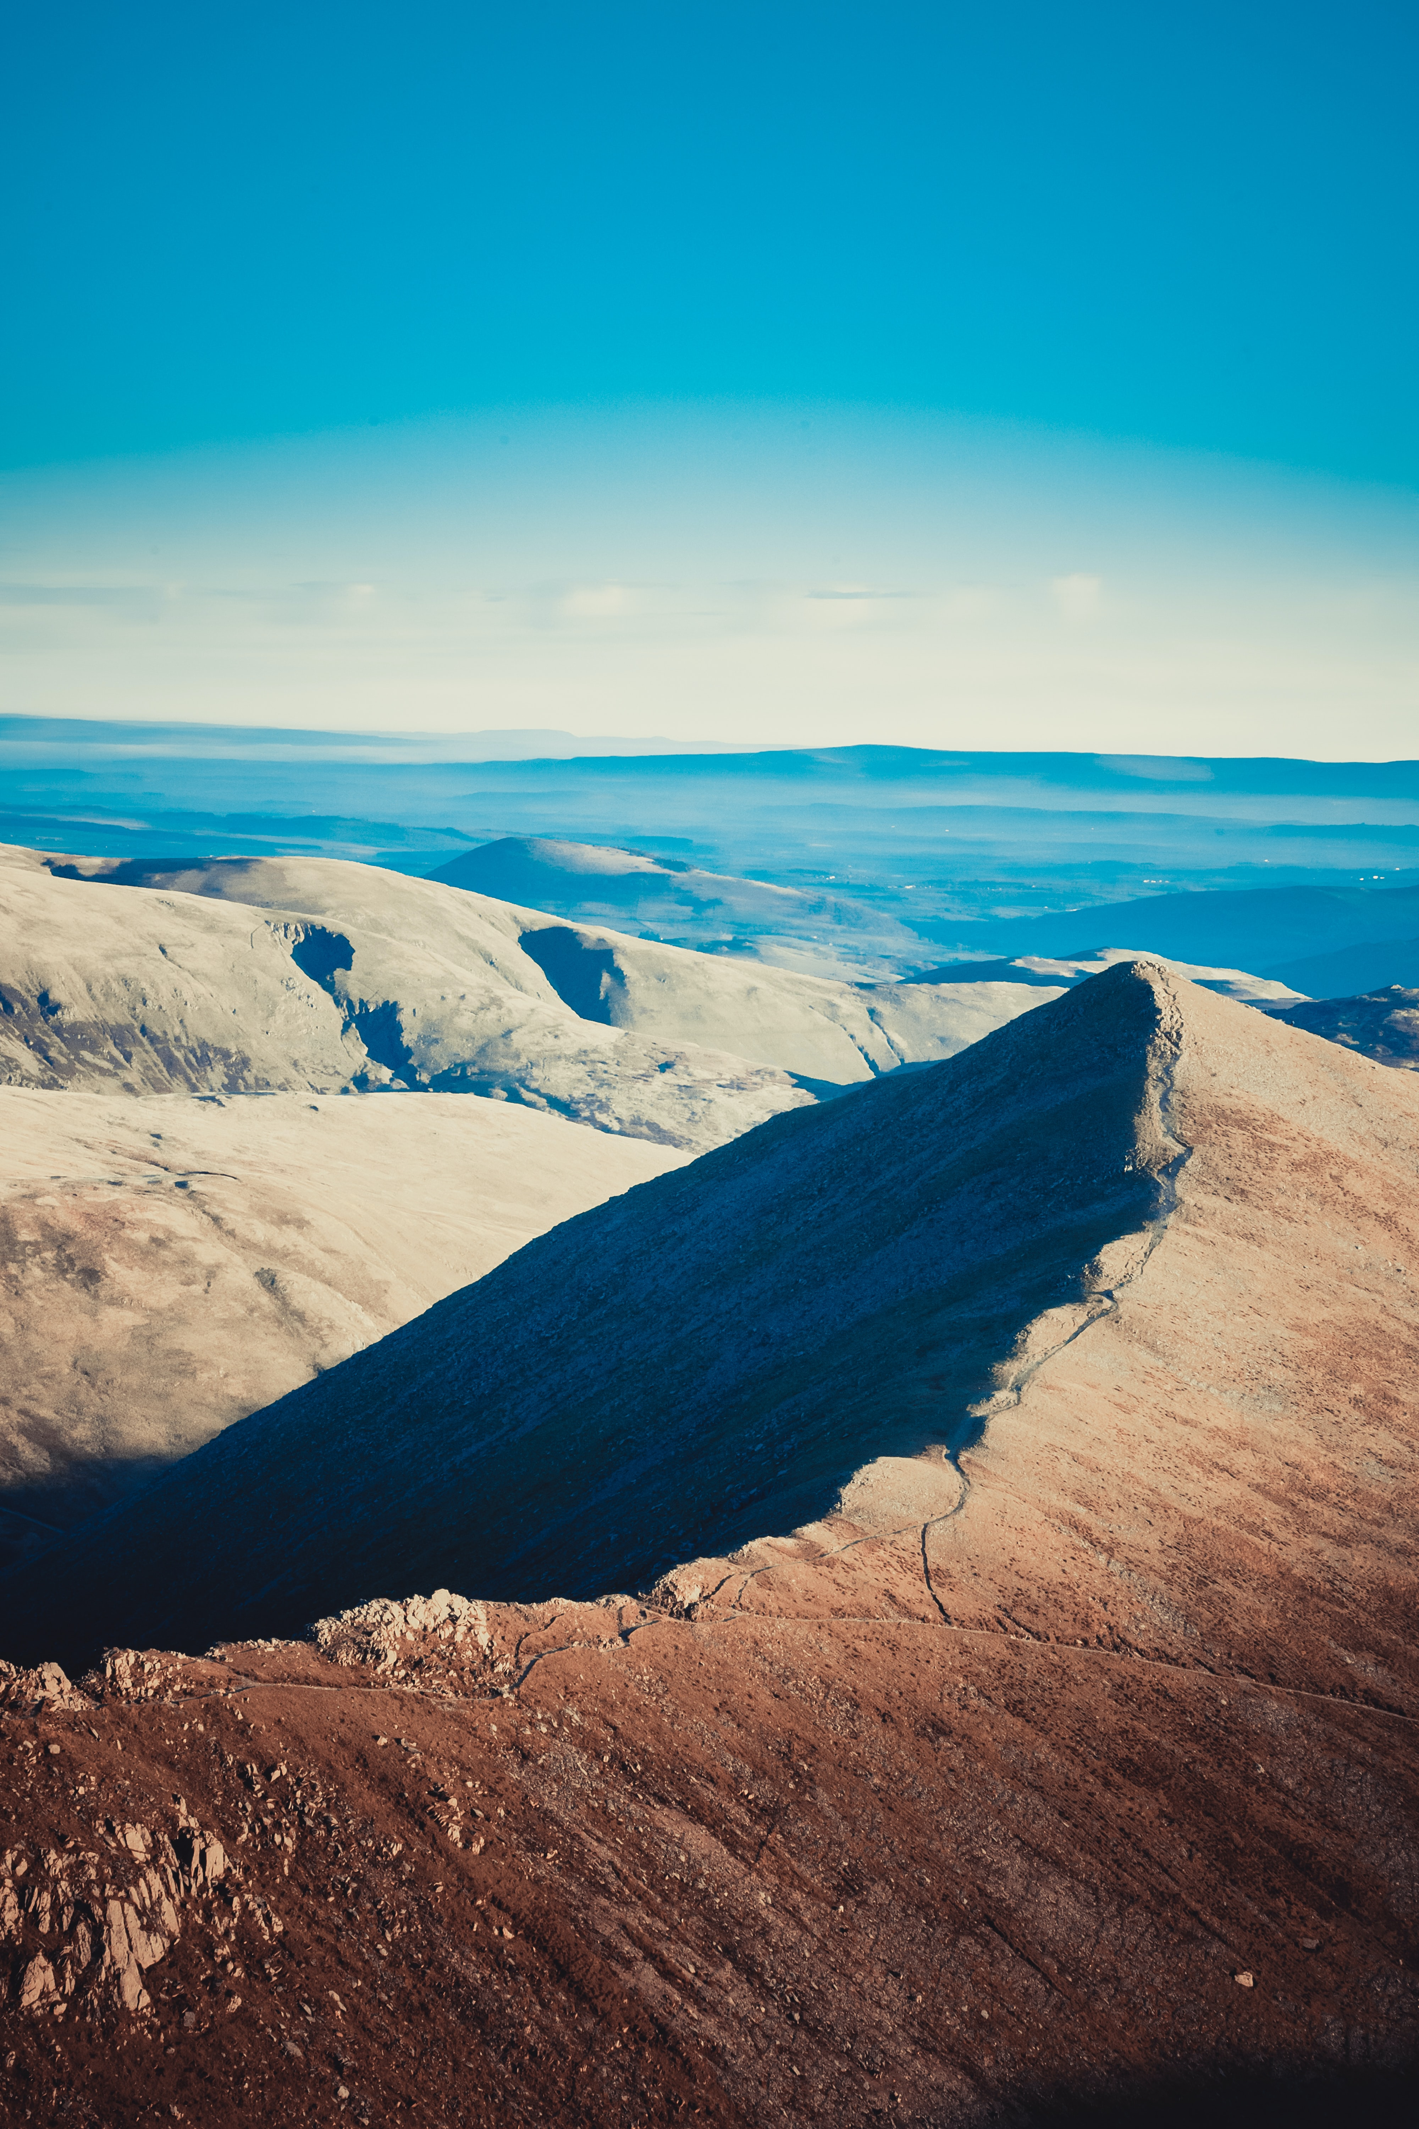
Arête
scottishbooktrust.com
Notes:
Photo by Jonny Gios on Unsplash, A arête at Hellvelyn, Ambleside, England

Slide 5
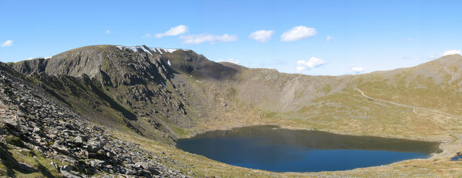
Corrie and lochan and tarn
scottishbooktrust.com
Notes:
Red Tarn and Helvellyn Red Tarn, encircled by Striding Edge ridge to left, Helvellyn summit (centre), and Swirral Edge (right) leading to Catstye Cam. A corrie is the big bowl-shaped hollow in the mountain side. A tarn (also known as a lochan) is a lake that can be found now in the bottom of some corries.
This image was taken from the Geograph project collection. See this photograph's page on the Geograph website for the photographer's contact details. The copyright on this image is owned by Gareth James and is licensed for reuse under the Creative Commons Attribution-ShareAlike 2.0 license.

Slide 6
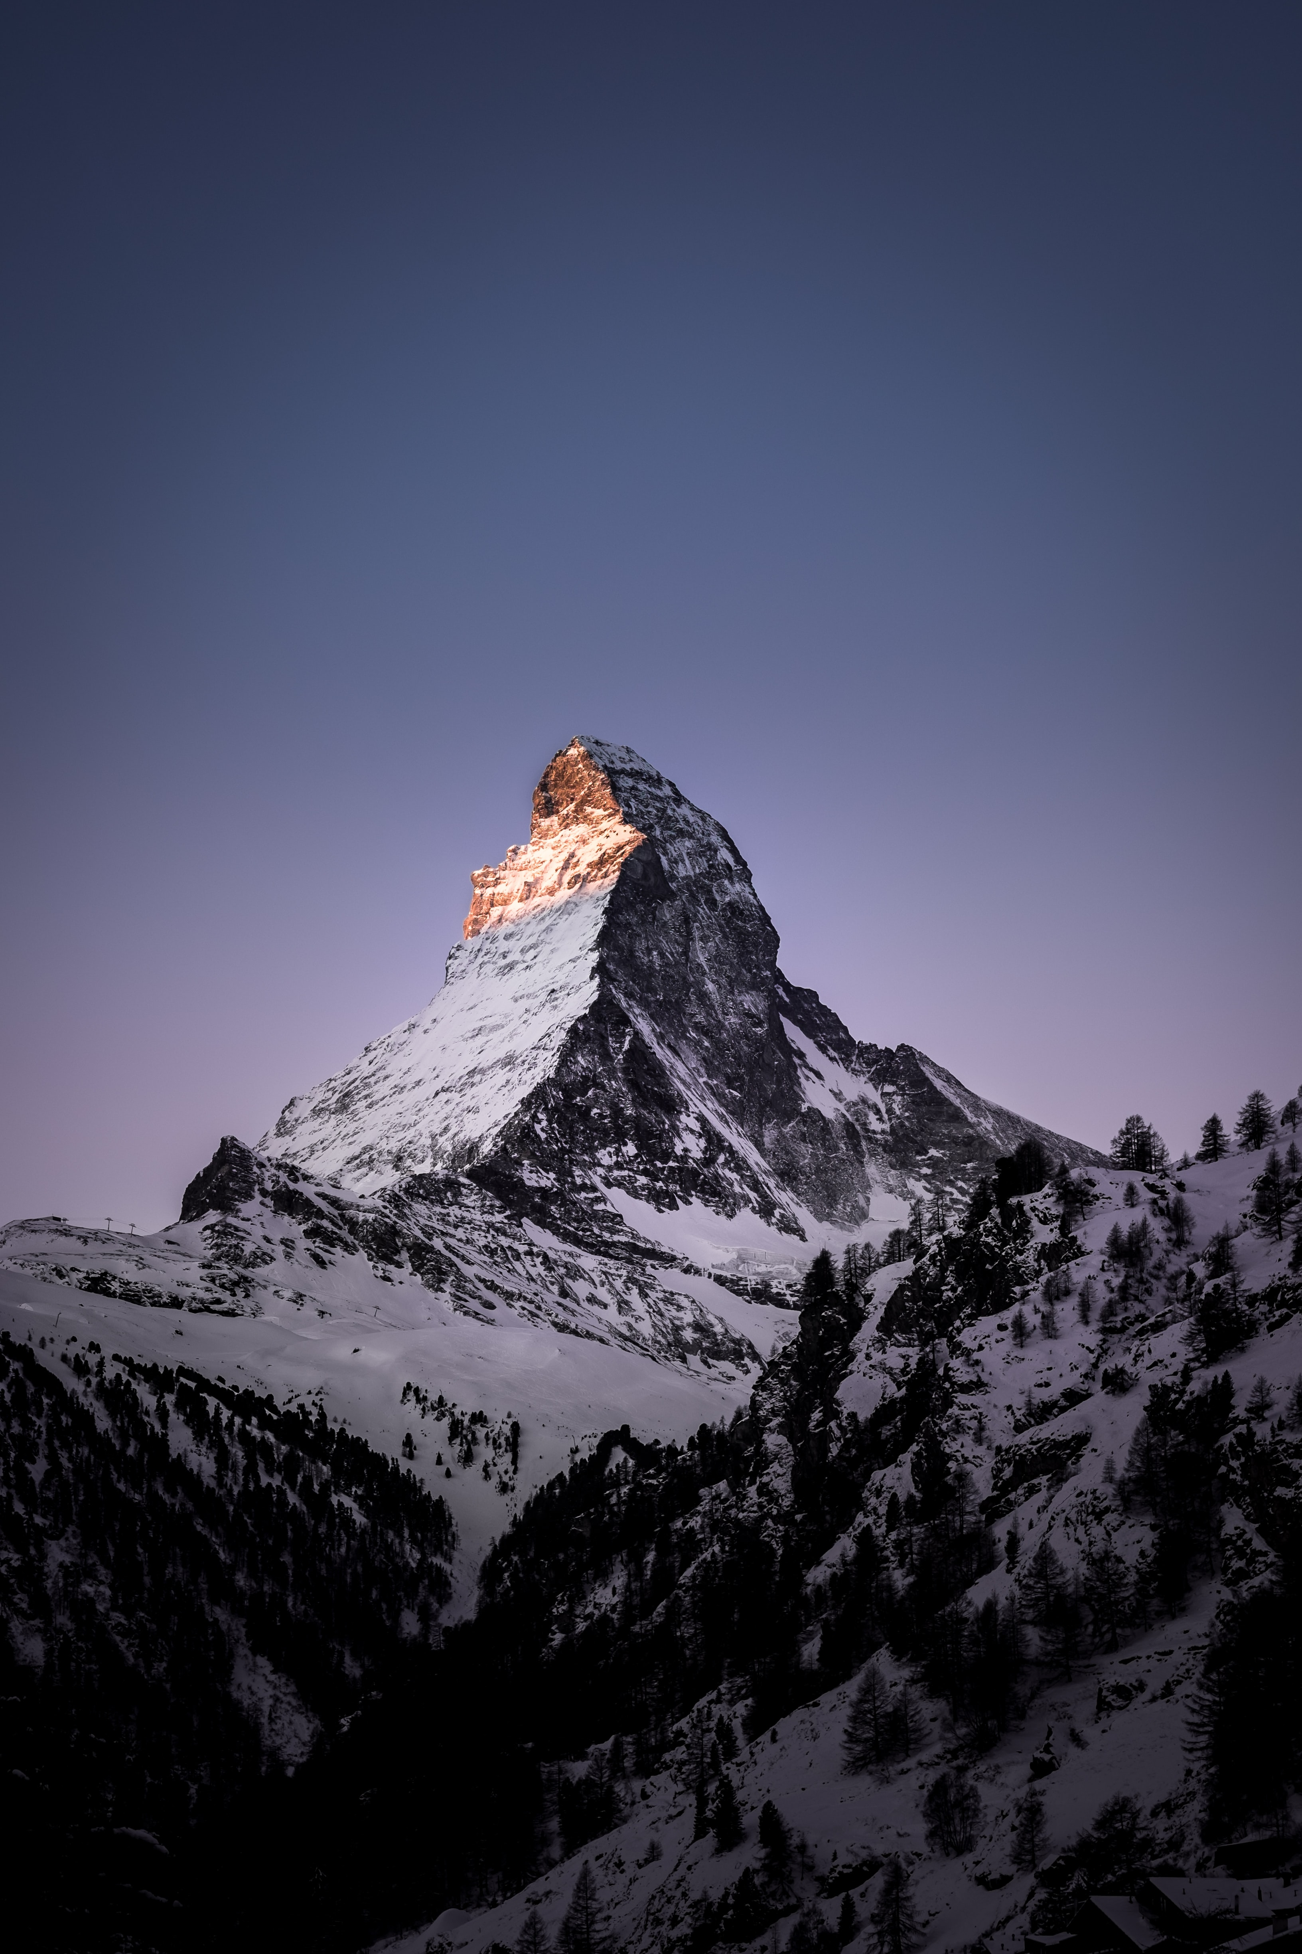
Pyramidal peak
scottishbooktrust.com
Notes:
Photo by Fabrice Villard on Unsplash, Matterhorn, Zermatt, Switzerland.

Slide 7
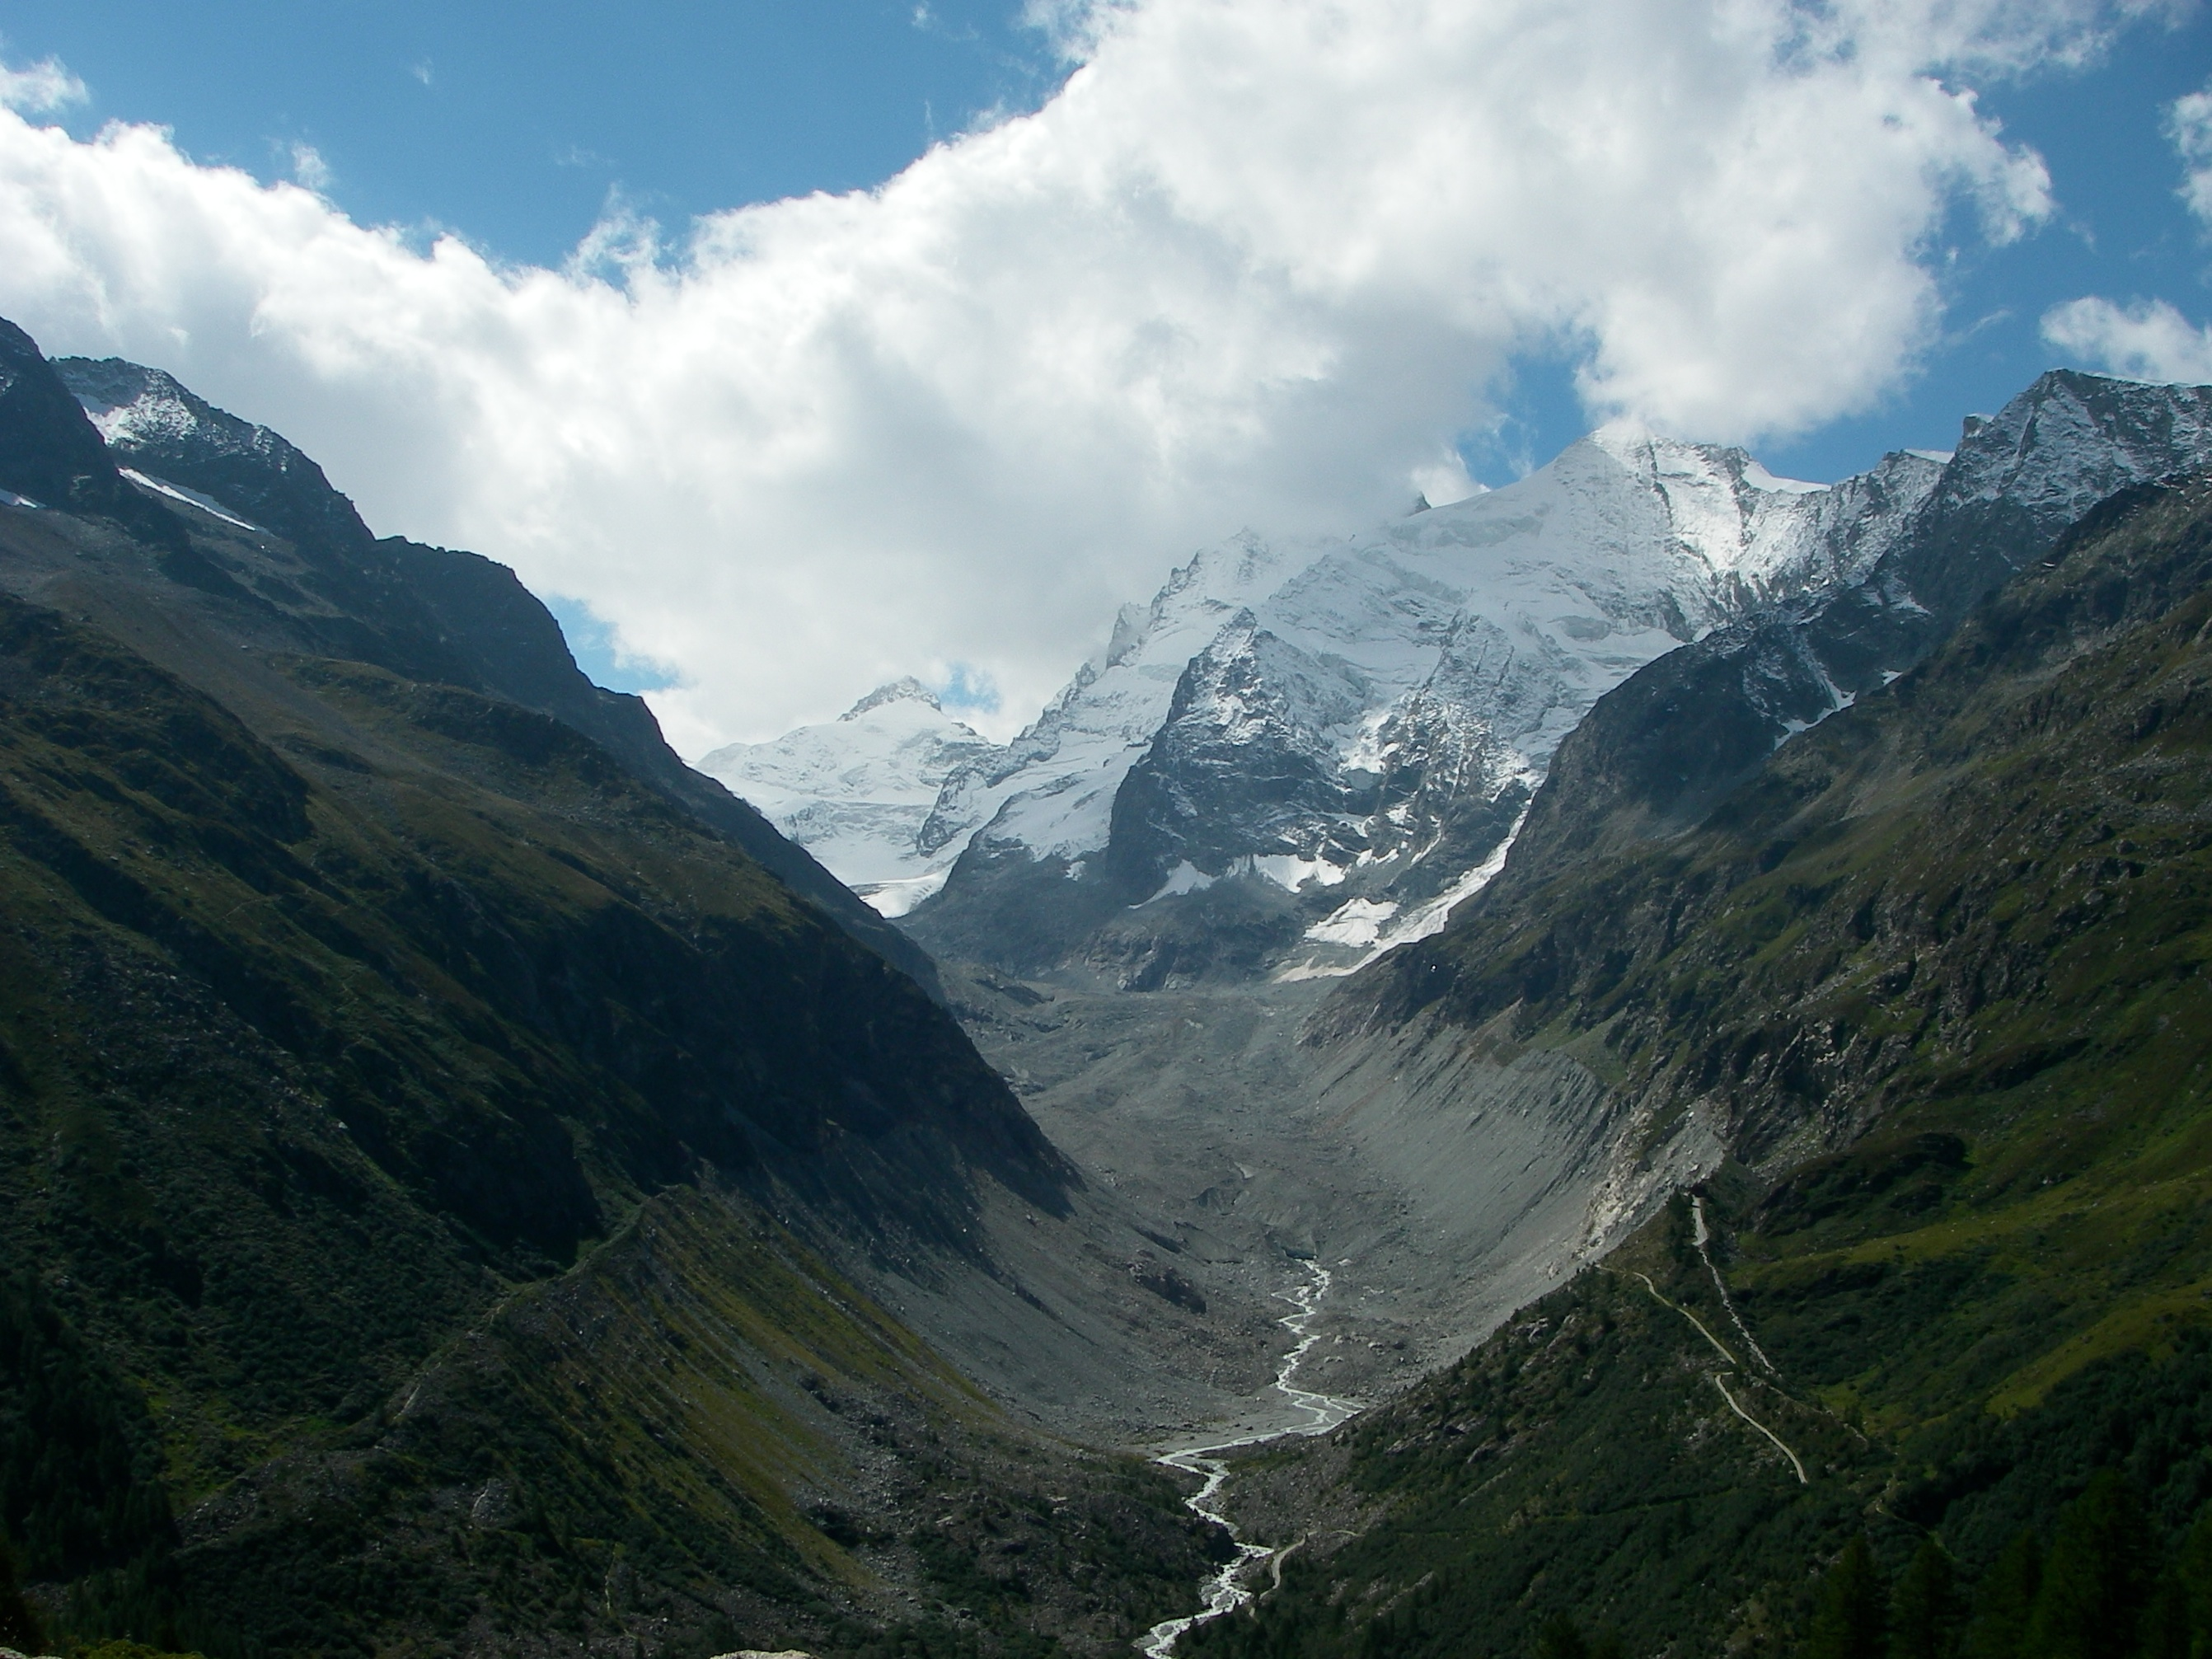
U-shaped valley
scottishbooktrust.com
Notes:
Glacial landscape of Vallée de Zinal from Roc de la Vache in Switzerland. This image was originally posted to Flickr by geographyalltheway.com at https://www.flickr.com/photos/16287002@N00/7112376977. It was reviewed on 29 December 2014 by FlickreviewR and was confirmed to be licensed under the terms of the cc-by-2.0.

Slide 8

Thank you
scottishbooktrust.com
Scottish Book Trust is a national charity changing lives through reading and writing. Registered company SC184248 | Scottish charity SC027669

