Slide 1
Landscapes
Glaciation

Slide 2
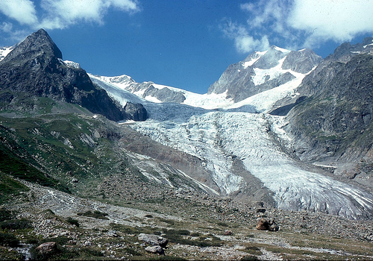
Glacial features

Slide 3
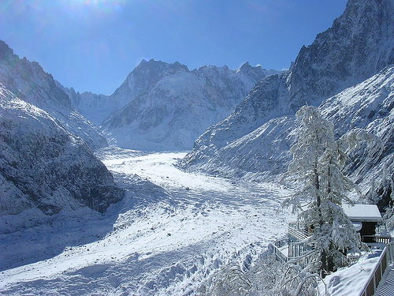
A Glacier

Slide 4
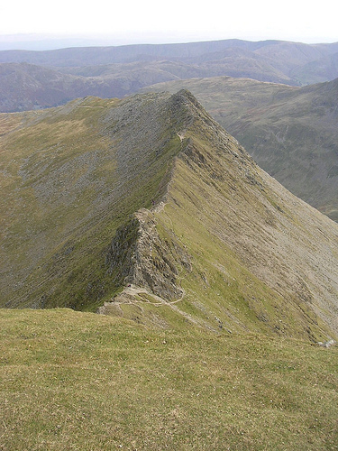
Arête

Slide 5
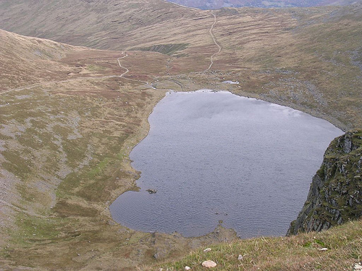
Corrie and lochan or tarn

Slide 6
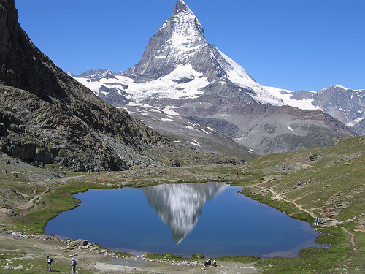
Pyramidal Peak

Slide 7
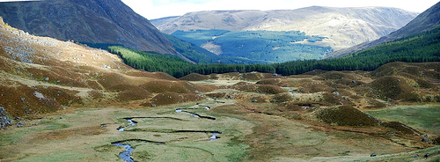
U shaped valley

