Slide 1


Book Discovery Guide
Issue 10: May 2026
scottishbooktrust.com

Slide 2


How to use this PowerPoint
This PowerPoint version of the Book Discovery Guide (issue 10) allows you to share the guide with your colleagues.
Each slide will contain the covers and where applicable, age ratings of the books.
Click ‘notes’ at the bottom of your window to read the blurbs of each book.
scottishbooktrust.com

Slide 3
What is Book Discovery Guide? (1)
Book Discovery Guide is our guide to help you find high-quality contemporary books for pupils of all ages and reading levels.
Each issue contains our top picks across themes, staff picks and guest recommendations, alongside useful resources for a vibrant reading culture.
scottishbooktrust.com

Slide 4

What is Book Discovery Guide? (2)
With all of our resources, we highly recommend that you read the book before using it with your class and use your best judgement on whether teaching about this topic is appropriate for your class.
This icon indicates you should check the notes for content warnings.
scottishbooktrust.com

Slide 5
The importance of using contemporary books in your classroom:
More representative; children are more motivated to read when texts contain characters like them.
Read about a wide range of experiences relevant to today (for example, climate change, refugee crisis, technology and social media).
Language is up-to-date, making it easier to follow.
See ‘notes’ of this slide for more information.
scottishbooktrust.com
Notes:
To find out more information on the importance of using contemporary books in your classroom or school, we recommend the following:
National Literacy Trust’s ‘Children and young peoples’ reading in 2023’ report: https://literacytrust.org.uk/research-services/research-reports/children-and-young-peoples-reading-in-2023
Scottish Book Trust’s article ‘How teachers can put the right book in the right hand’: https://www.scottishbooktrust.com/articles/how-teachers-can-put-the-right-book-in-the-right-hand

Slide 6
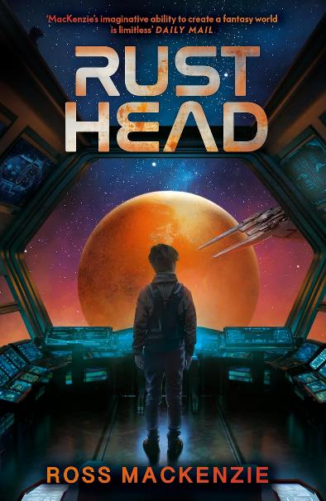
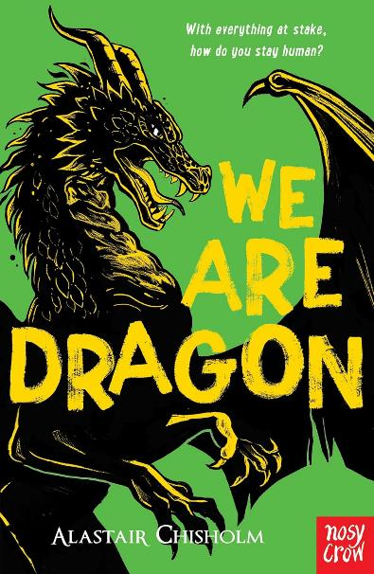
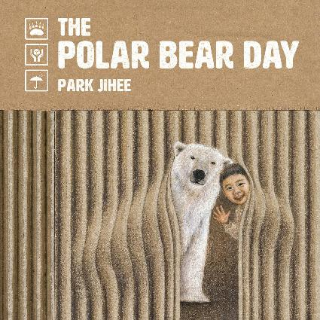
New from Scottish publishers and authors (1)
EY
P5–S1
P5–S1
scottishbooktrust.com
Notes:
New from Scottish publishers and authors
Discover some new picks from Scottish publishers and authors, including previous Junior Book of the Month picks. Each month we run our Junior Book of the Month competition on our website, offering you the opportunity to win some of the most exciting new Scottish publications for children and young people! Make sure you visit our website to join in- https://www.scottishbooktrust.com/book-of-the-month
The Polar Bear Day by Park Jihee (Floris Books)
One day a small child opens their front door to find a polar bear! They spend time together, find snacks in the fridge, and the polar bear has a bath. When night falls, they must help the polar bear return home. Almost wordless, this stunning picture book has a magical quality which draws in the reader and makes them curious about where the story will take them next.
Rusthead by Ross MacKenzie (Andersen Press Ltd)
A thrilling sci-fi adventure about one boy who must help battle an evil robot empire to save the galaxy! Best friends Kol and Sully are ‘rustheads’, (treasure hunters who must search planet Rust's vast desert of scrap for survival). When they discover a hidden spaceship and a mysterious girl on a mission, they’re launched into a fast-paced, galaxy-spanning adventure full of danger, friendship and courage.
We Are Dragon by Alastair Chisholm (Nosy Crow Ltd)
The third book in the series allows us to follow another member of Cub crew, living aboard one of the giant mechanical creatures that carry humans through the warring territories of a dangerous land. Reike is a tech whizz, strong willed, smart and convinced she alone can turn the war. She has her personal battles, finding the world overwhelming and struggling to process human interactions. Can the crew come together so the battle can be won?

Slide 7
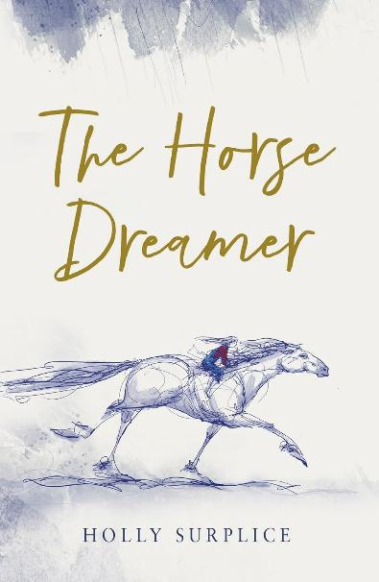
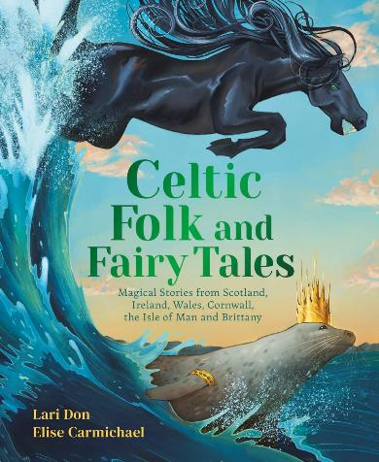
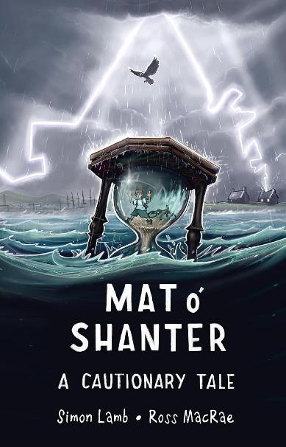

New from Scottish publishers and authors (2)
P6+
P4+
P5+
scottishbooktrust.com
Notes:
New from Scottish publishers and authors
The Horse Dreamer by Holly Surplice (Chicken House Ltd)
Previous Junior Book of the Month
This tender verse novel follows Merryn and her two sisters as they navigate the world after the loss of their father. Merryn fashions a horse from driftwood and storm debris, naming him Sorrel. From that moment on, this dreamlike companion seems to always be there when she needs him most. Set against a backdrop of wild Scottish coastline, this story is alive with feeling and dotted with rich, inky illustrations.
Content warning: death of a parent
Celtic Folk and Fairy Tales by Lari Don (Floris Books)
Previous Junior Book of the Month
Bringing together some of the most fantastical stories from Scotland, Ireland, Wales and more, this is the perfect collection to set your imagination alight. Kelpies, selkies, changelings, imps and giants stride through richly crafted worlds where anything is possible and unlikely heroes emerge. Lari Don’s skilful storytelling makes this a great book to read aloud with the whole family and will make you look twice at the world around you.
Mat o’ Shanter by Simon Lamb (Scallywag Press)
Previous Junior Book of the Month
Think you know Robert Burns’ Tam o’ Shanter? Get ready to see it turned inside out and used as a springboard for something brand new and electric! Simon Lamb reworks the classic epic to centre around Mat, a ‘young Prestwick lad’ with no concern for his worried parents calling him home. Peril, humour and stirring adventures ensue, all articulated in Simon Lamb’s enchanting and lively verse and illustrated in full by Scottish muralist, Ross MacRae.
Content warning: bullying

Slide 8
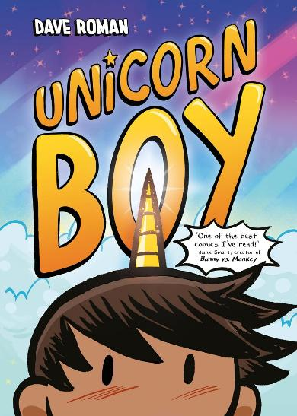

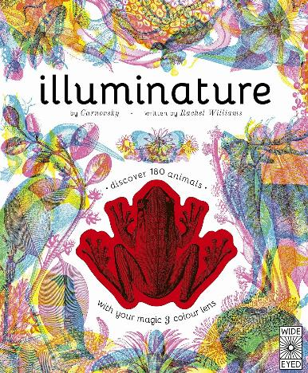
Really readable books (1)
P4–7
S2+
P4–7
scottishbooktrust.com
Notes:
Really readable books
We’ve picked some of our favourite readable texts, including graphic novels, non-fiction and dyslexia friendly printed books. Whether your pupils are keen bookworms, or less engaged with books, here are some great page-turners. If you’re looking for more books like this, see the really readable books for every child book list on our website! https://www.scottishbooktrust.com/book-lists/really-readable-books-for-every-child
Unicorn Boy by Dave Roman (Hodder Children's Books)
Brian’s normal life is interrupted when a singing unicorn horn pops out of his forehead. Now, despite his shyness he’s the centre of attention. What’s worse is now his best friend has been kidnapped and taken away into another realm! Can Brian embrace his powers to help those in need? This colourful graphic novel is funny and heartwarming. With expressive artwork and a fast-paced story, it’ll keep readers hooked.
Kickflip by LD Lapinski and Logan Hanning (Orion Children's Books)
When Elliot is bullied at school for not fitting in with the other girls, they find refuge in the local skatepark. However, when the other skaters assume Elliot is a boy, they realise that neither label feels quite right. Exploring friendship, gender, identity and sports, Lapinski and Logan’s signature styles perfectly balance images with text, making it both an engaging and accessible read that’s full of relatable characters who jump off the page.
Illuminature by Rachel Williams and Carnovsky (Wide Eyed Editions)
This interactive non-fiction book explores different animals and climates across the world. The twist is that it comes with a pair of viewing glasses! Looking through them allows readers to see both these environments during the day and at night, as well as the plant life you can expect to find there. Packed with interesting facts about climate zones, animals and plants, we love how this book cleverly invites readers in.

Slide 9
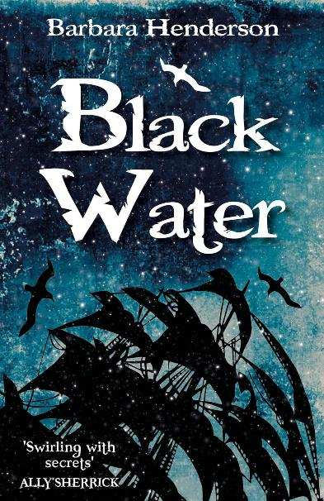
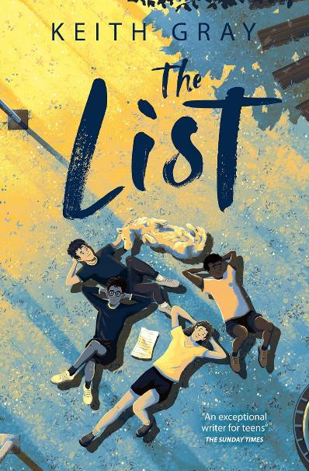
Really readable books (2)
P6–S1
S1+
scottishbooktrust.com
Notes:
Really readable books
Black Water by Barbara Henderson (Pokey Hat)
This historical novella follows Henry, a 13-year-old excise apprentice who is swept up in adventure when a band of smugglers are spotted (then stranded) within the Solway Firth. When forced to board the boat, the excisemen face canons, quicksand and deadly sabotage. Despite its length, Black Water is not short on story or adventure. Inspired by real events from Scottish history, including the life of Robert Burns, this thrilling story is a real page-turner!
The List by Keith Gray (Barrington Stoke Ltd)
Jake and Denny are best friends. However, this is the last summer they’ll spend together before Denny has to move to a new town. Deciding to make the most of the time he still has, Denny comes up with a list of everything he wants to do before he leaves (including settling a score or two)! This dyslexia-friendly book is an excellent coming-of-age story that shines a light on the complexities of friendship.

Slide 10
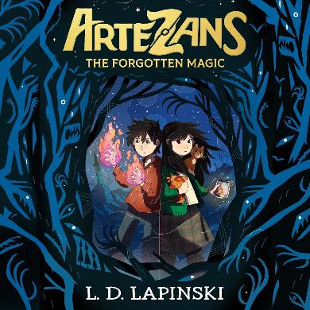
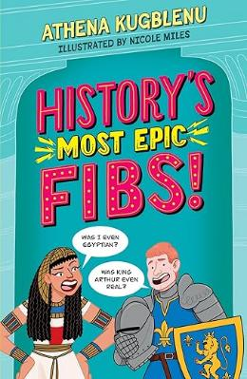
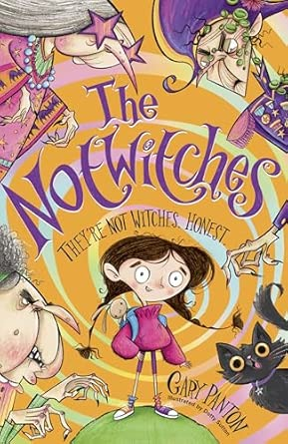
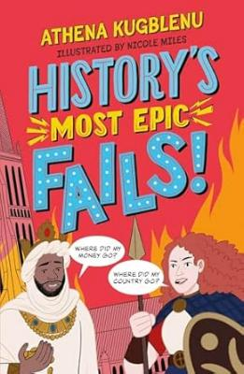
Top picks from our Authors Live programme
P4–7
P4–7
P3–7
scottishbooktrust.com
Notes:
Top picks from our Authors Live programme
Through our programmes like Authors Live, we get to share the work of the most exciting writing talent across the UK. We’ve compiled some of the latest releases from recent guest authors, all guaranteed to excite and engage your readers. Catch over 40 episodes of Authors Live on demand. https://www.scottishbooktrust.com/authors-live-on-demand
Artezans: The Forgotten Magic by LD Lapinski (Orion Children's Books)
Book one of this contemporary epic fantasy introduces Elodie and Ed Crane, who live in the Highlands with their dads and fear that because they’re adopted, they won't share their dads’ magical heritage. When they discover they do, an edge-of-your-seat adventure begins as they attempt to figure out why magic has been fading. LD’s depiction of magic ability as a skillset makes the reader reflect on what magic really is in the ordinary world we inhabit.
History’s Most Epic Fibs! / Fails! by Athena Kugblenu (Wren & Rook)
Discover history’s most epic fibs and fails with CBBC’s Horrible Histories writer and stand-up comedian, Athena Kugblenu, in this lively, laugh-out-loud non-fiction series. Readers will hear the truth behind some of history’s most pervasive myths and uncover the stories behind huge mistakes that changed the world forever – often for the better! Great picks for the classroom and for sharing at home, these books are guaranteed to get you laughing as you learn.
The Notwitches by Gary Panton and Dotty Sutton (Chicken House Ltd)
The Notwitches follows Melanda Notwitch, forced to serve her three awful aunties, on her brilliantly chaotic quest to escape her unhappy house and reclaim her magic. Along the way, we’ll meet a cast of bewitching and hilarious characters, from goblins to rock monsters to motorcycle gangs! A fabulously fun adventure, blending together humour, heart and a whole lot of silliness. Snappy chapters and laugh-out-loud illustrations make this perfect for newly independent readers.

Slide 11
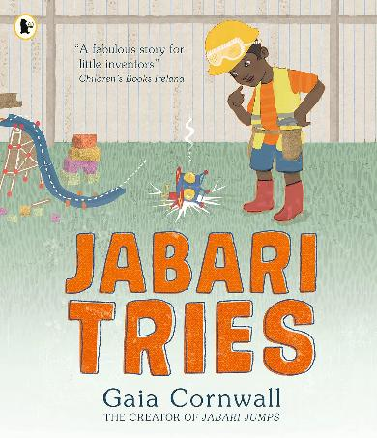
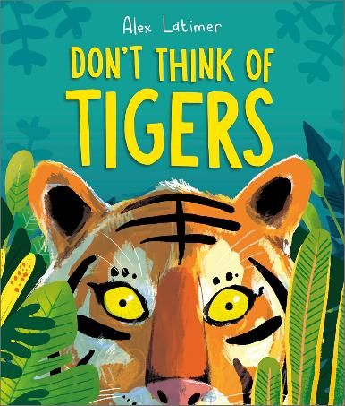
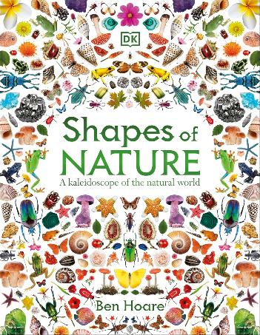
Scottish Book Trust staff picks (1)
P1–4
P1–5
P6+
scottishbooktrust.com
Notes:
Scottish Book Trust staff picks
Thank you to our colleagues for their recommendations.
Jabari Tries by Gaia Cornwall (Walker Books Ltd)
Perfect for exploring STEM topics and encouraging creative problem-solving, this beautifully-illustrated picture book follows Jabari as he tries to build a model that flies. He experiments with different materials and ramp structures, but it just won’t work. When he gets frustrated, his dad offers some good advice. Jabari takes a deep breath and tries again. This time, with a little help from his sister, Jabari’s model takes to the skies!
From Emily Ilett, School Communities Learning Co-ordinator
Don't Think of Tigers by Alex Latimer (Andersen Press Ltd)
This brilliantly funny picture book invites readers into an interactive, imaginative game where thinking about the ‘wrong’ thing is actually the whole point! Through encouraging a growth mindset approach, it shows children that the only way to get better at drawing is to practise and practise some more. With clever repetition and escalating humour, this beautifully-illustrated text keeps children engaged while gently building resilience and confidence.
‍From Pauline Bird, School Communities Manager
Shapes of Nature by Ben Hoare (Dk Children)
This book lays out nature in all its multi-coloured and multifaceted beauty and is full of facts and stunning photos. The shimmering beetles, shining gemstones, bold fruits and flowers and fluttering insects draw you into the pages and leave you wanting to stare at it all, choosing your favourites on every page. A wonderful book for anyone fascinated by the natural world.
‍From Ella McLellan, School Communities Regional Outreach Co-ordinator

Slide 12
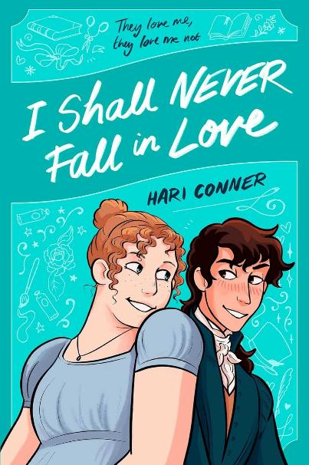
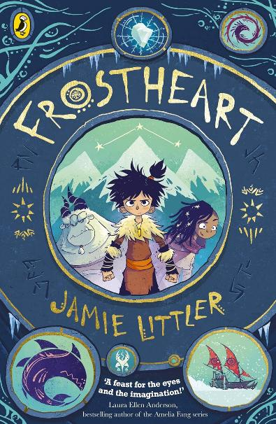

Scottish Book Trust staff picks (2)
P5–S2
S3+
scottishbooktrust.com
Notes:
Scottish Book Trust staff picks
Frostheart by Jamie Littler (Puffin)
Set in a snowy world where tribes live in isolated strongholds, Frostheart tells the story of Ash, a young boy raised by tribal elders after his explorer parents failed to return from a pathfinding mission. Determined to learn more about the mysterious magical skill he possesses that terrifies his own people, Ash joins the Frostheart, a sleigh with a motley crew of adventurers. With beautiful illustrations, readers will be swept up by Ash’s perilous journey!
From Heather Collins, School Communities Manager
I Shall Never Fall in Love by Hari Conner (Simon & Schuster Ltd)
Set in Regency England, Eleanor and George are two friends navigating the world of matchmaking, parties and romance. Whilst Eleanor feels pressure to be the perfect daughter, George explores their gender identity in secret. The hilarious artwork is jam-packed with charm and at the end, readers can learn more about the often-ignored history of the regency era. Inspired by Jane Austen’s Emma, this graphic novel is a historical romance you can’t help but fall in love with!
‍From Catherine Wilson Garry, School Communities Learning Content Manager

Slide 13

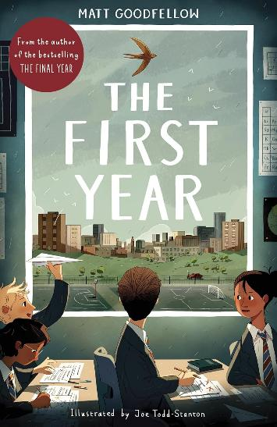
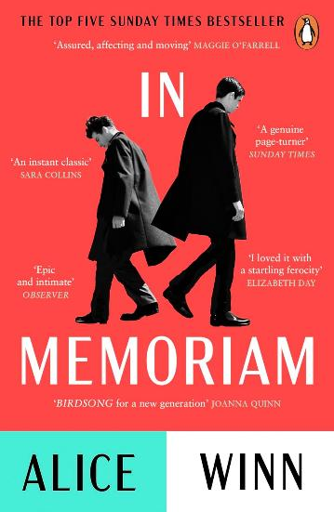
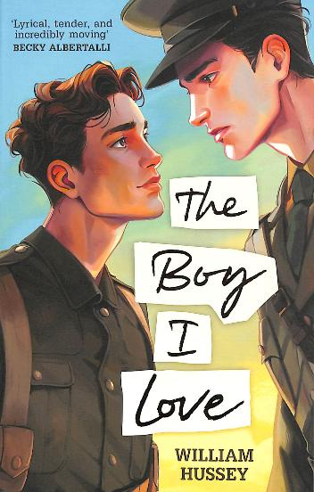
Guest Picks (1)
P5+
S4+
S2+
scottishbooktrust.com
Notes:
Guest Picks
Thank you to Emma Robertson, School Librarian at Knox Academy for her recommendations.
The First Year by Matt Goodfellow (Otter-barry Books)
This book can help anyone to better understand all of the difficulties that come with big life changes. I love that it is a novel in verse and written in a way that's beautiful but easy to understand. There are so many poetic moments that stick with you and make you want to read on to find out if things get resolved.
Content warning: bullying
In Memoriam by Alice Winn (Penguin Books Ltd)
Alice Winn encapsulates beautifully the horrors of war and the challenges that are faced by our main characters. She skilfully includes newspaper clippings as a way to draw readers into the narrative. The LGBTQ+ representation is also beautiful. It really is a must read for anyone interested in the first world war or for those who enjoy reading queer fiction.
Content warnings: graphic depictions of war and death (including suicidal ideation), homophobia, PTSD
The Boy I Love by William Hussey (Andersen Press Ltd)
I chose this book as it's similar to In Memoriam in a lot of ways, but is accessible for younger readers. It very clearly showcases the horrors of war and the difficulties the characters face having to hide who they are. It is a beautiful book with the concept of hope at its heart.
Content warnings: homophobia, war and death

Slide 14
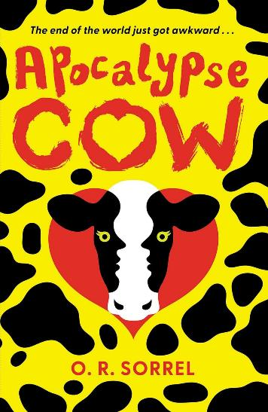
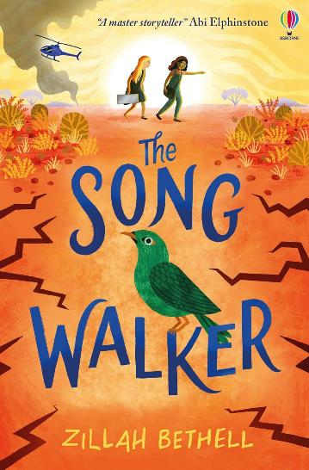
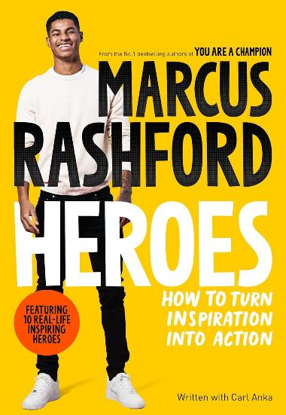
Guest Picks (2)
S3+
P5+
P5+
scottishbooktrust.com
Notes:
Guest Picks
Apocalypse Cow by OR Sorrel (Guppy Publishing Ltd)
A hoard of zombie cows are causing absolute chaos and you're stuck with two of your least favourite people.what could possibly go wrong? This book is absolutely bonkers but in the best way. It's a fun read for anyone who loves all things apocalyptic and zombie related.
The Song Walker by Zillah Bethell (Usborne Publishing Ltd)
A girl wakes up carrying nothing but a case she can’t get into. She doesn’t remember anything about herself and has to navigate the vast landscape of the Australian outback. The premise feels really unique and it becomes a great story of friendship and finding yourself. It is well written and keeps you guessing until the very last page.
Heroes: How to turn Inspiration into Action by Marcus Rashford (Macmillan Children's Books)
I don't often read non-fiction, but Marcus Rashford does a lot of inspirational work, so I was intrigued to find out who he himself considers heroic. It made me think about my own heroes in life and how I can stand up for the things that matter to me. You also get to learn lots about different types of people and understand how you can make a difference in the world.

Slide 15
Looking for more recommendations? (1)
Book lists
Among our carefully curated book lists, you can find up-to-date recommendations for all ages and stages. Whether you’re looking for something that covers a specific theme (like historical fiction, books with LGBTQ+ characters, stories that feature maths and science) or just searching for a spark of inspiration – there’s something for everyone to discover.
Recent book lists include:
10 wordless wonders
Reimagined fairytales
Our favourite children’s books about feminism and gender equality
Graphic novels for teens
Books for your science classroom
scottishbooktrust.com

Slide 16
Looking for more recommendations? (2)
Professional Learning sessions
Our expert School Communities team run fully-funded Professional Learning sessions across Scotland for teachers and learning professionals. Our Book Discovery sessions are designed to introduce you to new and exciting texts on different themes.
Discover our upcoming Professional Learning sessions
Junior Book of the Month
Each month we have five copies of our Junior Book of the Month to be won alongside a Q&A with the author. To enter, simply answer the short question on our website. Look out for the latest Junior Book of the Month in our newsletters and on our social media channels.
Discover our Junior Book of the Month
Stay in touch
To keep up-to-date with Scottish Book Trust, sign up to our schools and libraries newsletter and bookmark our opportunities and events page.
scottishbooktrust.com

Slide 17

Thank you
scottishbooktrust.com
Scottish Book Trust is a national charity changing lives through reading and writing. Registered company SC184248 | Scottish charity SC027669

