Slide 1



How to use this PowerPoint
This PowerPoint has been created to support our learning resource on Northern Soul by Phil Earle.
Where you see this icon, pupils should discuss the question on screen in groups.
scottishbooktrust.com

Slide 2

What is magical realism?
Scottish Book Trust
scottishbooktrust.com

Slide 3
Magical realism
Has anyone heard the term before?
2. What do you think it could mean?
scottishbooktrust.com

Slide 4
Magical realism definition:
‘The literary genre of magical realism brings fantastical elements to realistic, often humdrum, worlds and social structures, serving as a metaphor and a vehicle for underscoring their absurdity.’
Source: “A guide to magical realism”, Penguin Books
scottishbooktrust.com

Slide 5
What does this mean?
Magical realism is a style of writing that uses magical or fantastical elements in an otherwise normal or everyday setting. Often it does this to highlight the ridiculousness of something we all consider everyday.
scottishbooktrust.com

Slide 6



How to identify magical realism:
An everyday or normal setting in a world just like ours
A magical element – e.g. a ghost, a character who has supernatural powers, etc.
Usually used to highlight something absurd, ridiculous or wrong with society
scottishbooktrust.com

Slide 7
Can you think of any examples of magical realism?
It can be something you’ve read, watched, played or listened to. Share your thoughts with a partner!
scottishbooktrust.com

Slide 8
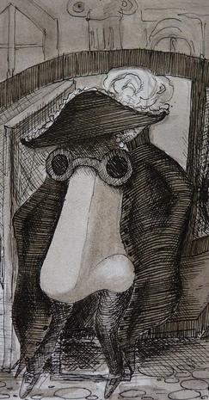
Magical realism example (1)
In the short story “The Nose” by Nikolai Gogol, a man wakes up to see his nose has disappeared. The nose becomes its own person, wandering around the town wearing the uniform of a high-ranking official.
scottishbooktrust.com

Slide 9
Magical realism example (2)
The story is often seen as a comment on class. Everyone accepts that the nose is important because of the outfit he wears. In Gogol’s society, people’s status was linked to the clothes that they wore and how they presented themselves. In other words, class was a costume or a performance.
scottishbooktrust.com

Slide 10
Magical realism example (3)
By using magical realism, Nikolai Gogol can comment on class in an unusual way. A story that says “social class is all just a performance” wouldn’t be very interesting. But by making up a funny story about a nose on the run, Gogol can still comment on social class, whilst creating a more engaging exploration of class.
scottishbooktrust.com

Slide 11
In other words
‘By including elements of the fantastical, you can start getting at the truth in another way. It’s another door into the truth.’
Salman Rushdie
scottishbooktrust.com

Slide 12
How is magical realism different to fantasy? (1)
Magical realism and fantasy are not the same! How do you think they might be different?
scottishbooktrust.com

Slide 13
How is magical realism different to fantasy? (2)
Fantasy is set in an alternative world, whereas magical realism is set in a world like our own. Magical moments in a fantasy novel are often much more open, whereas magic in magical realism is slightly mysterious. When you read magical realism, you may doubt whether the magic is real, or just in someone’s head.
scottishbooktrust.com

Slide 14
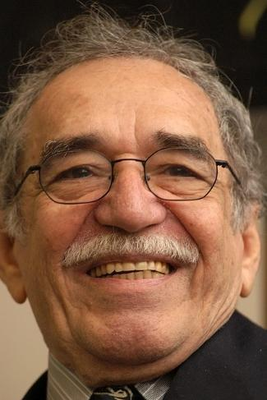
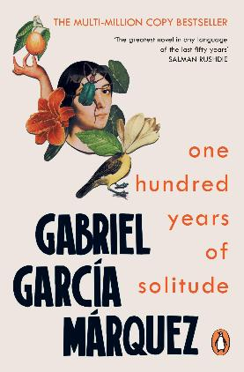
Magical realism and Latin America (1)
Magical realism is often associated with literature from Latin America.
Gabriel García Márquez was a Columbian writer who wrote One Hundred Years of Solitude which is widely regarded as the most famous magical realist novel.
scottishbooktrust.com

Slide 15
Magical realism and Latin America (2)
Countries across Latin America have a history of colonialism and political instability.
Some scholars see magical realism as a rejection of the Western style of storytelling. For Latin American countries, this could be a way to reject the countries that colonised them and write in their own literary style.
scottishbooktrust.com

Slide 16
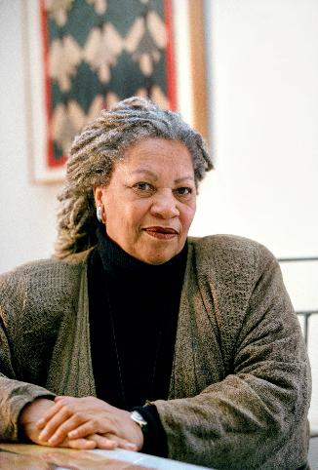
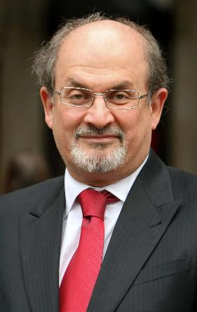
Other writers of magical realism
Other writers who use magical realism include American writer Toni Morrison, who used magical realism to shine a light on the horrors of slavery. Salman Rushdie, an Indian-born novelist, used magical realism to explore the impact of British colonialism on India.
scottishbooktrust.com

Slide 17
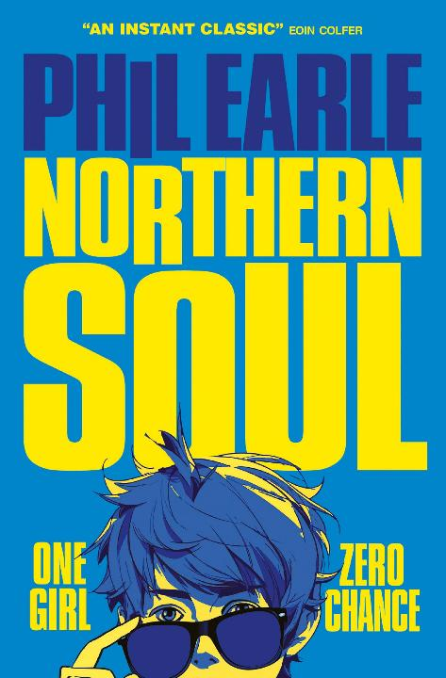
Do you think Northern Soul is magical realism? (1)
In Northern Soul, Marv is visited by the ghost of musician Otis Redding.
No one else can see Otis, but he can have an impact on the world around him.
Do you think this is magical realism? Why?
scottishbooktrust.com

Slide 18
Do you think Northern Soul is magical realism? (2)
Earlier, we saw that magical realism is ‘Usually used to highlight something absurd, ridiculous or wrong with society’. What do you think the author of Northern Soul might be trying to draw our attention to?
scottishbooktrust.com

Slide 19
Do you think Northern Soul is magical realism? (3)
If you’re stuck, it might help to think about some of the themes of Northern Soul.
What do you think are the key themes so far?
scottishbooktrust.com

Slide 20

How does Northern Soul use magical realism to poke fun of these ideas?
First love
Coming of age
Masculinity
scottishbooktrust.com

Slide 21
Northern Soul and first love
You could read Northern Soul’s magical realism as poking fun at being in love for the first time. Being in love makes Marv feel awkward and perhaps try a bit too hard instead of being himself.
We can see this when the ghost of Otis Redding suggest some very bad chat-up lines.
scottishbooktrust.com

Slide 22
Northern Soul and coming of age
You could read Northern Soul’s magical realism as poking fun at being a teenager. As Marv has grown up, he has grown apart from his dad. He doesn’t want to talk to him about Carly because he thinks he’s so embarrassing. However, the ghost of Otis Redding could show that he and his dad have more in common than he’d like to believe.
scottishbooktrust.com

Slide 23
Northern Soul and masculinity
You could read Northern Soul’s magical realism as poking fun at the societal idea of masculinity. The ghost of Otis Redding tells Marv he has to do a whole lot of ridiculous stuff to “woo” Carly, rather than just being himself and talking to her normally! Otis Redding was also alive during a different era (1941-1967), so we could see him as a metaphor for outdated ideas about gender.
scottishbooktrust.com

Slide 24

Thank you
scottishbooktrust.com
Scottish Book Trust is a national charity changing lives through reading and writing. Registered company SC184248 | Scottish charity SC027669

