Slide 1


Book Discovery Guide
Issue 9: March 2026
scottishbooktrust.com

Slide 2


How to use this PowerPoint
This PowerPoint version of the Book Discovery Guide (issue 9) allows you to share the guide with your colleagues.
Each slide will contain the covers and where applicable, age ratings of the books.
Click ‘notes’ at the bottom of your window to read the blurbs of each book.
scottishbooktrust.com

Slide 3
What is Book Discovery Guide? (1)
Book Discovery Guide is our guide to help you find high-quality contemporary books for pupils of all ages and reading levels.
Each issue contains our top picks across themes, staff picks, guest recommendations and responses to frequently asked questions.
scottishbooktrust.com

Slide 4

What is Book Discovery Guide? (2)
With all of our resources, we highly recommend that you read the book before using it with your class and use your best judgement on whether teaching about this topic is appropriate for the children in your class.
This icon indicates you should check the notes for content warnings.
scottishbooktrust.com

Slide 5
The importance of using contemporary books in your classroom:
More representative; children are more motivated to read when texts contain characters like them.
Read about a wide range of experiences relevant to today (for example, climate change, refugee crisis, technology and social media).
Language is up-to-date, making it easier to follow.
See ‘notes’ of this slide for more information.
scottishbooktrust.com
Notes:
To find out more information on the importance of using contemporary books in your classroom or school, we recommend the following:
National Literacy Trust’s ‘Children and young peoples’ reading in 2023’ report: https://literacytrust.org.uk/research-services/research-reports/children-and-young-peoples-reading-in-2023
Scottish Book Trust’s article ‘How teachers can put the right book in the right hand’: https://www.scottishbooktrust.com/articles/how-teachers-can-put-the-right-book-in-the-right-hand

Slide 6
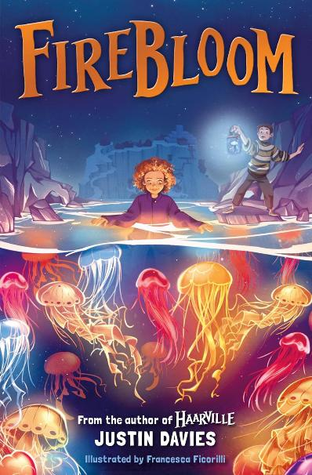
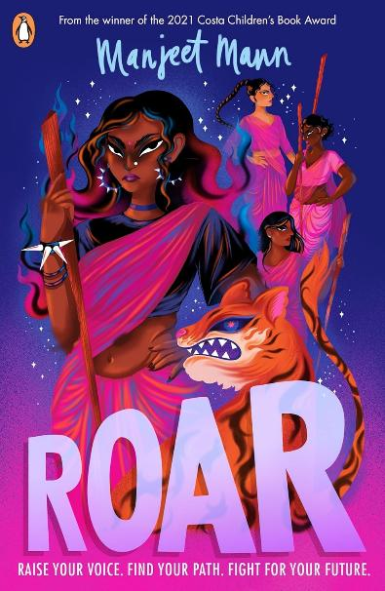
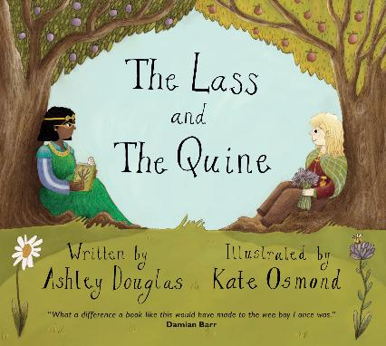

New from Scottish publishers and authors
P1+
P6+
S3+
scottishbooktrust.com
Notes:
New from Scottish publishers and authors
The Lass and The Quine by Ashley Douglas and Kate Osmond (Tippermuir Books)
This is the first original LGBTQ+ picture book published in Scots! The story follows a girl and a princess who, despite their differences, fall head over heels in love. Filled with rich illustrations, animals and fairytales, we love this picture book’s poetic writing and use of rhyme that make it a delight to read aloud.
Firebloom by Justin Davies (Kelpies)
2-year-old Tally Smuck is the island of Stormcliff’s 'Sting Winkler', a person who possesses the magical ability to communicate with jellyfish. With the Firebloom Festival approaching, and no sign of Tally’s powers, how will she ensure the annual light show goes off without a hitch? We loved Justin Davies’ fishy fantasy Haarville, and Firebloom promises just as much imagination and adventure.
Roar by Manjeet Mann (Penguin)
Inspired by the true story of Sampat Pal and the Pink Sari Gang, Roar is a novel-in-verse that explores the devastation caused by India’s caste system. Rizu, a 17-year-old from an upper caste, has her life changed forever when she is accused of being a witch. Fleeing for her life, she joins a group of women who seek revenge. But revenge always comes at a cost…
Content warnings: animal cruelty, bullying, death, gender discrimination, grief and loss, racial discrimination, violence.

Slide 7
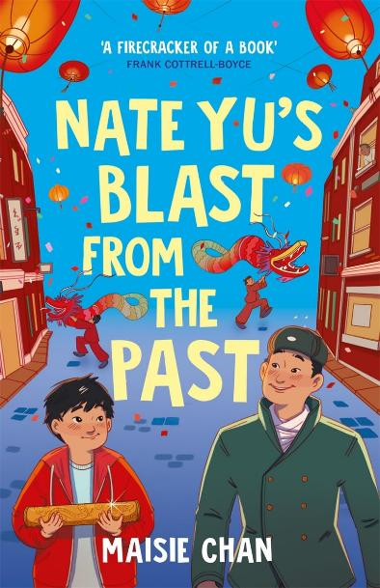
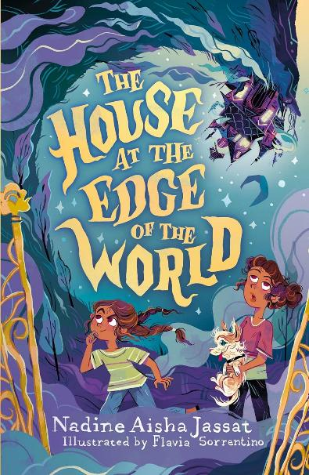
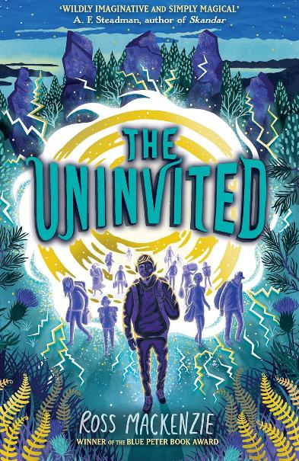
Book of the Month
Each month we run our Book of the Month competition on our website, offering you the chance to win exciting new Scottish publications for children and young people! Below are some previous picks. Make sure you visit our website to join in.
P6+
P6+
P7+
scottishbooktrust.com
Notes:
Book of the Month
Nate Yu’s Blast from the Past by Maisie Chan (Piccadilly Press)
Nate, an adopted Chinese boy, feels isolated from his Chinese heritage. One day, whilst studying World War I in his class, he sees the ghost of Jirou, a Chinese soldier who served for the British during WWI. This novel is a beautiful examination of identity and heritage that also shines a light on the importance of the Chinese Labour Corps, a group who have often been neglected by history.
The House at the Edge of the World by Nadine Aisha Jassat (Orion Children's Books)
When Amal and her family inherit a mysterious house, they discover Hope House is not a normal home, but something more magical. When threatened with eviction, Amal and her family have just thirty days to save Hope House from destruction. But can they uncover its secrets? This novel-in-verse’s mystery is guaranteed to keep you turning pages!
The Uninvited by Ross MacKenzie (Andersen Press)
Thirteen-year-old Samm Wolfback is a magical faerae who, since the Scourge, has been forced to live in a refugee camp in the human world. The camp is rife with crime and disease, and its inhabitants live in poverty. When Samm is offered a chance to escape, he jumps at it. This fantasy novel not only has a compelling adventure, but a rich exploration of the real-world discrimination faced by refugees.
Content warnings: unstable living/homelessness and family breakdown.

Slide 8
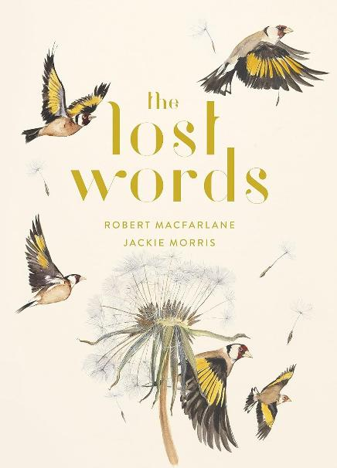
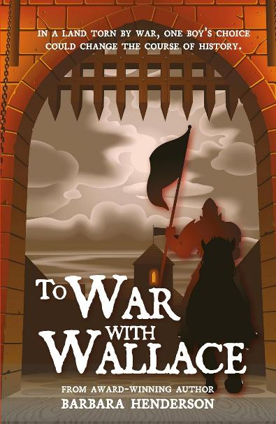
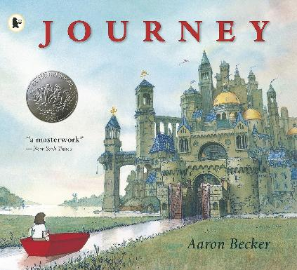
Great books for interdisciplinary learning (1)
P1+
P1+
P5–7
scottishbooktrust.com
Notes:
Great books for interdisciplinary learning
We’ve gathered some of our favourite books for exploring topics across the curriculum – from expressive arts and technologies to history and beyond! If you’re taking part in Reading Schools, these could be a great jumping off point for interdisciplinary book projects: https://www.scottishbooktrust.com/learning-resources/using-journey-for-a-cross-curricular-book-project
Journey by Aaron Becker (Walker Books)
Journey is a vibrant wordless book which follows a lonely girl who escapes into a magical world through a door she draws on her bedroom wall. Our cross-curricular learning resources (https://www.scottishbooktrust.com/learning-resources/using-journey-for-a-cross-curricular-book-project) will support you to explore the idea of a wordless book in Literacy and English, create your own type of transport in Technologies, and explore solutions for loneliness in Health and Wellbeing.
The Lost Words by Robert Macfarlane and Jackie Morris (Hamish Hamilton)
This beautiful book contains poems and artworks on wildlife from otters to brambles, acorns to kingfishers, and is perfect for reading aloud. The poems could provide a prompt around language – including exploring the Gaelic or Scots words for different animals and plants, or any other languages that your pupils speak. For outdoor learning and sciences, you could also use The Lost Words to explore your local area and its wildlife, learning more about habitats and ecosystems.
To War with Wallace by Barbara Henderson (Luath Press)
Barbara Henderson’s historic story transports readers to the Scottish Wars of Independence in 1297. Following Harry, a young apprentice armourer, readers can dive into the world of the Northern Uprising, the impact of William Wallace and the historic events of the Battle of Stirling Bridge. Thoroughly researched and supported with learning resources on the author’s website, this would make the perfect class text for diving headfirst into Scottish history!

Slide 9
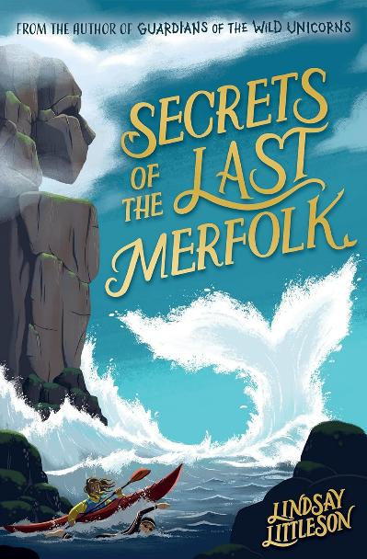
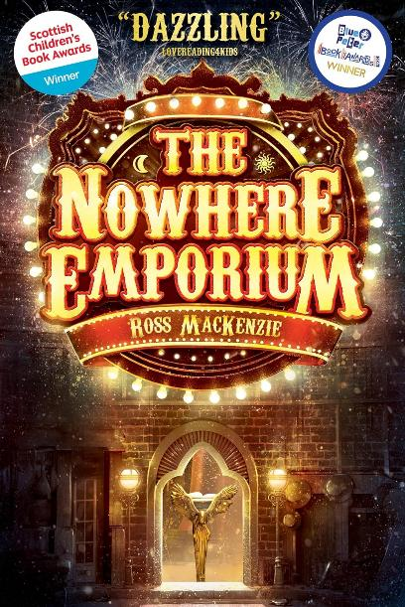
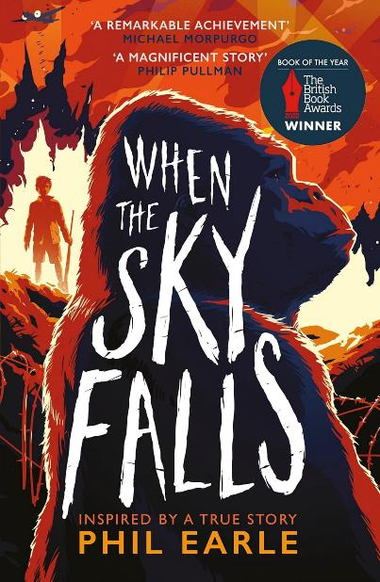
Great books for interdisciplinary learning (2)
P6+
P6+
P7+
scottishbooktrust.com
Notes:
Secrets of the Last Merfolk by Lindsay Littleson (Kelpies)
Lindsay Littleson’s exciting middle grade story blends Scottish folklore with the everyday. Stuck in a seaside town over the Christmas holidays, Finn spots some mysterious swimmers in the Firth late at night. Could the local legend of merfolk be true? Throughout this novel, there’s rich themes of sustainable development. Finn has to fight plans for a harbour development, which could prompt learning about conservation and Scotland’s wildlife at sea across sciences, technologies and social studies.
The Nowhere Emporium by Ross Mackenzie (Kelpies)
One day, the Nowhere Emporium arrives in Glasgow, enticing young orphan Daniel Holmes. The shop, and its owner Mr Silver, offer magic and enchantment, but when Mr Silver disappears, Daniel is forced to save the Nowhere Emporium before it is destroyed. Rich in imagination, we think this book lends itself to the Expressive Arts. With our learning resources (https://www.scottishbooktrust.com/learning-resources/ross-mackenzie-activity-pack) you can create your own Nowhere Emporium diorama or design your own Book of Wonders.
When the Sky Falls by Phil Earle (Andersen Press)
During WWII, 12-year-old Joseph is sent to the city to live with Mrs F – a friend of his grandmother who owns a rundown zoo. The novel explores Joseph’s dyslexia and the bullying he faces at school, his separation from his father, and the bond he develops with Adonis, the zoo’s gorilla. When the Sky Falls is a rich text for diving into the real perspectives behind historical events and could be used to explore more about the Blitz and everyday lives of people during WWII.
Content warnings: bullying.

Slide 10
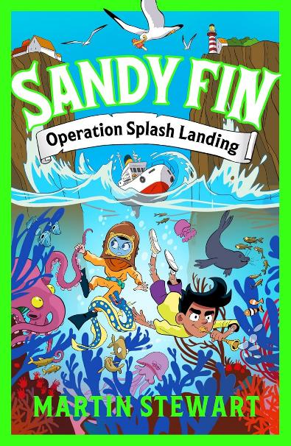
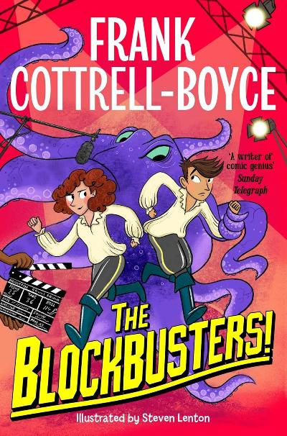
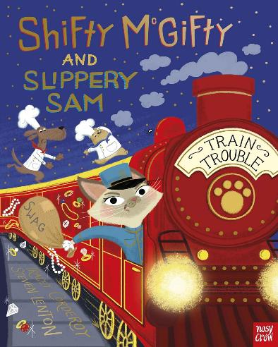
Top picks from Authors Live and our Events programme (1)
P2+
P5+
P5+
scottishbooktrust.com
Notes:
Top picks from Authors Live and our Events programme
Through our programmes like Authors Live and one-off events, we get to share the work of the most exciting writing talent across the country. We’ve compiled some of the latest releases from recent guest authors, all guaranteed to excite and engage your readers.
Shifty McGifty and Slippery Sam: Train Trouble by Tracey Corderoy and Steven Lenton (Nosy Crow)
We have loved the Shifty McGifty and Slippery Sam series since we gifted them in our first ever Read Write Count bags in 2015! The latest instalment is just as joyous: Shifty and Slippery are asked to bake on board the Pawrient Express, a train travelling to Venice. However, a villainous cat burglar threatens to ruin the trip! This rhyming caper is great fun to read aloud.
Sandy Fin: Operation Splash Landing by Martin Stewart (Zephyr)
Set in the seaside village of Portwhistle, our protagonists Sandy and Lily are ocean explorers in training. When Sandy’s home, the Museum of Seaside Stories, needs urgent repairs, help comes in the form of Albo Start who offers to fund the repairs. When something seems off with Start, Sandy and Lily are determined to uncover the truth. This illustrated chapter book is both funny and adventurous, with characters that jump off the page.
The Blockbusters! by Frank Cottrell-Boyce (Macmillan Children’s Books)
After stumbling backstage, Rafa accidentally finds himself in the limelight of a new Hollywood production. But whilst the VIP access and endless doughnuts are nice, Rafa is also on a mission to find his missing brother. Inspired by Frank Cottrell-Boyce’s work as a screenwriter, this latest book from the Children’s Laureate is sure to delight any budding actors, directors or film fanatics!
Catch over 40 events from your favourite authors on Authors Live on Demand (https://www.scottishbooktrust.com/authors-live-on-demand)
Discover upcoming school events, opportunities and tours (https://www.scottishbooktrust.com/learning-and-resources/school-events-and-opportunities)

Slide 11
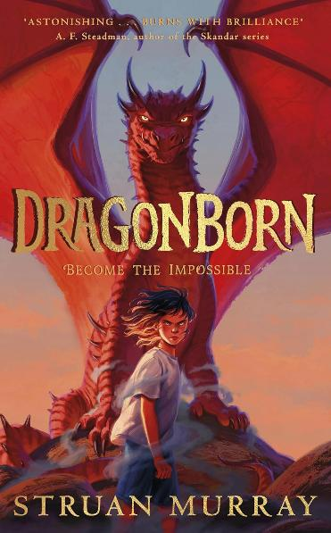
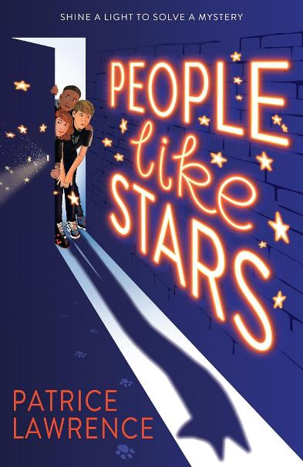
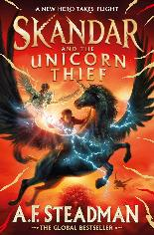
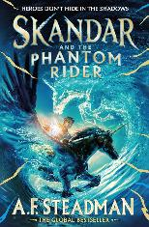
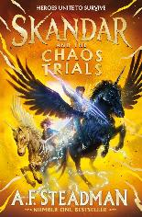
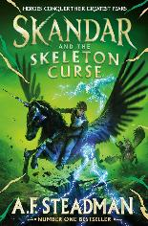
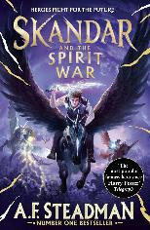
Top picks from Authors Live and our Events programme (2)
P6–S1
P6–S1
P6–S1
scottishbooktrust.com
Notes:
Dragonborn by Struan Murray (Puffin)
Whilst grieving her father’s death, Alex Evans also has to deal with her overbearing mother. One day, her frustration is too much and she finds her mouth full of flames! Alex realises she is a dragon and now, she must train alongside the other dragon children to unlock her full powers. Full of imagination, this fantasy features incredible world-building as well as a moving story of self-discovery.
Content warnings: grief and loss.
People Like Stars by Patrice Lawrence (Scholastic)
Three strangers are connected by something that happened a long time ago. Aryton was stolen as a baby; Stanley has a grandmother he can’t talk about; and Senna and her mum live in fear of upsetting their strict landlady. Switching between each character’s perspective, this is a rich mystery, ideal for any reader who loves well-written characters with real depth.
Content warnings: unstable living/homelessness and family breakdown.
Skandar by AF Steadman (Simon & Schuster)
The Skandar series introduces readers to an epic world of magic, fantasy and unicorns! Skandar Smith dreams of being a unicorn-rider – one of the select few chosen to hatch, train and bond with a unicorn. We absolutely love this world of epic battles, ferocious unicorns and courageous heroes: perfect for encouraging young readers’ imaginations!
Catch over 40 events from your favourite authors on Authors Live on Demand (https://www.scottishbooktrust.com/authors-live-on-demand)
Discover upcoming school events, opportunities and tours (https://www.scottishbooktrust.com/learning-and-resources/school-events-and-opportunities)

Slide 12
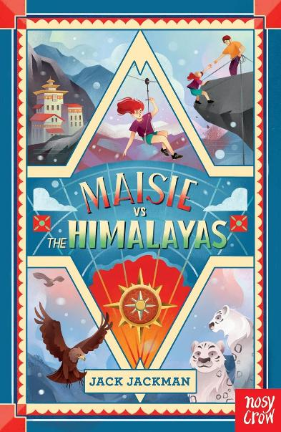
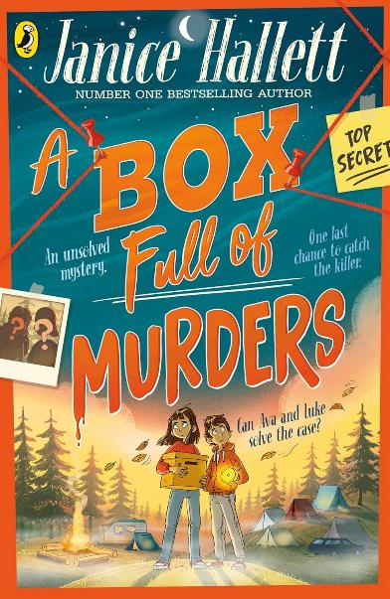
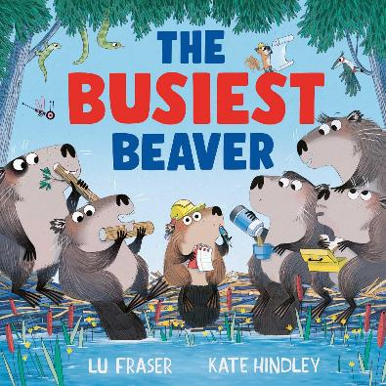
Scottish Book Trust staff picks (1)
Chris Newton, Head of School Communities
P1–3
P4+
P5–7
scottishbooktrust.com
Notes:
Scottish Book Trust staff picks
The Busiest Beaver by Lu Fraser and Kate Hindley (Simon & Schuster)
This fun, dramatic and warm picture book is another beauty from the dynamic duo of Lu Fraser and Kate Hindley. Nora doesn’t think like the other beavers and creates new solutions to old problems. This book highlights the importance of being confident and standing up for your beliefs, showing that it’s more than okay to be different.
Maisie vs the Himalayas by Jack Jackman (Nosy Crow)
An action-packed adventure filled with humour, heart and superpowers! Maisie and her dad are exploring caves in the Himalayas as research for his next book when things take an unexpected turn and they are forced to use their superpowers. Maisie discovers more about herself, but will she find the treasure and the whole truth?
A Box Full of Murders by Janice Hallett (Puffin)
Join Ava and Luke as they try to uncover an unsolved crime in this gripping whodunnit. An interactive investigation book that places the reader as detective; question everything and trust no one! This book takes in themes of family relationships, truth and trust.

Slide 13
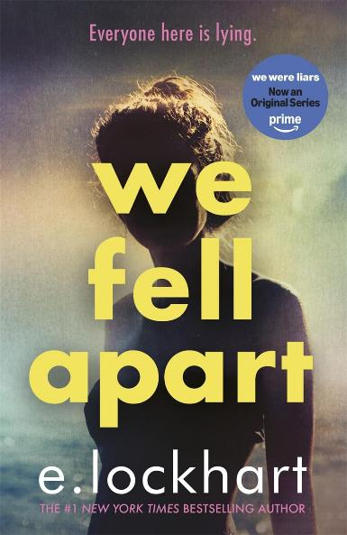
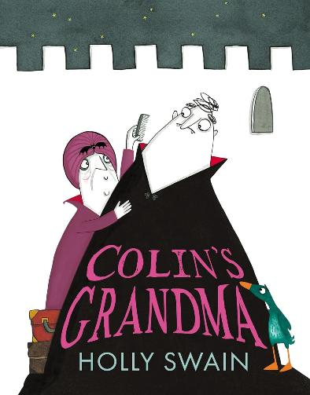
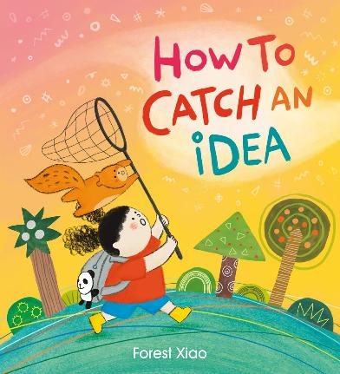
Scottish Book Trust staff picks (2)
Antonia Clark, School Communities Manager
EY+
EY+
S5+
scottishbooktrust.com
Notes:
Colin’s Grandma by Holly Swain (Farshore)
Colin and his pal Duck are back for another story full of chuckles! His Grandma is coming to visit and he is eager to please – but what will she make of his room mate and friend, Duck? A great story to read together – and share the joys of a surprise ending.
How to Catch an Idea by Forest Xiao (Orchard Books)
A lovely story with beautiful illustrations. Follow the little girl on her journey to discover ideas. What’s the best way to catch an idea? What would you pack in your bag for this adventure? Sparking conversations about creativity and imagination, this is perfect for a bedtime read.
We Fell Apart by E Lockhart (Hot Key Books)
A standalone novel with links to the We Were Liars series, there’s always a twist to look out for and this one builds slowly: when Matilda travels to meet her estranged father, she ends up alone in Martha’s Vineyard. As ever with E Lockhart, there’s twists, turns and a swoony romance!
Content warnings: animal cruelty.

Slide 14
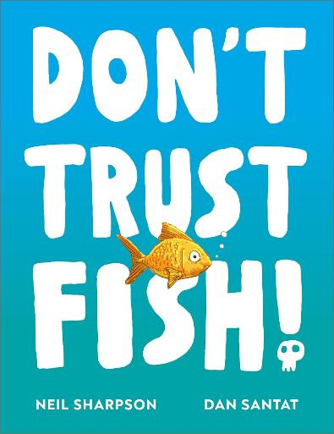
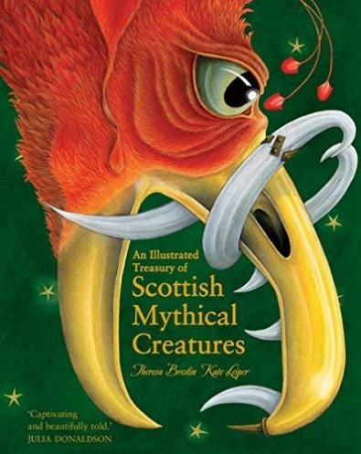
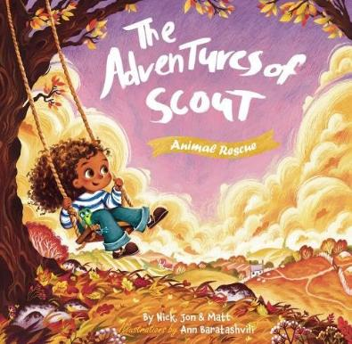
Scottish Book Trust staff picks (3)
Debbie McLeod, Reading Schools ELC Project Manager
EY+
EY+
P6–S1
scottishbooktrust.com
Notes:
Don't Trust Fish by Neil Sharpson and Dan Santat (Andersen Press)
This book will make you and your younger readers laugh out loud. Not only does it share facts on the different vertebrate groups, it also takes a deeper dive into the world of fish and presents lots of convincing (and hilarious) reasons why you should not trust them. You will never look at fish in the same way again!
The Adventures of Scout: Animal Rescue by Nicholas Parker, Jon Lakin, Matthew Baron and Ann Baratashvili (Independent Publishing Network)
Scout loves adventure – and she loves caring for the world around her. In this story, Scout and her best friend Vinnie must find a way to help the animals protect their habitats. A particularly fun and engaging feature is that Vinnie sneakily appears on every page, inviting children to spot him as they listen to or read the story.
An Illustrated Treasury of Scottish Mythical Creatures by Theresa Breslin and Kate Leiper (Floris Books)
A beautifully-illustrated book full of Scottish mythical creatures and the stories that surround them. Stories that will make readers laugh, think and get lost in mythical worlds. A range of ages will enjoy having this book read to them but readers in the upper primary years will benefit from reading this more independently. You can also use our learning resources (https://www.scottishbooktrust.com/learning-resources/scottish-myths-and-legends-learning-resources) to explore this book, and all its myths and legends, with your class!

Slide 15
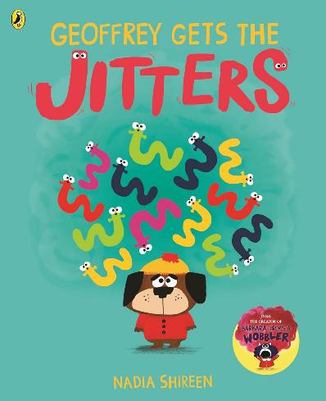
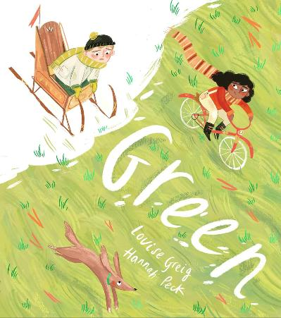
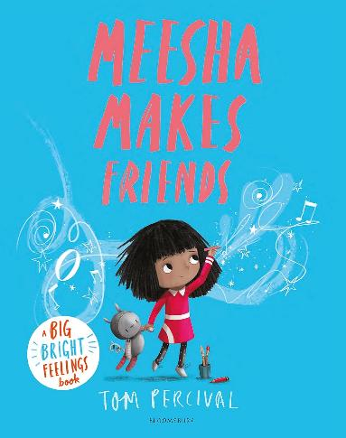
Great books for exploring mental health and wellbeing (1)
P1–3
P2–4
P2–4
scottishbooktrust.com
Notes:
Great books for exploring mental health and wellbeing
Books and stories offer excellent opportunities to support children and young people to explore emotional literacy and mental health. Whether you’re just starting to explore emotions or want narratives that help teens explore concepts like anxiety, we’ve hand-picked some of our favourite books for exploring mental health and wellbeing.
Geoffrey Gets the Jitters by Nadia Shireen (Puffin)
Thinking about school, Geoffrey can’t help but think 'what if?' What if he loses his favourite teddy, or his best friend Barbara doesn’t like him anymore? Geoffrey discovers these wiggly feelings in his tummy are the jitters. But just as Geoffrey feels overwhelmed, he discovers there’s things he can do to keep his jitters at bay. This funny and bright picture book is perfect for talking about times we feel nervous or worried, and what we can do to process and understand them.
Green by Louise Greig and Hannah Peck (Farshore)
When it snows, Ed is beyond excited to build a spectacular sled to go racing with his friends. However, the voice in Ed’s head tells him that his sled will never be good enough,and he quickly loses the opportunity to fully enjoy winter. This book offers a great prompt to talk about the concept of perfectionism, and what we can do to stop our feelings of inadequacy from holding us back.
Meesha Makes Friends by Tom Percival (Bloomsbury Children’s Books)
Tom Percival’s Big Bright Feelings series are great picture books for exploring emotional literacy. Meesha Makes Friends is a beautiful book for understanding shyness, loneliness and isolation. Meesha loves making her own creations, but she feels helpless at making friends. When she meets someone new at a party, she finds someone she can create with. We love how the narrative of this book celebrates Meesha for who she is and shows that she doesn’t have to change who she is to make connections.

Slide 16
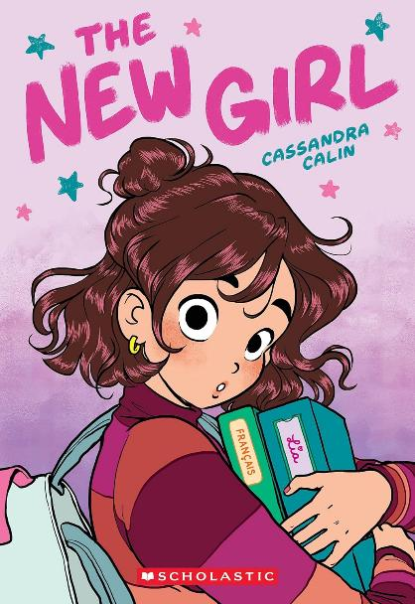
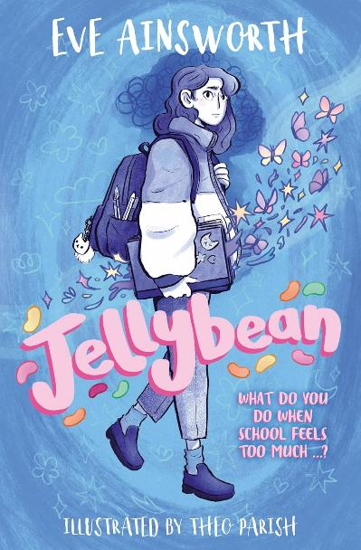
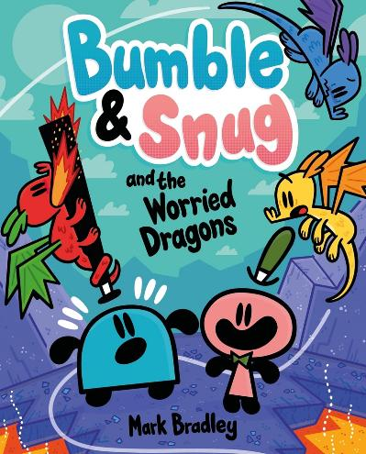
Great books for exploring mental health and wellbeing (2)
P3–5
P7+
P7–S2
scottishbooktrust.com
Notes:
Bumble and Snug and the Worried Dragons by Mark Bradley (Hodder Children’s Books)
When Bumble and Snug accidentally bring home some dragon eggs they find themselves responsible for raising the hatchlings! The Bumble and Snug series are funny and bold graphic novels, but we also love how Mark Bradley brings in themes of empathy and emotional literary. They’re perfect for noticing different character’s expressions and having a chat about why a certain character may be feeling a certain emotion.
The New Girl by Cassandra Calin (Scholastic)
This graphic novel is a visual treat. In this coming-of-age story we meet charming and relatable 12-year-old Lia, whose life is turned upside down when her family migrate from Romania to Canada. Lia struggles to navigate friendships, school, family, first crushes and painful periods! All amidst the turmoil of leaving her home, learning a new language and adapting to new cultures. Inspired by the author's own immigration experiences as a child, The New Girl is a heartwarming, candid reflection of pre-teen experiences.
Jellybean by Eve Ainsworth and Theo Parish (Barrington Stoke)
Ellie is overwhelmed by the idea of going to school. Her parents are sure her feelings must be due to bullying or schoolwork but eventually realise that Ellie is experiencing anxiety. As her absence turns into weeks, then months away from school, both Ellie and her parents explore a way to help her back. This short dyslexia-friendly book from Barrington Stoke is a great exploration of anxiety with a hopeful ending.
Content warnings: depression and/or anxiety.

Slide 17
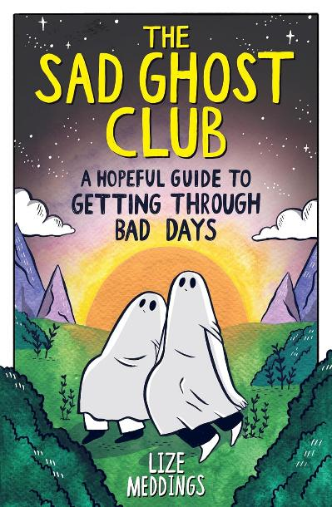
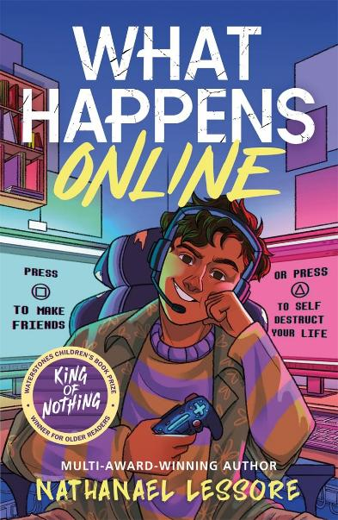
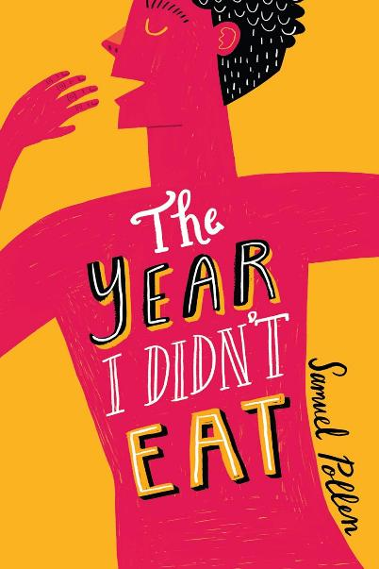
Great books for exploring mental health and wellbeing (3)
S1+
S2+
S3+
scottishbooktrust.com
Notes:
The Sad Ghost Club: A Hopeful Guide to Getting Through Bad Days by Lize Meddings (Wren & Rook)
The most recent instalment in The Sad Ghost Club graphic novel series shares the Sad Ghost Club’s rules for taking things one day at a time. This is a wonderful guide to help readers through sad or heavy days, sharing the message that you are not alone in how you feel.
Content warnings: depression and/or anxiety.
What Happens Online by Nathanael Lessore (Hot Key Books)
At school, 14-year-old Fred is miserable, he has no friends and feels invisible. But within the safe space of his gaming world, Fred takes on an online alter-ego, 'Existor',who is becoming increasingly influential at school. In his quest for popularity, 'Existor' makes choices that don't reflect who Fred truly is, entangling him in a web of lies. A meaningful yet witty take on bullying, grief, family, depression and friendship struggles. Immensely readable and full of gamer lingo to hook in readers.
Content warnings: bullying, depression and/or anxiety.
The Year I Didn’t Eat by Samuel Pollen (Zuntold)
Drawing on the author’s own experiences, this powerful novel follows Max, a fourteen-year-old boy struggling with anorexia. During the stress of Christmas, his older brother gifts him a geocache. After he hides it in the local woods, he starts receiving anonymous letters from 'E', someone who Max feels like he can really talk to. When Max is struck by a family crisis, his eating disorder worsens – will anyone be able to help him find his way out? This honest and tender account of living with an eating disorder offers a message of hope.
Content warnings: depression and/or anxiety, disordered eating.

Slide 18
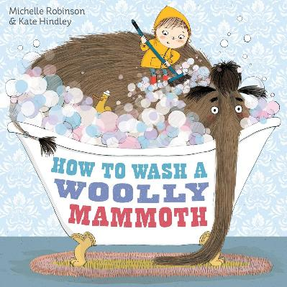
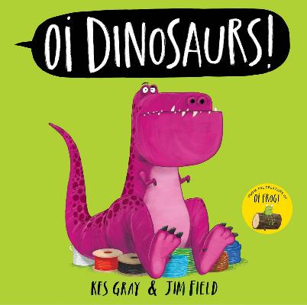
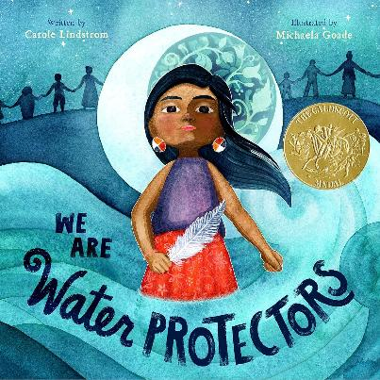
Recommendations from schools (1)
Thank you to Reading School Kyleakin Primary School on the Isle of Skye for their recommendations.
EY+
P1+
P2+
scottishbooktrust.com
Notes:
How to Wash a Woolly Mammoth by Michelle Robinson and Kate Hindley (Simon & Schuster)
This is a really funny book. The illustrations made us laugh, especially when the wet mammoth was in the tree and needed to get a trampoline to get down. The illustrations are really clever and the ridiculous mammoth character was a real class favourite.
Oi Dinosaurs! by Kes Gray and Jim Field (Hodder’s Children’s Books)
The book that I am recommending is called Oi Dinosaurs! I want to recommend this book because it's funny, interesting and has facts.
We are Water Protectors by Carole Lindstrom (St Martin's Press)
We liked the illustrations and the pretty colours in the book. After reading the book we were able to talk about how important water is to everyone and why we should look after it. We liked the strong female character who was speaking out about what was important to her people but is also important to you and me.

Slide 19
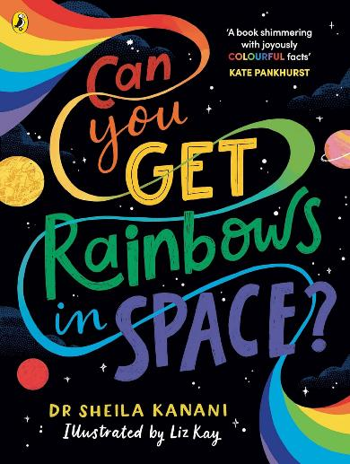
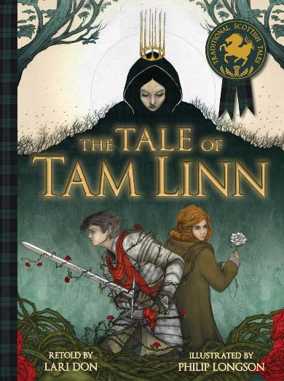
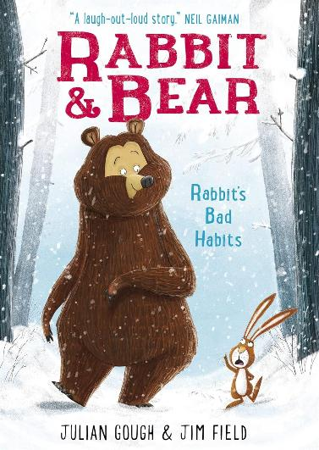
Recommendations from schools (2)
Thank you to Reading School Kyleakin Primary School on the Isle of Skye for their recommendations.
P3+
P3+
P3+
scottishbooktrust.com
Notes:
Can you Get Rainbows in Space? by Dr Sheila Kanani (Puffin)
This book is about space and lots of colours and why things are the colour they are as well as having lots of facts. I recommend this book because it has lots of colourful pictures and is a good way to get younger kids to read and learn about space at the same time.
The Tale of Tam Linn retold by Lara Don (Kelpies)
This book is a traditional Scottish tale. I picked this book because I like traditional stories. It is a picture book not a chapter book. It has lovely illustrations of flowers and nature.
Rabbit and Bear: Rabbit's Bad Habits by Julian Gough and Jim Field (Hodder Children’s Books)
I would recommend Rabbit and Bear: Rabbit's Bad Habits because it is really funny and enjoyable, and I would say the ages that would enjoy it most would be between 5–10.

Slide 20
Looking for more recommendations? (1)
Book lists
Among our carefully curated book lists, you can find up-to-date recommendations for all ages and stages. Whether you’re looking for something that covers a specific theme (like historical fiction, books with LGBTQ+ characters, stories that feature maths and science) or just searching for a spark of inspiration – there’s something for everyone to discover.
Our most recent book lists include:
Really readable books for every child
Picture books to discuss children’s rights in the classroom
Our favourite BPOC protagonists in children’s and young adult books
Children’s books that celebrate libraries
Great picture books for sensory storytelling
scottishbooktrust.com

Slide 21
Looking for more recommendations? (2)
Professional Learning sessions
Our expert School Communities team run fully-funded Professional Learning sessions across Scotland for teachers and learning professionals. Our Book Discovery sessions are designed to introduce you to new and exciting texts on different themes.
Discover our upcoming Professional Learning sessions
Junior Book of the Month
Each month we have five copies of our Junior Book of the Month to be won alongside a Q&A with the author. To enter, simply answer the short question on our website. Look out for the latest Junior Book of the Month in our newsletters and on our social media channels.
Discover our Junior Book of the Month
Stay in touch
To keep up-to-date with Scottish Book Trust, sign up to our schools and libraries newsletter and bookmark our opportunities and events page.
scottishbooktrust.com

Slide 22

Thank you
scottishbooktrust.com
Scottish Book Trust is a national charity changing lives through reading and writing. Registered company SC184248 | Scottish charity SC027669

