Slide 1

Book Discovery Guide
Issue 2: April 2021
scottishbooktrust.com

Slide 2

How to use this PowerPoint
This PowerPoint version of the Book Discovery Guide (Issue 2, April 2021) allows you to share the guide with your colleagues.
Each slide will contain the covers and, where applicable, age ratings of the books.
Click “Notes” at the bottom of your window to find the blurbs for each book.
scottishbooktrust.com

Slide 3
What is Book Discovery Guide?
Book Discovery Guide is our guide to help you find high-quality contemporary books for pupils of all ages and reading levels.
Each issue contains our top picks across themes, staff picks, guest recommendations and responses to frequently asked questions.
scottishbooktrust.com

Slide 4
The importance of contemporary books in your classroom:
More representative, which allows pupils to see themselves on page
Read about a wide range of experiences relevant to today (for example, climate change, refugee crisis, technology and the Internet)
Language is up-to-date, making it easier to follow
scottishbooktrust.com
Notes:
For more information on the importance of using contemporary books in your classroom, you may find the following useful:
“Why using ‘classic’ children’s books can be problematic” from TES: https://www.tes.com/magazine/teaching-learning/general/why-using-classic-childrens-books-can-be-problematic
“Exploring teachers’ knowledge of contemporary literature” from The Open University: http://oro.open.ac.uk/12527/

Slide 5


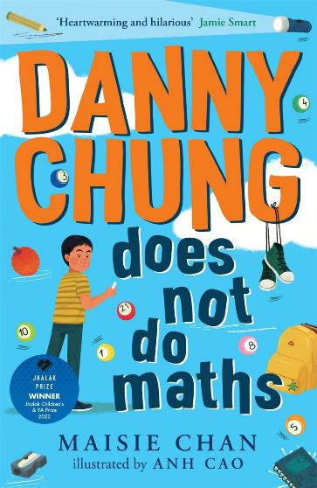

New from Scottish publishers and authors
P4-P7
S1+
S1+
scottishbooktrust.com
Notes:
Danny Chung Does Not Do Maths, Maisie Chan (Picadilly Press)
Danny Chung loves drawing, and he does not like maths. His life is turned upside down when his little, wrinkly, ex-maths champion grandmother from China comes to visit. This is a delightfully heart-warming read!
Robyn, Simon Birks, illustrated by Ege Acvi and lettered by Lyndon White (Blue Fox Comics)
A brilliant story complete with stunning art, Robyn is an exciting introduction to a version of Robin Hood you’ve never seen before. Robyn had to raise herself after being abandoned as a child. Trouble is on the horizon, and she needs to make some unlikely allies if she’s going to survive
The Humiliations of Welton Blake, Alex Wheatle (Barrington Stoke)
A hilarious, charming story from the award-winning Alex Wheatle about the trials and tribulations of teenage life, from crushes to school bullies. Peppered with Star Wars references and laugh out loud, cringeworthy moments that every awkward teen will relate to, this is the perfect read to lighten your mood..

Slide 6
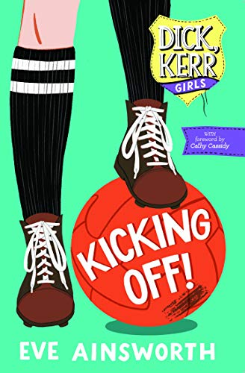
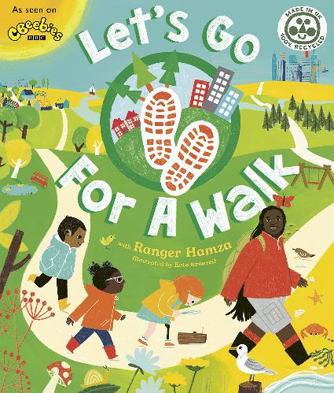
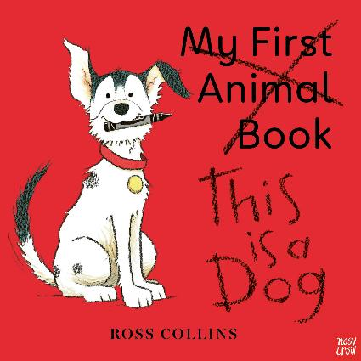
The First Minister’s Reading Challenge Celebration Festival (2021), Part 1
P1-P3
P1-P3
P4-P7
scottishbooktrust.com
Notes:
This is a Dog, Ross Collins (Nosy Crow)
This is a Dog is a colourful and entertaining take on the traditional My First Animal Book. A loveable but mischievous pup decides to steal the limelight – outsmarting all the other animals to make this story all about him! Winner of The Bookbug Picture Book Prize 2021, voted for by children and families across Scotland.
Let’s Go for a Walk, Ranger Hamza (Ivy Kids)
This colourful walking guide is written by CBeebies’ Ranger Hamza from the hit TV show ‘Let’s Go For a Walk’. Perfect for exploring outdoors whatever the location or weather, it’s full of suggestions for things to spot with fascinating facts on every page.
Kicking Off!, Eve Ainsworth (Uclan Publishing)
It’s 1917, and shy teenager Hettie wants to help the war effort. She signs up to work in the local Dick, Kerr & Co. munitions factory, but has no idea she’s about to make sporting history and change her life forever. This is the remarkable story of the Dick, Kerr Ladies team – football’s forgotten legends – brought to life for young readers.

Slide 7
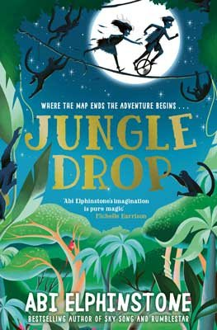
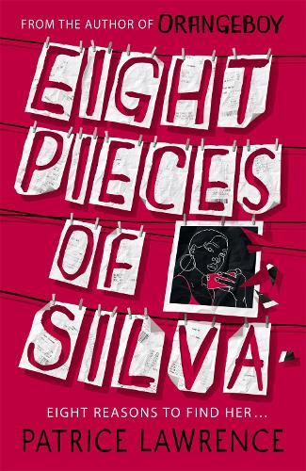
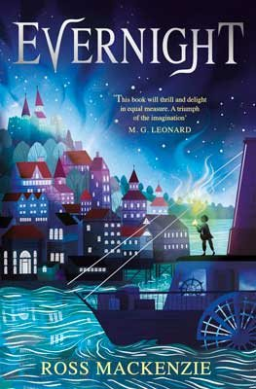
The First Minister’s Reading Challenge Celebration Festival (2021), Part 2
P4-P7
S3+
P6-S3
scottishbooktrust.com
Notes:
Jungledrop, Abi Elphinstone (Simon & Schuster Children’s UK)
Eleven-year-old twins, Fox and Fibber, have been rivals for as long as they can remember. When the twins are whisked off to Jungledrop, a magical Unmapped Kingdom that conjures the weather, things get wildly out of hand… This magical adventure is the second book in the Unmapped Chronicles series, from middle grade favourite Abi Elphinstone.
Eight Pieces of Silva, Patrice Lawrence (Hodder Children’s Books)
When Becks’ mum and stepdad go on their honeymoon to Japan, Becks and Silva are left alone. Until Silva disappears. Can Becks piece together the clues her stepsister had left behind and bring her home? An addictive and gripping mystery from the award-winning author of Orangeboy.
Evernight, Ross MacKenzie (Andersen Press)
Thousands of years ago, the Evernight came to the Silver Kingdom and turned everything to darkness and chaos. It was defeated by the skill and bravery of the Witches. But now the Evernight is about to return…

Slide 8
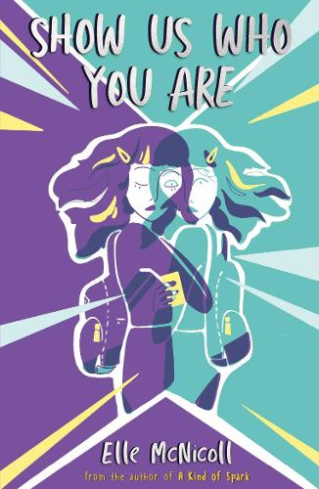
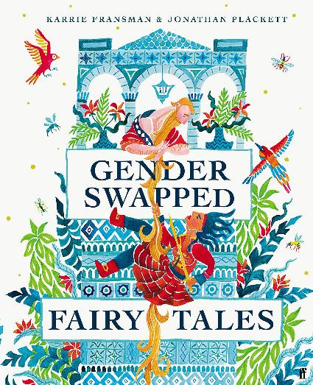
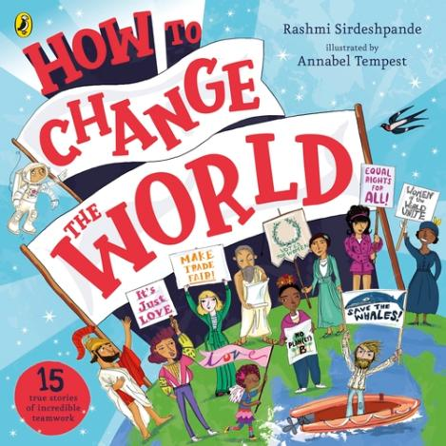
Staff picks: Ella McLellan
P3+
P5-S1
P4-S1
scottishbooktrust.com
Notes:
Gender Swapped Fairy Tales, Karrie Fransman and Jonathan Plackett (Faber & Faber)
Classic fairy tales with one change – the genders are swapped. Jacqueline climbs the beanstalk and Rapunzel lets down his beard.
Show Us Who You Are, Elle McNicoll (Knights Of)
A powerful and moving sci-fi story about being true to yourself and not letting others define your worth.
How to Change the World, Rashmi Sirdeshpande and Annabel Tempest (Puffin)
A wonderful non-fiction book about coming together to change the world, with topics like environmentalism and equal rights.

Slide 9
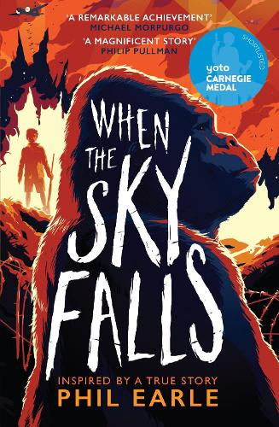
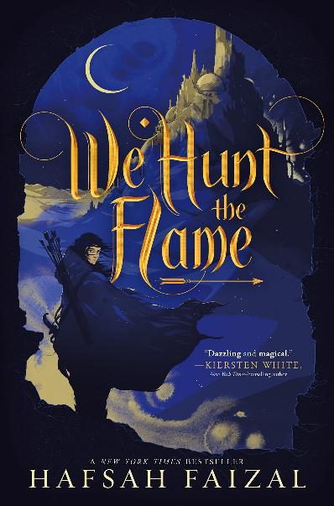
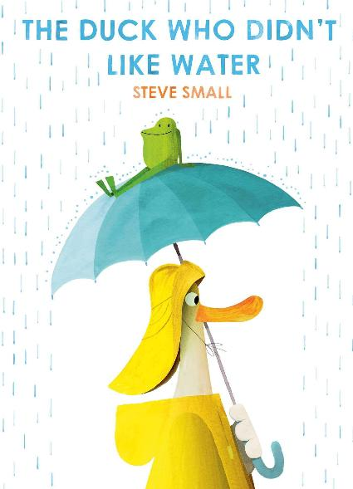
Staff picks: Thomas Jefferson
P1+
P4-P7
S4+
scottishbooktrust.com
Notes:
The Duck Who Didn’t Like Water, Steve Small (Simon & Schuster Children’s UK)
Duck thinks he has everything he needs indoors, until a lost frog hops into his life during a storm and he discovers what’s missing from his life.
When the Sky Falls, Phil Earle (Andersen Press)
When the Sky Falls throws you headfirst into the Blitz with emotional twists and turns and a small cast of characters bound together by the trials of war, anger and loss.
We Hunt the Flame, Hafsah Faizal (Macmillan’s Children’s Books)
World-building at its f inest, weaving vivid descriptions through a rich and absorbing tale, placing the reader at heart of a mysterious world of magic.

Slide 10
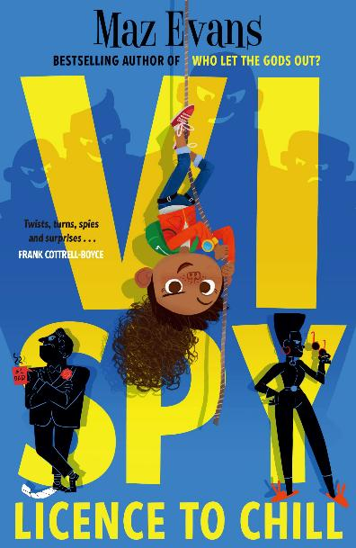
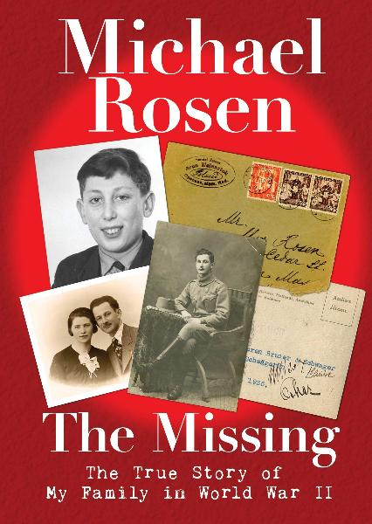
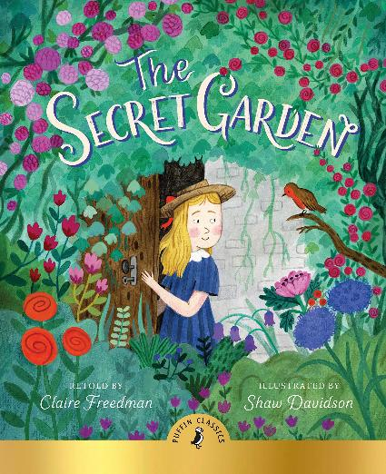
Staff Picks: Signe Rudoviča
P6+
P4-P7
P5-S1
scottishbooktrust.com
Notes:
The Missing, Michael Rosen (Walker Books)
Michael Rosen recalls his family’s history from World War II, and searches through personal recollections and archives for his missing relatives.
The Secret Garden, retold by Claire Freedman, illustrated by Shaw Davidson (Puffin)
An atmospheric re-telling of a childhood classic with beautiful illustrations that invite the reader to look for the secret of the garden.
Vi Spy: License to Chill, Maz Evans, illustrated by Jez Tuya (Chicken House)
This book reads like a fun, fast-paced spy action movie, while also talking about a child’s place in-between separated parents.

Slide 11
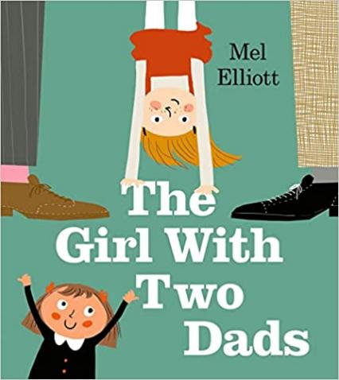
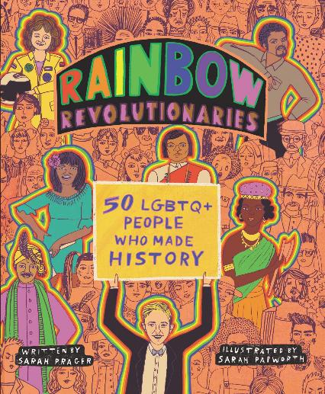
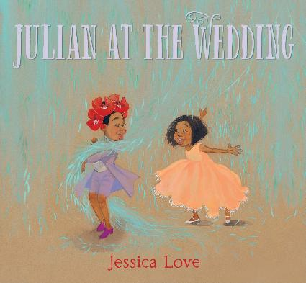
Books about LGBT+ characters and history (Primary)
P1+
P1-P3
P4+
scottishbooktrust.com
Notes:
Juian at the Wedding, Jessica Love (Walker Books)
‘A wedding is a party for love’ explains Julian in this vibrant, celebratory story, taking place at a same-sex wedding, which is refreshingly incidental to the story. This is a book about playfulness, imagination, friendship...and a dog with very muddy footprints! A magical tale to share with children of any age.
The Girl with Two Dads, Mel Elliott (Egmont)
‘How cool!’ thinks Pearl, when she discovers that the new girl in her class has an extra dad instead of a mum. She can’t wait to go round to Matilda’s to find out what life must be like without a boring mum who makes you eat your veggies! But she soon discovers that maybe life isn’t that different with two dads after all...
Rainbow Revolutionaries, Sarah Papworth, illustrated by Sarah Prager (Harpercollins)
Take a journey through the lives of fifty revolutionary LGBTQ+ f igures who made history in this illustrated book. Rainbow Revolutionaries celebrates members of the LGBTQ+ community who have shaped the world and our everyday lives.

Slide 12
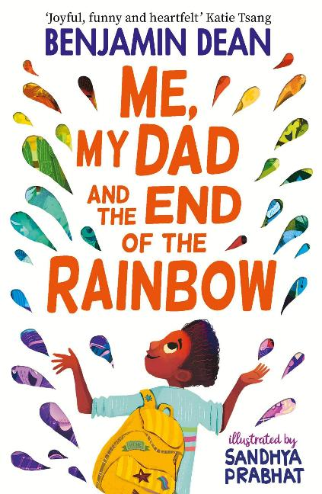

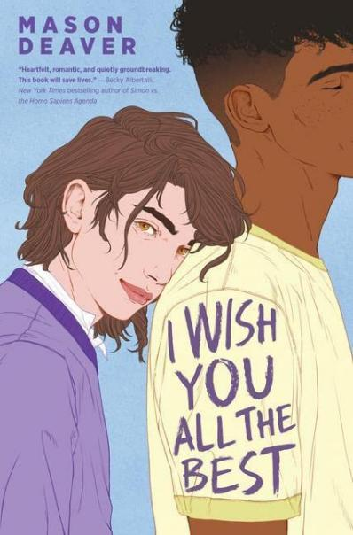
Books about LGBT+ characters and history (Secondary)
P4-S1
S1+
S3+
scottishbooktrust.com
Notes:
Me, My Dad and the End of the Rainbow, Benjamin Dean, illustrated by Sandhya Prabhat (Simon & Schuster Children’s UK)
When Archie can’t understand why his parents have separated, he sets out on a quest with his two best friends to find a way to bring this family back together. This touching debut novel explores the complexity of family, gender and sexuality with kindness and humour.
Proud, compiled by Juno Dawson (Stripes Publishing)
Brilliant, inclusive, hilarious and heart-breaking – this collection of short stories and poetry from LGBTQ+ writers is full of fantastic reads to dip into, each a unique response to the broad theme of pride. Proud includes contributions from Alice Oseman, Dean Atta, Saffa Khan and many more.
I Wish You All the Best, Mason Deaver (Push)
Featuring a non-binary main character, this book tackles themes such as coming out, family, friendship and romance with compassion and heart. I Wish You All The Best is a shining example of how hope can triumph in the face of adversity.

Slide 13
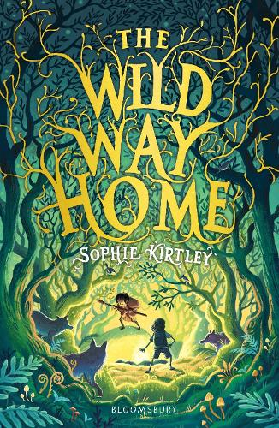
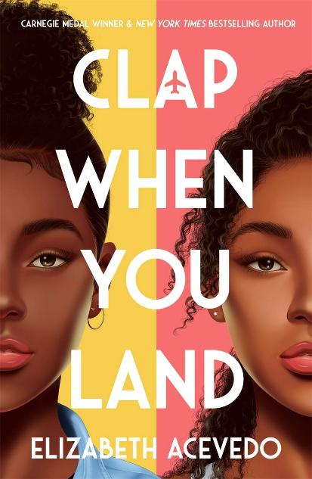
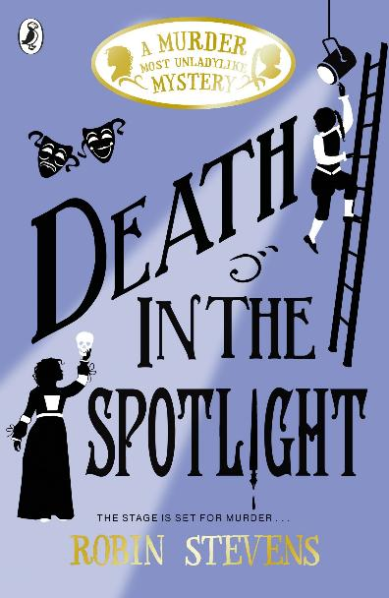
Guest picks: Moira Foster
P4-7
S3+
P4-7
scottishbooktrust.com
Notes:
Moira Foster is an Education Support Officer in Dundee City Council. She promotes reading for pleasure through projects like the Two Moons Festival and Dundee Wishing Tree. She is one of the winners of the Learning Professional Award 2021.
The Wild Way Home, Sophie Kirtley McCaughrean (Bloomsbury Children’s Books)
When Charlie’s wee brother is born with a heart problem, Charlie feels overwhelmed and seeks refuge in the woods where he loves to play. But something has changed. He’s been transported back to the Stone Age! This is a beautifully written book and a wonderful story where courage, kindness and hope ooze out of the pages.
Clap When You Land, Elizabeth Acevedo (Hot Key Books)
Camino, in the Dominican Republic, is devastated by the loss of her father in a plane crash. Yahaira, in the US, is devastated by the loss of her father in the same accident. Neither expect their tragedy will result in the discovery of a secret sister. Written in blank verse for young adults, this is a clever, intense, and thought-provoking read.
Death in the Spotlight, Robin Stevens (Puffin)
If Hazel Wong and Daisy Wells are in the area then murder can’t be far behind. Set in the Rue Theatre in London, clues and red herrings abound. Our intrepid young detectives play their part (quite literally) to perfection in order to solve the crime. Smart, exciting and jolly good fun!

Slide 14
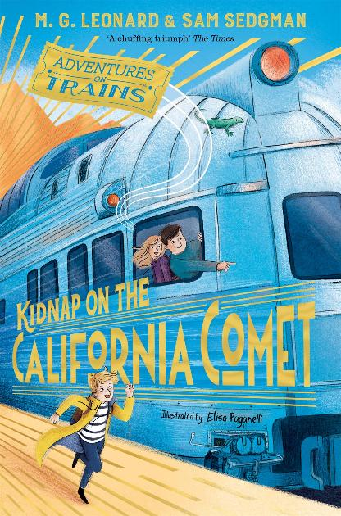
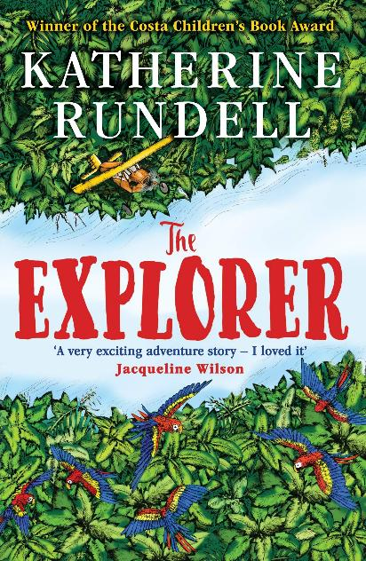
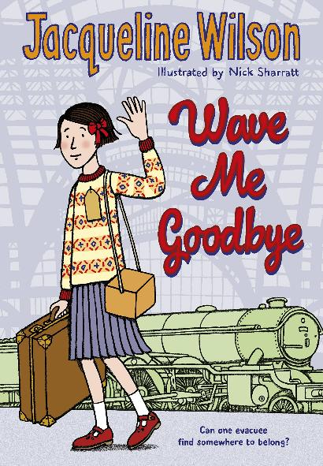
Guest picks: Elaine Hallyburton
P4-P7
P4-P7
P4-P7
scottishbooktrust.com
Notes:
Elaine Hallyburton is a Library Service Manager for Leisure and Culture Dundee. She works in schools and libraries delivering Bookbug Sessions, the Dundee Picture Book Award and lots more. She is one of the winners of the Learning Professional Award 2021.
Kidnap on the California Comet, MG Leonard (Macmillan Children’s Books)
Harrison Beck is invited, along with his Uncle Nat to experience an amazing three-day journey from Chicago to San Francisco. But when the daughter of billionaire August Reza goes missing enroute, Hal finds himself with another mystery to solve. The perfect, classic mystery on the coolest train with lots of twists and turns to keep you guessing.
The Explorers, Katherine Rundell (Bloomsbury Children’s Books)
This story follows four children, lost in the Amazon rainforest after a plane crash. With suspense and drama at every turn, the children meet many dangers as they try to survive in this beautiful yet hostile environment. So vivid are the descriptions that you cannot help but fall in love with their surroundings. This is a great read for the brave explorers, big and small, in us all.
Wave Me Goodbye, Jacqueline Wilson (Yearling)
World War II has begun and 10-year-old Shirley f inds herself on a train with her classmates, heading into the countryside. She arrives at a strange half empty house, owned by the equally strange and reclusive Mrs Waverley. Thrown together by the upheavals of war, they have to adjust quickly to separation from family and friends. A lovely story of friendship, loss and the impact of war.

Slide 15

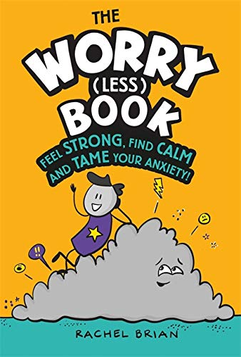
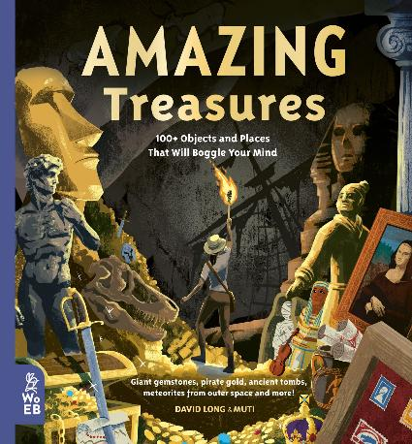
FAQs: Non-fiction recommendations
P3+
P3+
P2+
scottishbooktrust.com
Notes:
Amazing Treasures, David Long and Muti (What on Earth Books)
Written in a narrative style and full of fun facts to dip in and out of, this is a perfect book to try with reluctant readers. The treasures are sure to spark discussion.
My Greatest Ever Football Team Ever, Tom Fordyce (Wren & Rook)
A brilliant, active book with comic book style illustrations and biographies. It also includes female footballers from national teams.
The Worry (Less) Book, Rachel Brian
Great for helping children explore and understand their big feelings and emotions. It’s full of tips to empower young readers and adults alike!

Slide 16
Find out more
Learn about our schools programmes and learning resources
Register for our upcoming CLPL sessions
Find more book recommendations with our book lists or our Bookzilla app
scottishbooktrust.com

Slide 17

Thank you
scottishbooktrust.com
Scottish Book Trust is a national charity changing lives through reading and writing. Registered company SC184248 | Scottish charity SC027669

