Slide 1

Keeping your library up to date
Some ideas for your library space
scottishbooktrust.com

Slide 2


Auditing your books:
Helps ensure your books are up-to-date, engaging and representative
Allows you more space to display your books in an interesting and attractive way
Allows you to involve your pupils – helping engage them with the library space and giving them a sense of ownership
scottishbooktrust.com

Slide 3
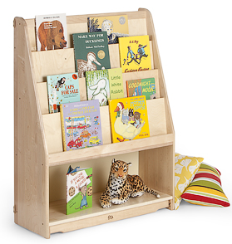
Child height picture books
Allows children to be drawn in by covers
Easier to find than thin spines
Children can see how many books they’ve read
scottishbooktrust.com
Notes:
Image credit: Community Playthings

Slide 4
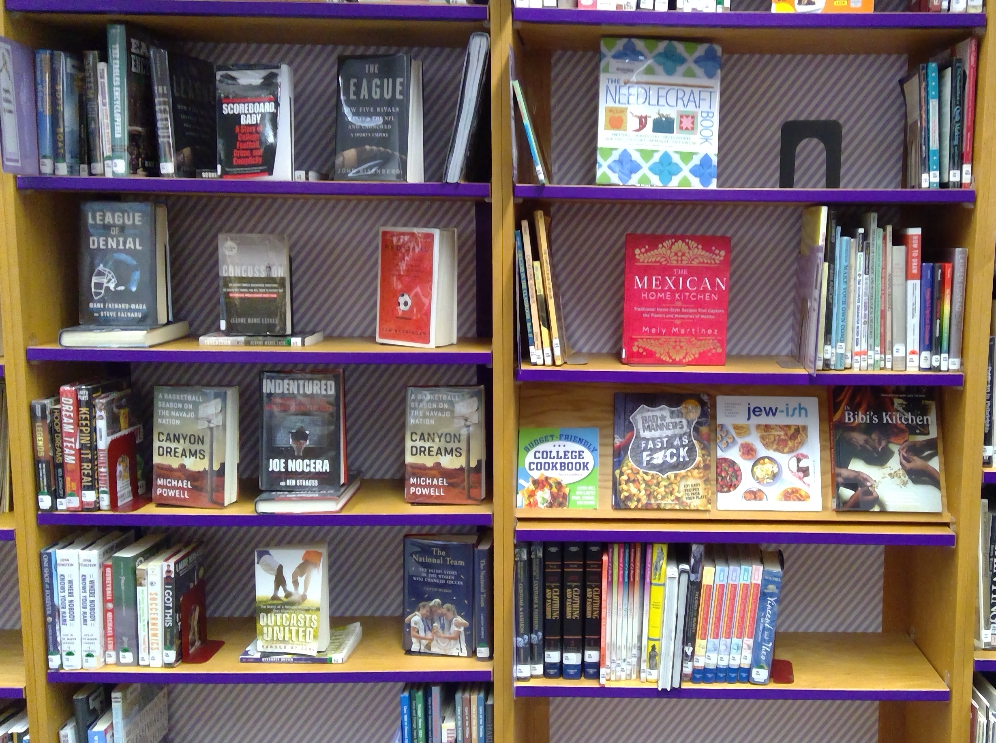
Dynamic shelving
Covers facing out is more engaging
Can spotlight specific books or series
Can add recommendation cards and encourage pupils to leave a review of books they have enjoyed
scottishbooktrust.com
Notes:
Image credit: Don’t Shush Me!

Slide 5
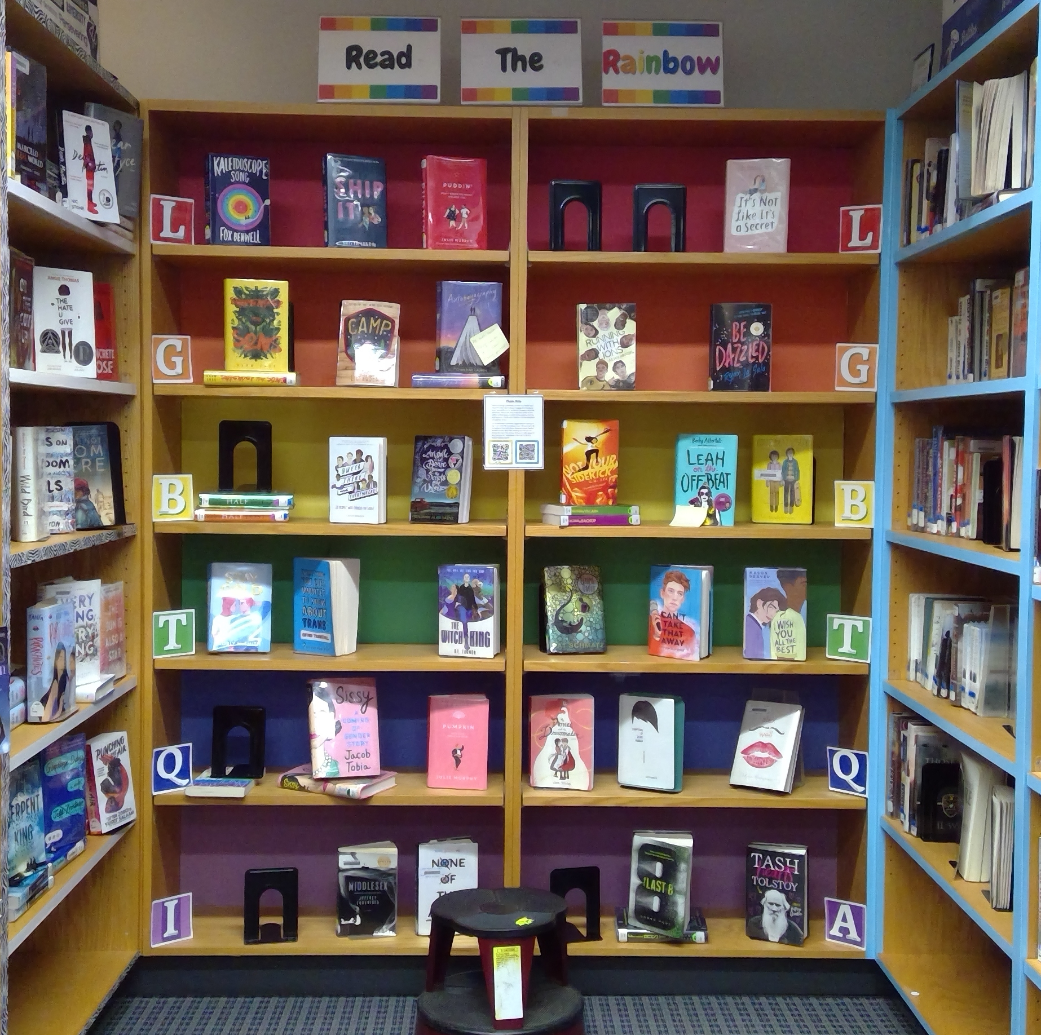
Curated displays
Can tie into a book group or school learning
Helps children easily find books on specific topic
Something new that encourages revisiting the library
scottishbooktrust.com
Notes:
Image credit: Don’t Shush Me!

Slide 6
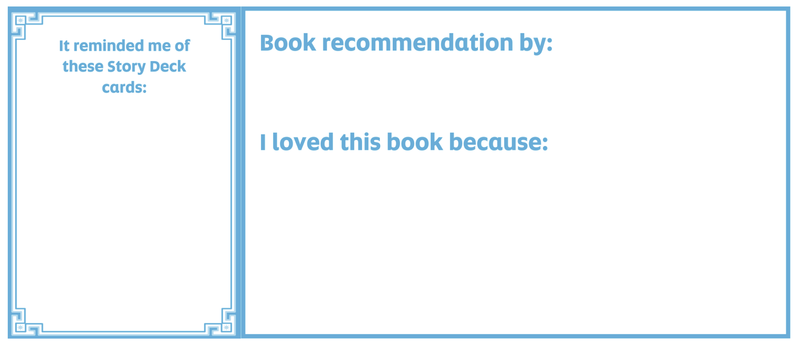




Secondary settings: Story Deck shelf shouters
Allows children to make book recommendations based on Story Deck images
Children can select books by the look of cards they like!
scottishbooktrust.com

Slide 7
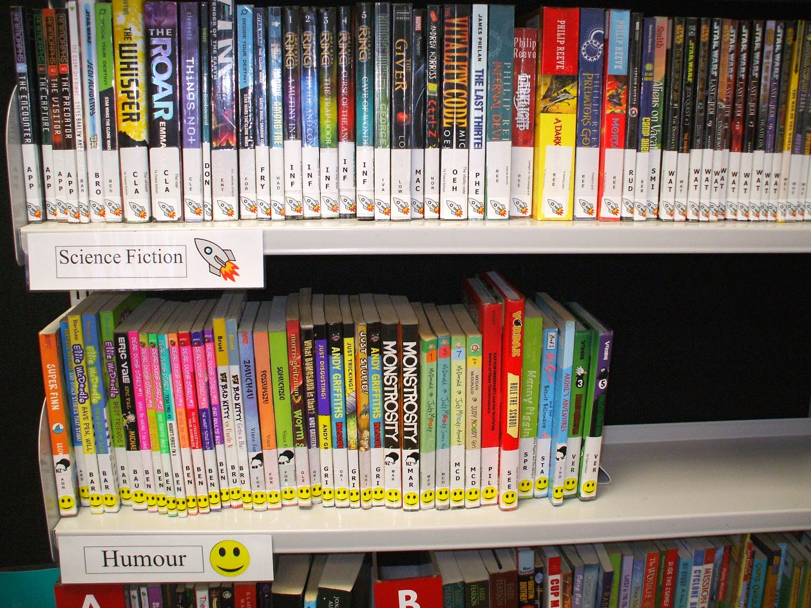
Genre stickers
Allows children to quickly identify genre or mood
Helps children identify what kinds of books they like
scottishbooktrust.com
Notes:
Image credit: Good Keen Librarian

Slide 8
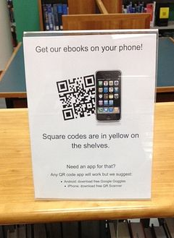
QR Codes
Allows you to spotlight specific eBook/audiobooks online
Especially good if you don’t have physical devices or audiobooks on CD!
Saves space
scottishbooktrust.com
Notes:
Image credit: Pinterest

Slide 9

Thank you
scottishbooktrust.com
Scottish Book Trust is a national charity changing lives through reading and writing. Registered company SC184248 | Scottish charity SC027669

