Slide 1
Book Discovery Guide
Issue 8: June 2025
scottishbooktrust.com

Slide 2
How to use this PowerPoint
This PowerPoint version of the Book Discovery Guide (Issue 8) allows you to share the guide with your colleagues. Each slide will contain the covers and, where applicable, age ratings of the books. Click “Notes” at the bottom of your window to read the blurbs of each book.
scottishbooktrust.com

Slide 3
What is Book Discovery Guide? (1)
Book Discovery Guide is our guide to help you find high-quality contemporary books for pupils of all ages and reading levels. Each issue contains our top picks across themes, staff picks, guest recommendations and responses to frequently asked questions.
This icon indicates you can find a discussion guide for this title on our website.
scottishbooktrust.com
Notes:
Discussion guides can be found at: https://www.scottishbooktrust.com/learning-resources/teen-book-discussion-guides

Slide 4
What is Book Discovery Guide? (2)
With all of our resources, we highly recommend that you read the book before using it with your class and use your best judgement on whether teaching about this topic is appropriate for the children in your class.
This icon indicates you should check the Notes for content warnings.
scottishbooktrust.com

Slide 5
The importance of using contemporary books in your classroom:
More representative - and children are more motivated to read when texts contain characters like them
Read about a wide range of experiences relevant to today (for example, climate change, refugee crisis, technology and social media)
Language is up-to-date, making it easier to follow
See “Notes” of this slide for more information
scottishbooktrust.com
Notes:
To find out more information on the importance of using contemporary books in your classroom or school, we recommend the following:
National Literacy Trust’s “Children and young peoples’ reading in 2023” report: https://literacytrust.org.uk/research-services/research-reports/children-and-young-peoples-reading-in-2023/
Scottish Book Trust’s article “How teachers can put the right book in the right hand”: https://www.scottishbooktrust.com/articles/how-teachers-can-put-the-right-book-in-the-right-hand

Slide 6
New from Scottish publishers and authors
P6+
P3+
P5+
scottishbooktrust.com
Notes:
New from Scottish publishers and authors Ice Cream Boy by Lindsay Littleson (Floris Books) A heart-warming novel set in Glasgow. The story follows Luca Verani who dreams of taking over his family’s ice cream café. When his aunt announces she's selling the struggling business and Luca realises that his beloved nonna's memory is disappearing, everything starts to fall apart. Discussion guide here: https://www.scottishbooktrust.com/learning-resources/teen-book-discussion-guides Content note: contains depictions of discrimination and racism I Don’t Do Mountains by Barbara Henderson (Scottish Mountaneering Press) During a three-day expedition into the Cairngorms, bookworm Kenzie’s imagination is set alight by stories of ancient magic – and by morning, the group leader has disappeared… A high-stakes eco-adventure set against the backdrop of the Scottish wilderness. A Flash of Neon by Sophie Cameron (Little Tiger) Meet Laurie who lives in Inverness with her 2 Mums and her student brother, Joel. When Neon enters her life in person, no one is more surprised than Laurie because until he arrived, he had been purely and simply a figment of her imagination. Neon's arrival helps Laurie to take stock of her friendships and consider what it means to be a good friend.

Slide 7
Bookzilla Book of the Month
Each month we run Bookzilla Book of the Month, where we give you the change to win some of the most exciting new Scottish publications for children and young adults!
P3+
P6+
P6+
scottishbooktrust.com
Notes:
Bookzilla Book of the Month Maisie vs Antartica by Jack Jarman (Nosy Crow) Filled with humour, heart and a touch of the supernatural, this first book in a brilliant new series takes you on a non-stop adventure in Antarctica, perfect for the most intrepid of readers! Maisie thinks her dad is the most boring person in the world. There, she realises he's not as ordinary as she thought, and he has hidden talents that help them survive. My Name is Samin by Fidan Meikle (Floris Books) A moving debut novel that explores themes of loss, friendship and immigration. Samim is thirteen years old, a gifted chess player and a refugee. Told though a non-linear narrative, we join Samim on his heart-breaking yet hopeful journey as he flees Afghanistan in search of safety. Discussion guide here: https://www.scottishbooktrust.com/learning-resources/teen-book-discussion-guides Content note: contains depictions of discrimination and racism Skyfleet: March of the Mutabugs by Victoria Williamson (Tiny Tree) Twelve-year-old Amberley has faced incredible challenges since the crash that took her parents and paralysed her legs. Now, with her best friend Ricardo about to be sent away and a swarm of mutated insects closing in on the Skyfleet base, the stakes have never been higher. Now, Amberley and Ricardo must confront the deadly swarm and save their home, discovering their inner strength and the true meaning of friendship along the way.

Slide 8
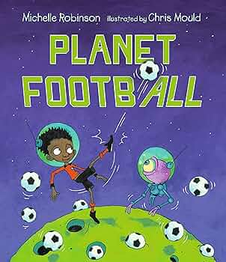
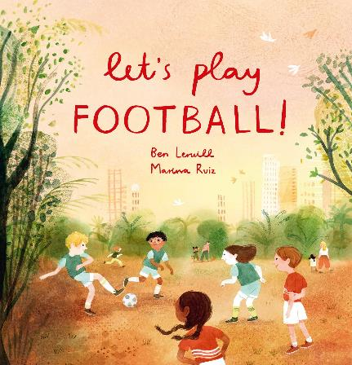
What to read if they like… football! (1)
EY+
EY+
P2+
scottishbooktrust.com
Notes:
What to read if they like… football! Let’s Play Football! by Ben Lerwill (Welbeck Childrens Books) This uplifting picture book celebrates how football can be played by everyone anywhere (even in space!). Celebrating the accessibility of the world’s favourite support, this is a joyful and inclusive story that will make you want to find a ball and get outside! Planet Football by Michelle Robinson (Walker Books) In this fun, rhyming, football meets aliens picture book adventure, mega footy fan, Jackson, becomes an international star with his ‘out of this world’ kick which lands ALL of Earth’s footballs on the moon! With the World Cup in jeopardy, Jackson blasts into space on a ball rescue mission, where he discovers that the moon folk are mega football fans too! A joyful tale of sharing your passion and playing with friends. Zac and Jac by Cathy Jenkins (Cando) Supported by the educational charity Show Racism the Red Card. Nine-year-olds Jac and Zac are best friends who both love football and love their dads, but when Jac discovers that his father is racist he is horrified and has no idea how to change his entrenched views and attitudes. There are excellent discussion points and activities included in this important book.

Slide 9
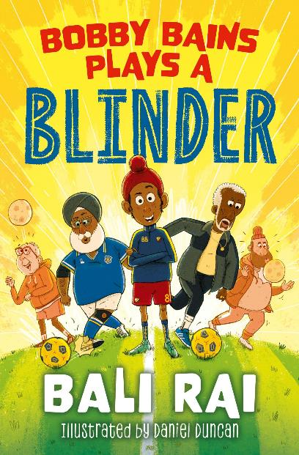
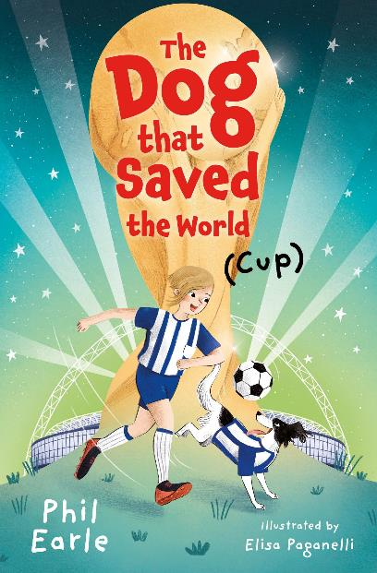
What to read if they like… football! (2)
P4+
P4+
P1+
scottishbooktrust.com
Notes:
What to read if they like… football! Bobby Bains Plays a Blinder by Bali Rai (Barrington Stoke) Bobby Bains is a young Sikh who loves football and helping people. Whilst helping his mum at the local food bank, he meets an older man called Trevor who seems lonely. Bobby wants to help him and is convinced that Trevor would get on well with his grandad, Nana-ji because of their mutual love of football and reggae. Bobby hatches a plan to help both Trevor and Nana-ji enjoy football again: a walking football tournament! The Dog that Saved the World (Cup) by Phil Earle (Barrington Stoke) This novel is inspired by the theft of the World Cup trophy in 1966 but brought into a contemporary setting. We meet Pickles the dog, and Elsie. Elsie is football obsessed and has a chance to play football at Wembley during half time. However, when her Dad loses his job, Elsie's dreams seem to be slipping away. It's a heartwarming novel which sensitively deals with topics of poverty and homelessness. Bad United: Just for Kicks by Louise Forshaw (Stripes Publishing) In this graphic novel we meet Hoof the Unicorn who LOVES football but some of his on-pitch antics see him kicked off his team for not being good enough. He's feeling pretty terrible until he finds a new team of football 'misfits' in Bad United, who encourage their players to embrace their unique skills! A fun, comic style story of inclusivity and believing in yourself for early and less confident readers.

Slide 10
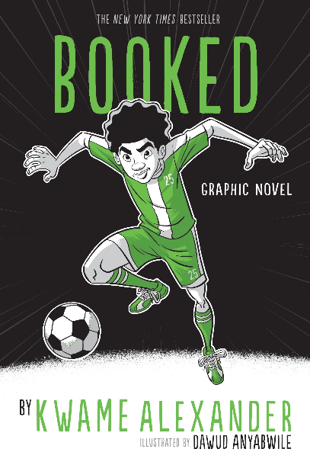
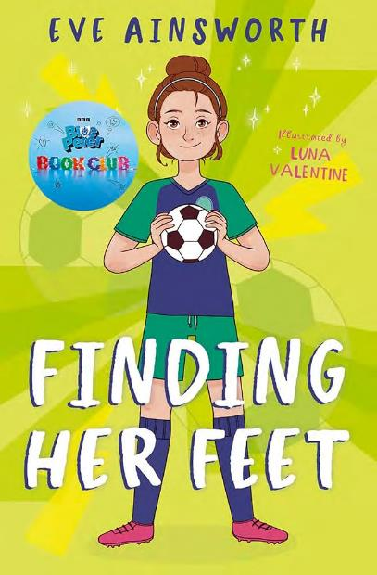
What to read if they like… football! (3)
P5+
P5+
P5+
scottishbooktrust.com
Notes:
What to read if they like… football! Booked: Graphic Novel by Kwame Alexander (Andersen Press) Follow soccer-obsessed twelve-year-old Nick as he navigates the highs and lows of sports, a new crush, standing up to a bully, and, most challenging, his parents’ separation. Helping him along are his best friend and fellow soccer player Coby and The Mac, an ex-rapper librarian. This is a bold and heartfelt graphic novel with powerful and relatable themes. Finding Her Feet by Eve Ainsworth (Barrington Stoke) On starting secondary school Lily struggles to overcome her anxiety and navigate changing friendships. But encouraged by her PE teacher she discovers a talent for football that helps her to find her place. Interspersed with tales from the history of women's football, this super-readable title is filled with hope and inspiration. Key Player by Kelly Yang (Knights Of) Desperate to achieve the grades she needs to attend journalism camp Mia plans to track down the Chinese women's football team for an exclusive interview in the run up to the Women's World Cup. Caught between her conflicting loyalties to her native and adopted countries, with the impending match against the USA, Mia's tenacious spark challenges preconceptions about identity, success and the meaning of sport.

Slide 11
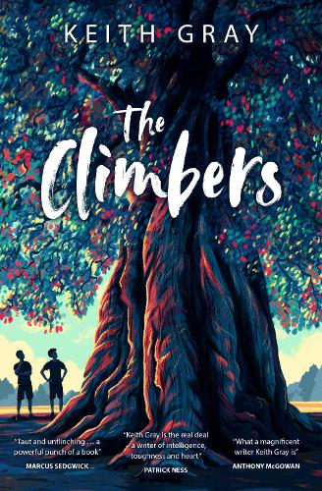
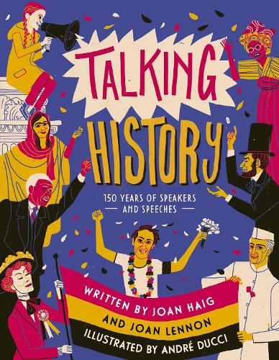
Great books for book groups (1)
We've hand-selected books that are great for running a book group with your pupils. Each of these titles has a discussion guide with ready-to-go discussion questions, creative writing prompts and recommendations of what to read next.
P4+
P6+
S1+
scottishbooktrust.com
Notes:
Great books for book groups We've hand-selected books that are great for running a book group with your pupils. Each of these titles has a discussion guide with ready-to-go discussion questions, creative writing prompts and recommendations of what to read next. Talking History by Joan Haig and Joan Lennon (Templar Publishing) This beautifully illustrated non-fiction book is filled with profiles on some of the most influencial activists and speakers that the world has to offer. Dive into the speeches of Harvey Milk, Malala Yousafzai and Greta Thunberg to explore topics including colonialism, climate change, women's rights and more! The Climbers by Keith Gray (Barrington Stoke) This moving and hilarious story follows the rivalry between Sully and Nottingham - two young boys desperate to be the best tree climbers in their small town. A masterful examination of friendship, internal battles and ambition. Know My Place by Eve Ainsworth (Barrington Stoke) This accessible read from Barrington Stoke is a poignant look at growing up in the care system. Amy has been in foster care since she was six and doesn't feel like she belongs anywhere. Now, she's with the Dawsons - will they be able to earn her trust? Will she ever be able to feel settled?

Slide 12
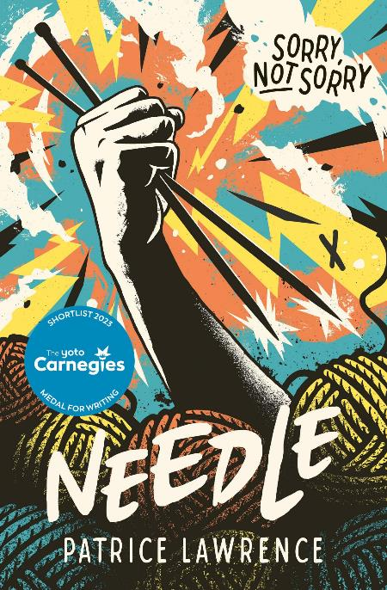
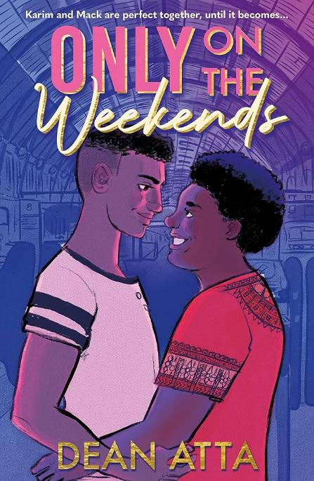
Great books for book groups (2)
We've hand-selected books that are great for running a book group with your pupils. Each of these titles has a discussion guide with ready-to-go discussion questions, creative writing prompts and recommendations of what to read next.
S1+
S1+
scottishbooktrust.com
Notes:
Great books for book groups We've hand-selected books that are great for running a book group with your pupils. Each of these titles has a discussion guide with ready-to-go discussion questions, creative writing prompts and recommendations of what to read next. Needle by Patrice Lawrence (Barrington Stoke) This highly readable book follows one day in the life of Charlene, a Black teen growing up in foster care. When her foster brother destroys her knitting, she stabs him with a knitting needle. Now on the run, Charlene is torn between a racist justice system and her family. Content note: contains depictions of racism and violence Only on the Weekends by Dean Atta (Hodder Children’s Books) It's hard not to fall in love with this novel-in-verse. Hopeless romantic Mack has a serious crush on Karim, the most popular boy in school. The only problem is Karim is not ready to come out as gay, and Mack isn’t keen on being anybody’s secret. A fresh and layered look at relationships, first love and sexuality.

Slide 13
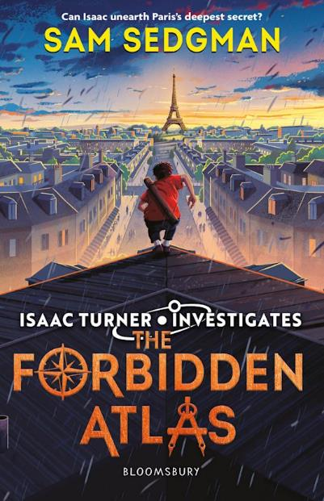
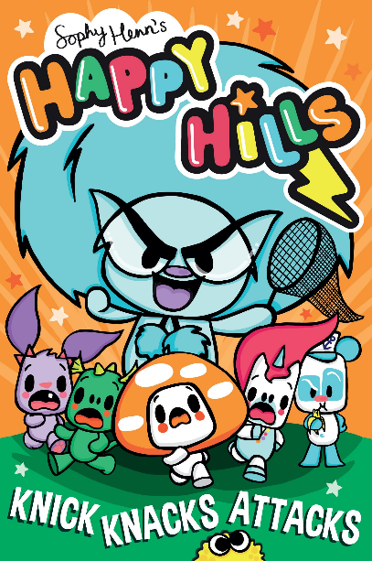
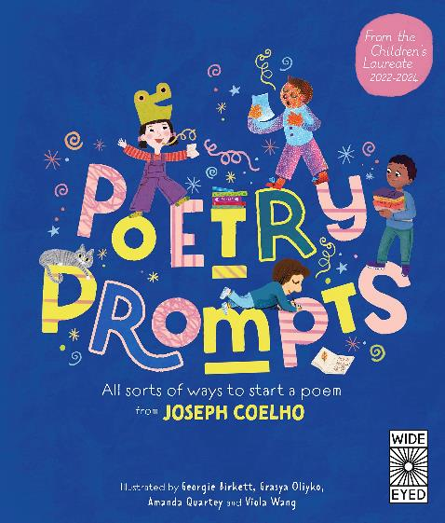
Authors Live and Events
Catch up on over 40 events from your favourite authors on Authors Live on Demand!
P4+
P6+
P4+
scottishbooktrust.com
Notes:
Authors Live Catch up on over 40 events from your favourite authors on Authors Live on Demand!
The Forbidden Atlas by Sam Sedgman (Bloomsbury Children’s Books) Isaac and Hattie have been invited to a high-profile event at the French National Archives in Paris. But as Isaac prepares to make his speech, the lights go out and a single shot is fired. As they investigate, Isaac and Hattie are pulled into an underground world, searching secret and forgotten places for a stolen letter, a missing sister and a map that will unearth a long-buried secret… Happy Hills: Knick Knak Attack by Sophy Henn (Simon & Schuster) Meet the friendly and not-so-friendly residents of Happy Hills, a place where anything can happen and always does! The wacky residents of Happy Hills have caught the attention of villainous KNICK KNACKS. He's going to swipe, sneak and snatch himself a whole collection of new friends - whether they like it or not! Poetry Prompts by Joseph Coelho (Wide Eyed Editions) Each fun and engaging prompt for writing a poem helps children discover how to write poems and then read them out loud. This is a book to build confidence and literacy skills through channelling children's imaginations. This is a book for the whole family to enjoy, bright, cheerful but cool illustrations will appeal to children of all primary ages.

Slide 14
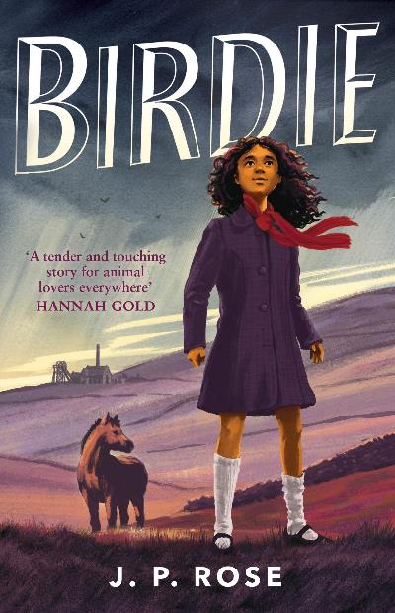
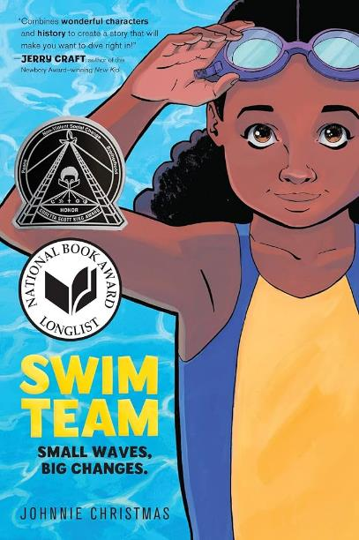
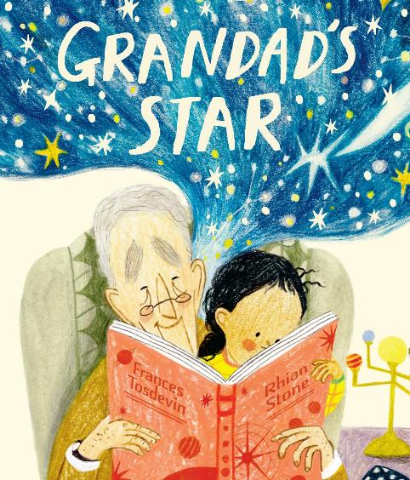
Staff picks: Emily Ilett
EY+
P5+
P4+
scottishbooktrust.com
Notes:
Birdie by J.P. Rose (Andersen Press) Set in the 1950s about Birdie, who is sent to live with her great aunt in the Yorkshire Dales, leaving behind her friends at the home for mixed race children where she’s been brought up. Birdie is treated as an outsider by her aunt and faces racism from the villagers. One day Birdie discovers Mr Duke, the last pit pony in the village. It’s the beginning of a remarkable friendship. Discussion guide here: https://www.scottishbooktrust.com/learning-resources/teen-book-discussion-guides Content note: contains depictions of discrimination and racism Swim Team by Johnnie Christmas (Harperalley) Bree is forced to face her fear of swimming when she moves to a new school in Florida. Her older neighbour Etta teaches Bree to swim, as well as teaching her about the generational impact of segregation and the structural inequality within the public pool system. Bree finds strength and community through swimming and joins the school swimming team: the Manatees. Will they make it to the state championship? Grandad’s Star by Frances Tosdevin (Rocket Bird Books) A young girl whose relationship with her famous astronomer Grandad changes when he starts to forget things. As his memory starts to fade, the young girl teaches him the names of stars that he used to tell her about. Their changing relationship is sensitively portrayed showing the challenges alongside the warmth and the love.

Slide 15
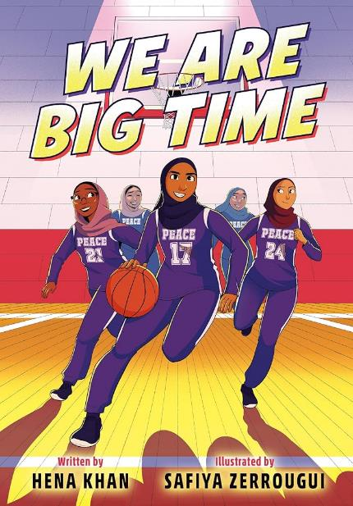
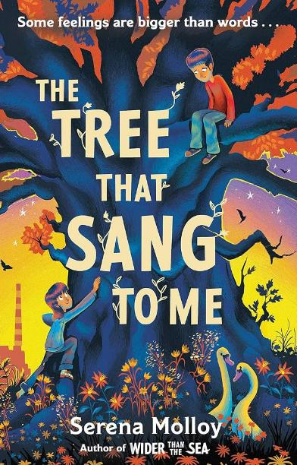
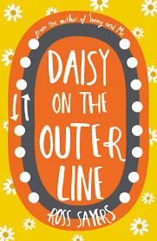
Staff picks: Jen Grainge
P4+
P5+
S3+
scottishbooktrust.com
Notes:
We Are Big Time by Hena Khan (Random House) This fast-faced and energetic graphic novel follows teenager, Aliya, as she struggles with the move to a new school where she joins the all-girls Muslim basketball team. Based on a true story- this team are out to prove that they are more than their religion. The Tree That Sang to Me by Serena Molloy (Hodder Children’s Books) A beautiful verse novel suitable for Dyslexic readers. An unexpected breakdown of his family unit leaves Kai feeling lost and alone. He turns to nature for solace, where an unexpected friendship helps him to see things differently. Daisy on the Outer Line by Ross Sayers (Gob Stopper) A teenage time travel adventure of self-discovery. This dark yet witty novel, written in Scots, follows flawed teenager, Daisy, as she is forced to face herself, her grief and her struggles with mental health. Heart-breaking and funny in equal measure.

Slide 16
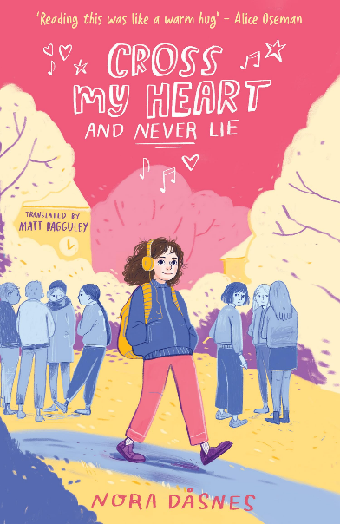
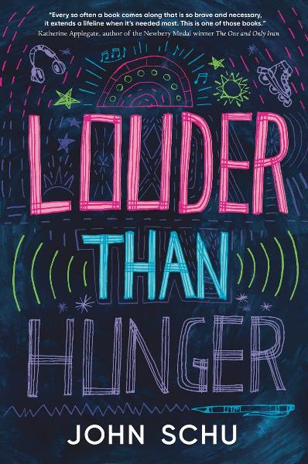
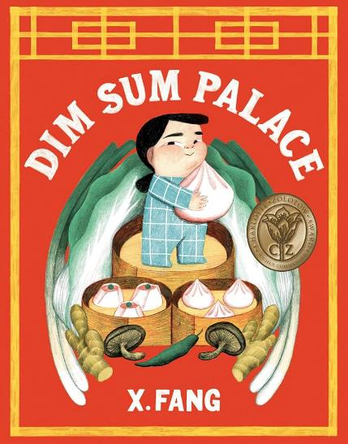
Staff picks: Catherine Wilson Garry
P1+
P6+
S1+
scottishbooktrust.com
Notes:
Dim Sum Palace by X. Fang (Pushkin Children’s Books) When a little girl hears she's visiting Dim Sum Palace tomorrow, her dreams are filled with bao, buns and all sorts of delicious dumplings. This beautifully illustrated picture book is full of details and funny moments. Just be warned – it will make you crave a plate of dim sum! Cross My Heart and Never Lie by Nora Dåsnes (Farshore) This bold and bright graphic novel follows 12-year-old Tuva as she starts a new year at school. Unfortunately, her friends have split into Team Linnea and Team Bao – those in a rush to become teenagers, and those who still hate the idea of crushes and growing up. With hilarious illustrations, this beautiful coming-of-age story perfectly captures the moment before becoming a teenager. Louder Than Hunger by John Schu (Walker Books) Jake loves skating and musicals, reading comics and spending time with his grandmother. However, Jake also has an eating disorder, and he needs to spend time in inpatient care. This novel-in-verse expertly uses font and layout on the page to let us into Jake's world, his mind and his recovery. Content note: contains depictions of disordered eating

Slide 17
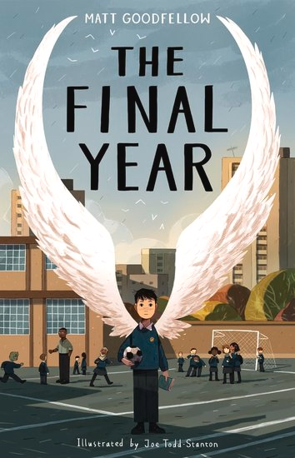
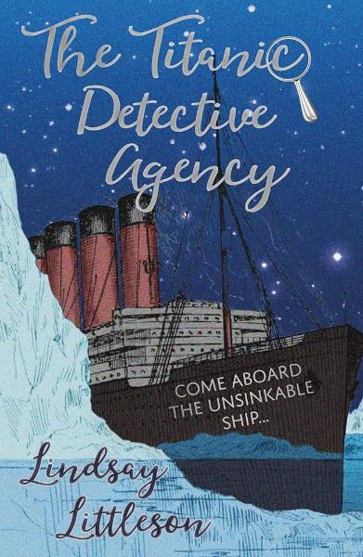
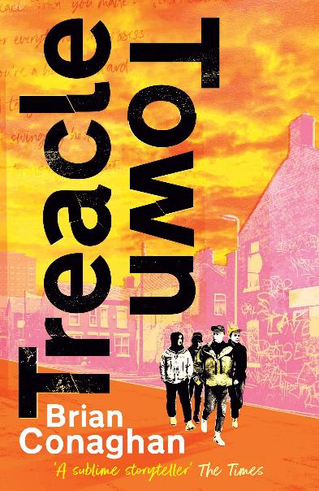
Guest recommendations: Reading Champs
S2+
P5+
P4+
scottishbooktrust.com
Notes:
Treacle Town by Brian Conaghan (Andersen Press) Con O’Neill is stuck in a world of brutal gang violence, sectarian vendettas and personal tragedy. No money. No prospects. A social design that entraps inhabitants of Treacle Towns up and down the country. Connor is desperate to get away. When he stumbles upon the new world of slam poetry, Con senses a glimmer of hope – a hope that might just lead to his escape from Treacle Town. But it won’t be easy. The Final Year by Matt Goodfellow (Otter-Barry Books) Life can be tough in your last year of primary school. Nate is ready for it all, knowing his best friend PS is at his side. But when they are put in two different classes and PS finds a new friend in Turner, the school bully, Nate's world turns upside-down. His new teacher, Mr Joshua, sees a spark inside of Nate that’s lit by his love of reading and writing. But with so much working against him, and anger rising inside him, will this be enough? The Titanic Detective Agency by Lindsay Littleson (Pokey Hat) A captivating and heartwarming mystery adventure that brings to life some of the stories of those children on board the Titanic. It effortlessly blends historical fiction with a modern detective twist, all while delivering an engaging mystery that will appeal to readers of all ages.

Slide 18
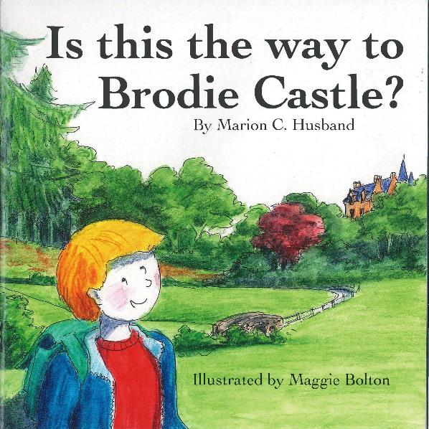
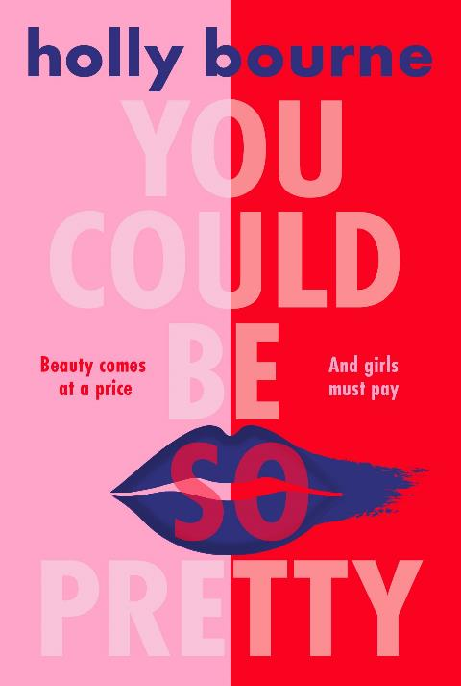
Guest recommendations: Reading Champs (2)
P1+
S1+
scottishbooktrust.com
Notes:
Is This the Way to Brodie Castle? by Marion C. Husband (Marion C. Husband, Self-published) From a dream comes an amazing adventure which will take you all around Scotland as young hero Brodie looks for a castle and a crown. Brodie enjoys a skip and a twirl at a ceilidh and afternoon tea with the king. This is a story of friendship, kindness and hope, and adventures we would all like to go on! You Could Be So Pretty by Holly Bourne (Usbourne Publishing) A powerful, dystopian novel full of twists and turns and with such an unexpected ending you are bound to be shouting from the rooftops! An essential read for ALL twenty-first century teenagers – including boys! A relevant reminder to resist societal pressure and to stand up for who you are. Content note: contains depictions of sexism, sexual assault and disordered eating

Slide 19
For more recommendations
Download our free Bookzilla app to find book recommendations, challenges and dares
Browse the Book lists on our website, which you can filter by age, topic and genre
Enter our Bookzilla Book of the Month competition to win a copy of our monthly pick
Learn more about our upcoming CLPL sessions, including our Book Discovery Sessions, where we share some of our favourite texts on a specific topic
scottishbooktrust.com

Slide 20
Thank you
scottishbooktrust.com
Scottish Book Trust is a national charity changing lives through reading and writing. Registered company SC184248 | Scottish charity SC027669

